Slide 1





NAPCRG PBRN Conference
June 2025
Comparing Long-Term Buprenorphine and Illicit Opioid Use by Home, Office, or Telehealth Induction
Donald Nease, MD
Director of Community Engagement | Colorado Clinical & Translational Sciences Institute -
Professor and Green-Edelman Chair for Practice-Based Research| University of Colorado Dept of Family Medicine
Linda Zittleman, MSPH
Senior Instructor
Director of High Plains Research Network
University of Colorado Dept of Family Medicine

Slide 2
Disclosures
I have no conflicts of interest to disclose.
Notes:
Focuses on the effect the induction setting/approach experience can have on long-term treatment outcomes
Aim 1: Compare treatment engagement in MAT in patients receiving home induction (asynchronous, unobserved) versus office induction (synchronous, observed), measured by:
Number of days of buprenorphine treatment in the first 30, 90, and 270 days from induction, measured by initial prescription and refills.
Number of days of use of illicit opioids between day one and day 270 of treatment, measured through self-report and confirmed by urine toxicology testing.
Percent of patients in each group who took buprenorphine on ≥80% of the days between day one and day 270.
Percent of patients in each group using illicit opioids on <10% days from induction to nine-month follow-up.
Quality of life and social functioning at baseline and 30, 90, and 270 days from induction.
Aim 2: Identify clinically relevant practice and patient characteristics associated with successful long-term treatment as measured by the proportion of patients taking their buprenorphine prescription on ≥80% days and/or using illicit opioids on <10% days from induction to nine-month follow-up.

Slide 3
HOMER Study Team
Augusto Basterrechea (Study Buddy)
David Bauerly (CPAC)
Liz Bell (Study Buddy)
Alicia Brooks (Study Buddy)
Natalie Buys (Contract Manager)
Fred Crawford (CPAC)
Kristen Curcija (Study Buddy/Mngt)
Miriam Dickinson (Biostatistician)
Andrea Dreckman (CPAC)
Maret Felzien (CPAC)
Doug Fernald (co-Investigator)
Nicole Gastala (Consultant)
Tristan Hall (Analyst)
Lori Heeren (CPAC)
Camille Hochheimer (Analyst)
Vivian Jiang (Researcher)
Bethany Kwan (co-Investigator)
Joe LeMaster (NRN site PI)
Cory Lutgen (NRN Project Mngt/Study Buddy)
Brian Manning (Researcher)
Jammie Martinez (CPAC)
Melanie Murphy (CPAC)
Don Nease (co-Principal Investigator)
Ben Sofie (Project Manager)
Elizabeth Staton (Technical Writer)
Jack Westfall (co-Investigator)
David Wolff (CPAC)
Linda Zittleman (co-Principal Investigator)
Erin Zook (CPAC)
And former
team members:
Jill Alai (SB)
Jennifer Ancona (SB)
Emily Brown (CPAC)
Jen Carroll (NRN site PI)
Sadie Fritzler (SB)
Sindy Gonzalez (SB)
Daijah Jones (SB)
Ashley Kucera (SB)
Marlayna Martinez (SB)
Norah Sanchez (CPAC)
Christin Sutter (SB)
CPAC = Community and Patient Advisory Council; SB = Study Buddy)
Notes:
Listed alphabetically. Intentionally mixed CPAC into list vs separate list. No degrees listed.

Slide 4

Context and Rationale for this study (in 2018!)
“Induction” = clinical term for the initial phase of treatment with medication for opioid dependence or use disorder (MOUD).
  Patient stops taking opioids, enters into mild to moderate withdrawal
  Symptoms assessed (clinical or subjective opiate withdrawal scale)
  Timing of first dose of medication is determined
  Subsequent assessment + medication dose repeated 1-3 times
Primary care practices can provide treatment for OUD with buprenorphine.
Guideline: Patients receive induction at the office! But induction at home* and via telehealth were being tried & documented.
Differences between what occurs during an induction at the office, at home, or via telehealth might influence a person’s experience, motivation to stay in treatment, and long-term outcomes.
Clinicians and staff had questions about the different induction approaches (“Which one should I use?”) and strong beliefs about which one to use despite a lack of evidence (“I ONLY do <insert type> inductions!”)
*Home or location of patient’s choice other than the practice
Notes:
I re-ordered the points on this slide. This flow works best IMO.
I changed the bullet “Differences between what occurs…” back to a statement versus a question. This was a premise stated in the grant application. We think there are differences. And these differences made clinical teams’ questions meaningful and legit and other clinicians’ strong beliefs about the superiority of one method very frustrating. If presented as a question, I would expect that the study would report on what patients experienced during induction (# of contacts, anxiety, etc.), but we didn’t do that.

Slide 5
Home vs Office vs Telehealth for Medication Enhanced Recovery
Primary Questions:
    Do treatment outcomes differ by induction method? (Is one MOUD induction method best?)
    Is there a set of characteristics that I can use to help determine which induction method will be best for this patient in front of me right now?
Funded by Patient Centered Outcomes Institute (PCORI)
3-year study (July 2020 – June 2023) extended to April 2025
Partnered with a council of clinicians, patients, and other community members to guide all aspects of study
Opportunity for primary care practices to fill the gap in the evidence, inform and advance primary care, and improve patient care
Notes:
Focuses on the effect the induction setting/approach experience can have on long-term treatment outcomes
Aim 1: Compare treatment engagement in MAT in patients receiving home induction (asynchronous, unobserved) versus office induction (synchronous, observed), measured by:
Number of days of buprenorphine treatment in the first 30, 90, and 270 days from induction, measured by initial prescription and refills.
Number of days of use of illicit opioids between day one and day 270 of treatment, measured through self-report and confirmed by urine toxicology testing.
Percent of patients in each group who took buprenorphine on ≥80% of the days between day one and day 270.
Percent of patients in each group using illicit opioids on <10% days from induction to nine-month follow-up.
Quality of life and social functioning at baseline and 30, 90, and 270 days from induction.
Aim 2: Identify clinically relevant practice and patient characteristics associated with successful long-term treatment as measured by the proportion of patients taking their buprenorphine prescription on ≥80% days and/or using illicit opioids on <10% days from induction to nine-month follow-up.

Slide 6



Setting and Participants
Eligible practices:
  Primary care practices from the State Network of Colorado Ambulatory Practices and Partners and the American Academy of Family Physicians National Research Network at the DARTNet Institute practice-based research networks
  At least one prescriber treating patients with OUD with buprenorphine
  Conducted at least one induction with buprenorphine by the time of enrollment
  Ability and willingness to conduct all three induction types
Eligible patients:
  Age 16 or older
  With OUD or opioid dependence
  Seeking treatment with buprenorphine at participating primary care practices
  Agreed to be randomized to home, office, or telehealth MOUD induction
HOMER protocol paper
  The Odyssey of Homer
  Original enrollment goals: 100 primary care practices and 1000 patients.
  Learn more about the challenges and subsequent adjustments made here:

Slide 7
Design
Pragmatic randomized comparative effectiveness research trial embedded within a Comprehensive Cohort Design
Randomization at patient level
Comprehensive Cohort Study Design
Consent to randomization?
Yes
No
Randomize
Home
Office
Telehealth
Choice
Home
Office
Telehealth
Outcomes:
Number of days of prescribed buprenorphine treatment between day 1 – 270 obtained from a Participant Tracker maintained by practice
Number of days of other opioid use between day
1 – 270, measured via self report
Percent of patients who reported taking buprenorphine on >80% of days between 1 – 270
Percent of patients who reported taking other opioids on <10% of days between 1 – 270
Notes:
For Outcomes #3 and #4: Why did we include Outcomes #3 and #4 (the “% of days”)? Patients receiving MAT may adjust their daily dose of buprenorphine based on symptoms and side effects. Therefore, the number of days of prescribed medication does not tell the whole story.
There are numerous methods for determining successful medication assisted treatment. We chose “80% days of use of buprenorphine” and “less than 10% days of use of illicit opioids” at nine months because that reflected the extant scientific evidence, our experience with IT MATTTRs, clinical meaning, and clinical feasibility.
Some patients might taper off buprenorphine quickly and not use other opioids. Some patients with OUD or opioid dependence continue to use illicit opioids on occasion. Therefore, successful treatment will also include patients that did not use illicit opioids on greater than 10% of days during the study.
OLD NOTE FROM PREVIoUS PRESENTATION
Comprehensive Cohort Design (CCD) does more than encourage greater enrollment in the study. CCD acknowledges that patients who do not agree to randomization might have different characteristics than patients that agree to be randomized.³ these patients are an important subgroup of the people seeking treatment for OUD. The RCT design does not allow their experience to be included in the study. The inclusion of these patients through a CCD responds to our practices’ experiences AND strengthens our ability to answer clinically relevant, patient-centered research questions that inform and support effective MAT.
(Choice box does not say “patient choice.”) We also acknowledge that sometimes the clinician might be the driving force behind the selected induction method. We added 2 questions to the baseline patient survey (administered at enrollment) to assess locus of control. The questions ask about patients’ preference for their role in decision-making (locus of control) and about their actual role (who had most control in the decision).

Slide 8
Analysis - Intent to Treat
Practice and participant demographics summarized using descriptive statistics.
  Outcomes analysis used generalized linear models.
  Pearson’s χ2 tests, Fisher’s exact test, and ANOVA were used to examine baseline characteristics between arms.

Slide 9
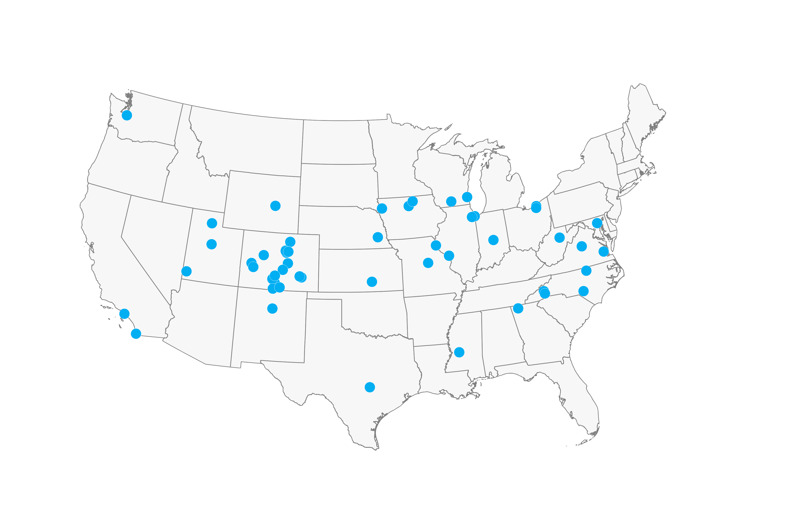
Results: Practice Characteristics (N=60)
Type:
  Federally qualified health centers = 37%
  Hospital-owned = 32%
  24% Private = 24%
  Academic medical center = 19%
Median number of MDs: 5
MOUD activity: 63% of practices reported providing MOUD to more than 20 patients in the 12 months prior to starting study.
45 enrolled at least 1 patient in the study
Add Map

Slide 10
Results: Patient Characteristics (N = 150)
Patient characteristic | Overall N = 150¹ | Office N = 43¹ | Home N = 64¹ | Telehealth N = 43¹ | p-value²
Demographics
Age ³ (Mean / SD) | 38.6 (12.0) | 38.0 (12.1) | 39.4 (12.2) | 38.0 (11.8) | 0.78
18-34 | 70 (47.0%) | 22 (51.2%) | 27 (42.9%) | 21 (48.8%)
35-64 | 73 (49.0%) | 19 (44.2%) | 34 (54.0%) | 20 (46.5%)
65+ | 6 (4.0%) | 2 (4.7%) | 2 (3.2%) | 2 (4.7%)
Sex assigned at birth³ |  |  |  |  | 0.32
Female | 78 (52.3%) | 19 (44.2%) | 33 (52.4%) | 26 (60.5%)
Male | 71 (47.7%) | 24 (55.8%) | 30 (47.6%) | 17 (39.5%)
Race (check all that apply)
American Indian or Alaska Native | 13 (8.7%) | 3 (7.0%) | 5 (7.8%) | 5 (11.6%) | 0.76
Black or African American | 11 (7.3%) | 1 (2.3%) | 7 (10.9%) | 3 (7.0%) | 0.29
White | 124 (82.7%) | 38 (88.4%) | 53 (82.8%) | 33 (76.7%) | 0.36
Other | 6 (4.0%) | 3 (7.0%) | 1 (1.6%) | 2 (4.7%) | 0.43
Hispanic, Latino/a, or Spanish origin⁴ | 19 (12.9%) | 12 (27.9%) | 2 (3.2%) | 5 (11.9%) | 0.001
Education³ |  |  |  |  | 0.46
Some high school or less | 22 (14.8%) | 5 (11.6%) | 9 (14.3%) | 8 (18.6%)
High school graduate | 67 (45.0%) | 21 (48.8%) | 31 (49.2%) | 15 (34.9%)
Some college or technical school | 46 (30.9%) | 15 (34.9%) | 15 (23.8%) | 16 (37.2%)
College graduate | 14 (9.4%) | 2 (4.7%) | 8 (12.7%) | 4 (9.3%)
Previous OUD treatment³ | 81 (54.4%) | 23 (53.5%) | 34 (54.0%) | 24 (55.8%) | 0.97

Slide 11
Results: Days of Prescribed Buprenorphine Treatment
Overall
Over the 270-days of patient follow-up:
  Median number of days of prescribed buprenorphine = 113
  Range = 0 – 270 days
  11% of participants had at least 270 days of prescribed buprenorphine treatment
Notes:
IRR = incidence rate ratio

Slide 12
Results: Days of Prescribed Buprenorphine Treatment
Adjusted Analysis
270-day follow-up
  No significant differences between induction types
    home vs. office IRR = 0.68, 95% CI = 0.45-1.02
    telehealth vs. office IRR = 0.66, 95% CI = 0.43-1.02
    home vs. telehealth IRR = .97, 95% CI = 0.71-1.49
  Identifying as Hispanic or Latino was significantly associated with a lower number of days of prescribed buprenorphine treatment (IRR= 0.43; 95% CI = 0.23-0.73, p<.01)
30- and 90- follow-up:
  No significant differences between induction types
  Identifying as Hispanic or Latino/a remained significantly associated with fewer days of prescribed buprenorphine treatment
Notes:
IRR = incidence rate ratio

Slide 13
Results: Days of Other Opioid Use
At 270-day follow-up, of the 81 (54%) of survey respondents:
  Overall
  32 (40%) reported other opioid use
  Median = 55 days; Range = 10 – 158 days
  Adjusted Analysis
  270-day follow-up: No significant differences between induction types
    home vs. office OR = 2.58, 95% CI = 0.6-11.17
    telehealth vs. office OR = 3.0, 95% CI = 0.64-14.08
    home vs. telehealth OR = 1.16, 95% CI = 0.33-4.16
  90-day follow-up: No significant differences between induction types
  30-day follow-up: More participants randomized to the telehealth induction reported other opioid use compared to office induction (OR = 11.37, 95% CI: 1.67-77.62).
  Due to confidence interval, interpret with caution.

Slide 14
Results: % of Days
% of Days Using Buprenorphine
270-day follow-up, of the 81 (54%) of survey respondents:
  56 (69%) reported using buprenorphine on >80% of days between 1 – 270
  No significant differences between study arms
90- and 30-day follow-up: No significant differences between study arms
% of Days Using Other Opioids
270-day follow-up, of the 81 (54%) of survey respondents:
  62 (77%) reported using other opioids on <10% of days between 1 – 270
  No significant differences between study arms
90-day follow-up: No significant differences
30-day follow-up: Proportion of participants who reported other opioid use on <10% of days was significantly lower in home and telehealth induction compared to office induction
(OR = 0.06, 95% CI = 0 - 0.98; OR = 0.06, 95% CI = 0 - 0.8, respectively)
Notes:
Don – I honestly don’t think we need the IRR’s on here. That helps to lessen the noise.

Slide 15
Conclusions & Implications
HOMER is the largest primary care-based randomized trial with the longest follow-up period of buprenorphine use for MOUD to date.
Diverse primary care practices across the country are providing MOUD.
People with diverse backgrounds seek MOUD from primary care.
No differences in long-term buprenorphine use and other opioid use were detected between induction arms.
Results indicate that patient treatment outcomes will not be better or worse based on induction type alone.
Primary care can and should offer MOUD using office, home, or telehealth induction approaches – and feel comfortable doing so – to increase access to live-saving care.

Slide 16

Thank You
Linda Zittleman, MSPH (co-Principal Investigator)
CU Department of Family Medicine
linda.zittleman@cuanschutz.edu
Donald Nease Jr., MD (co-Principal Investigator)
CU Department of Family Medicine
donald.nease@cuanschutz.edu
“But you, brave and adept from this day on . . . there’s hope that you will reach your goal . . . the journey that stirs you now is not far off.”
- from The Odyssey by Homer
https://medschool.cuanschutz.edu/homer

