Slide 1


Slide 2
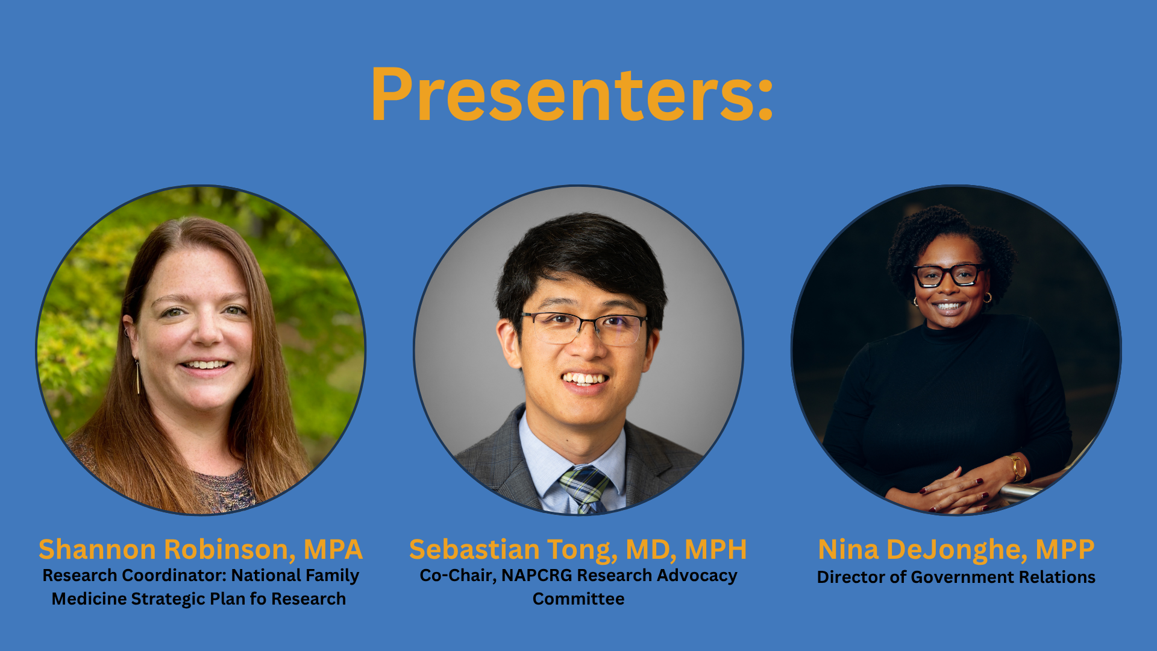

Slide 3

The U.S. National Family Medicine Research Strategic Plan
2025
Notes:
https://napcrg.org/programs/national-family-medicine-strategic-plan-for-research/description/

Slide 4
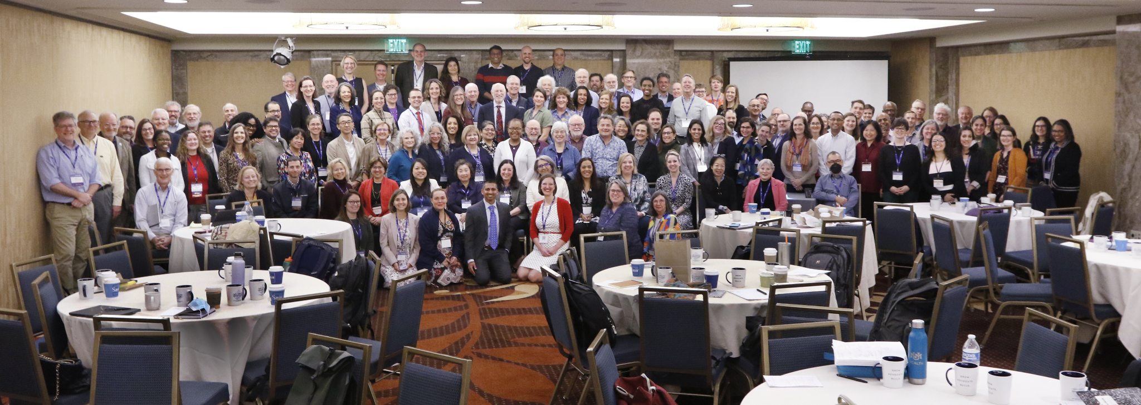



Background
2023 Research Summit
Family Medicine Research A National Strategic Plan

Slide 5



Vision: Family Medicine research is whole-person, family, and community centered and improves health enhancing health promotion, improving care for chronic diseases and advancing healthcare delivery, while including cross-cutting themes of health equity, technology, and team science.
Pathways/
Mentorship
Funding / Advocacy
Infrastructure
Goal:
Grow the family medicine research workforce by expanding pathways and strengthening mentorship
Goal:
Increase funding for family medicine research and advocate for enhanced health policy and support
Goal:
Build a national infrastructure for organizing and optimizing family medicine research opportunities.

Slide 6
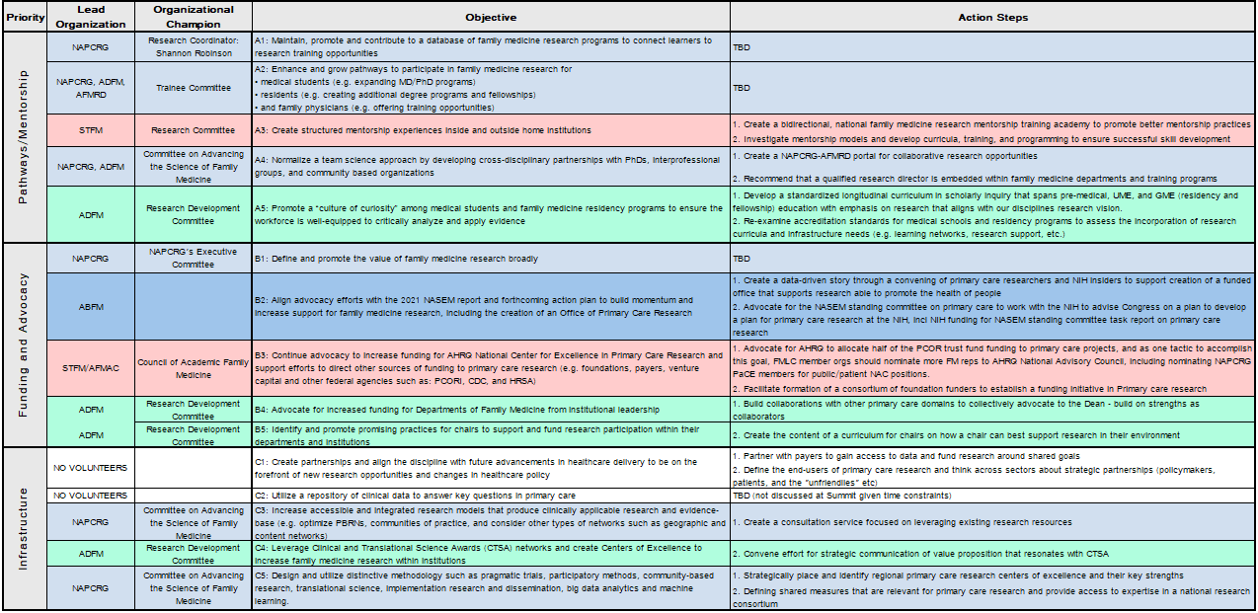
Family Medicine Research A National Strategic Plan

Slide 7
Advocacy Objectives - NFMSPR
Objective | Action Steps
B1: Define and promote the value of family medicine research broadly
B2: Align advocacy efforts with the 2021 NASEM report and forthcoming action plan to build momentum and increase support for family medicine research, including the creation of an Office of Primary Care Research | 1. Create a data-driven story through a convening of primary care researchers and NIH insiders to support creation of a funded office that supports research able to promote the health of people. 2. Advocate for the NASEM standing committee on primary care to work with the NIH to advise Congress on a plan to develop a plan for primary care research at the NIH, incl NIH funding for NASEM standing committee task report on primary care research
B3: Continue advocacy to increase funding for AHRQ National Center for Excellence in Primary Care Research and support efforts to direct other sources of funding to primary care research (e.g. foundations, payers, venture capital and other federal agencies such as: PCORI, CDC, and HRSA) | 1. Advocate for AHRQ to allocate half of the PCOR trust fund funding to primary care projects, and as one tactic to accomplish this goal, FMLC member organizations should nominate more FM reps to AHRQ National Advisory Council, including nominating NAPCRG PaCE members for public/patient NAC positions. 2. Facilitate formation of a consortium of foundation funders to establish a funding initiative in Primary care research
Family Medicine Research A National Strategic Plan

Slide 8

Current Activities
Continued efforts
  2021 NASEM report
  CAFM, AFMAC, FMLC, etc.
  Multiple letters of support sent
  Social media presence
NIH: Communities Advancing Research Equity (CARE) for HealthTM
  Pilot establishing primary care Research Network Hubs to expand research opportunities
  Continued partnership - quarterly meetings
Family Medicine Research A National Strategic Plan

Slide 9
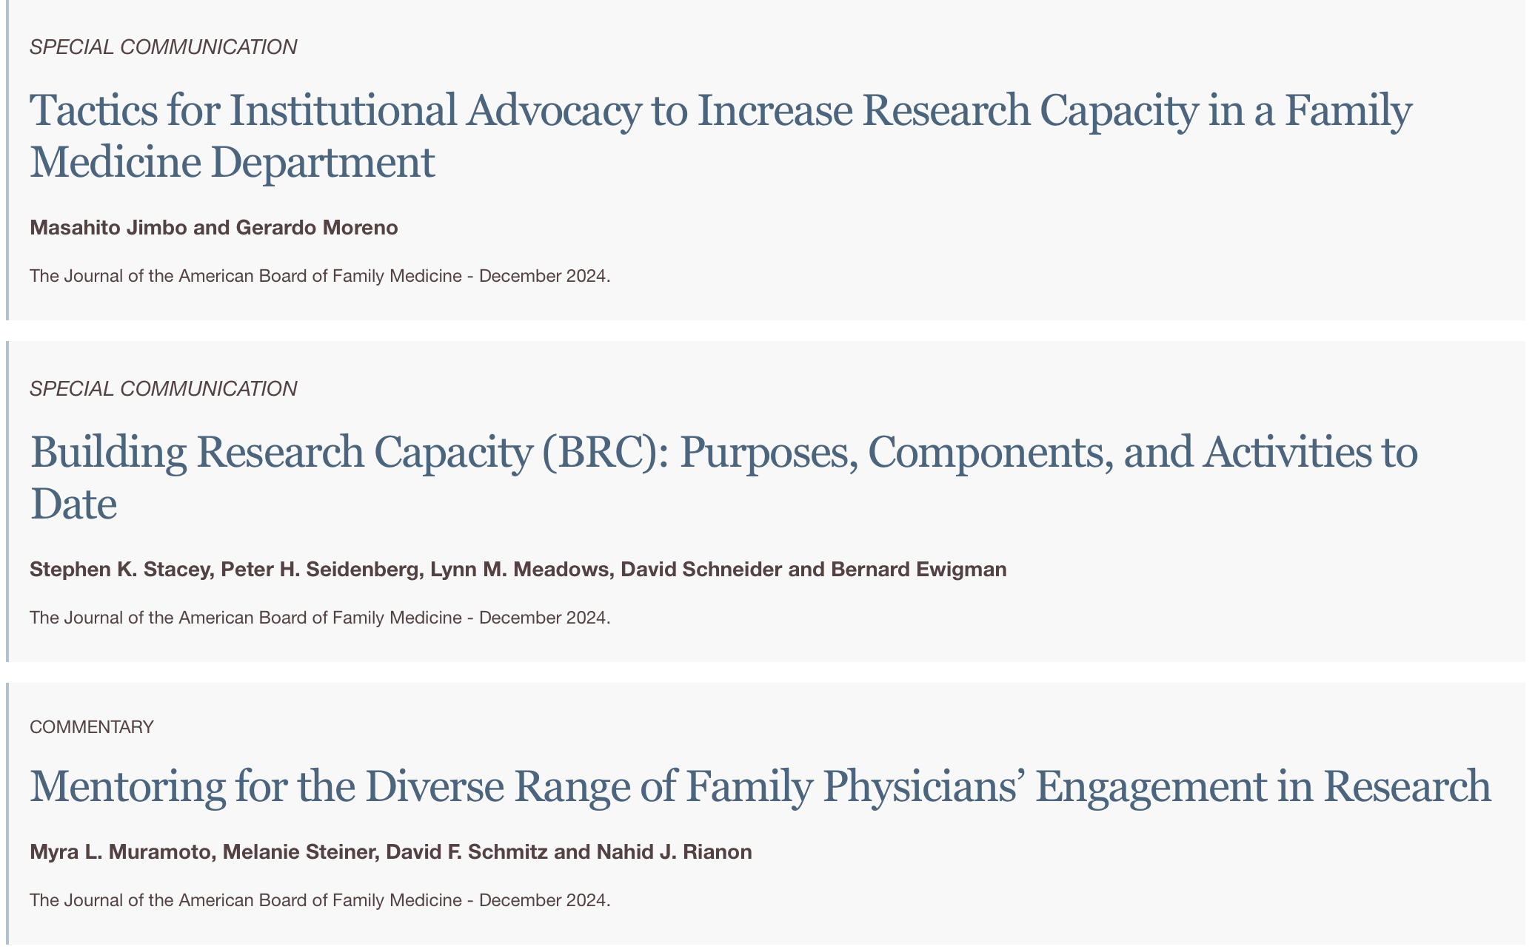

JABFM Special Issue - Complete!
Special journal issue - share history and future vision for research within the discipline
JABFM Special Issue: > 600 copies to be mailed- Q1 2025
Family Medicine Research A National Strategic Plan

Slide 10
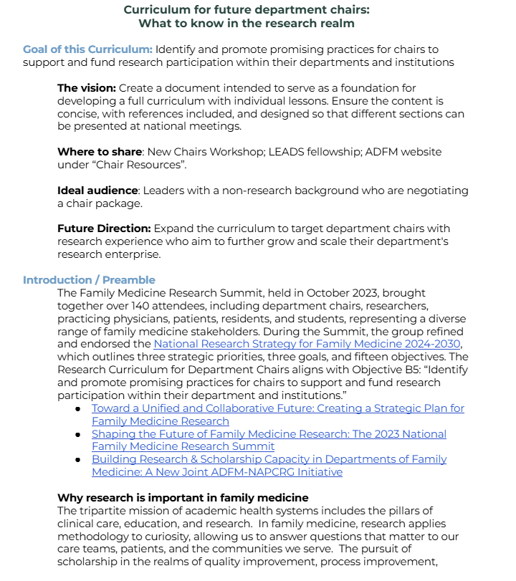
Current Activities
Development of curriculum for new FM Dept chairs
Promising practices to support and fund research participation
  Why research is important in family medicine
  Tools to Assess Research Capacity
  Resources
  Learning Sessions - Webinar
    Regulation
    Ecosystem
    Infrastructure
    Funding
Family Medicine Research A National Strategic Plan

Slide 11
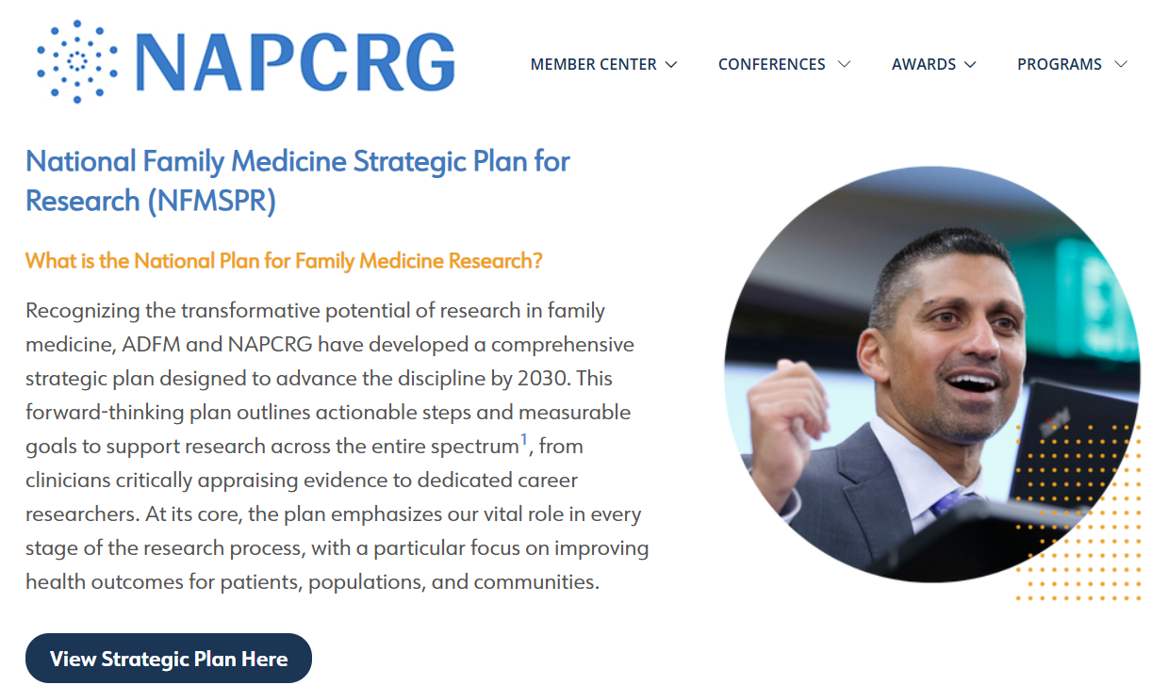
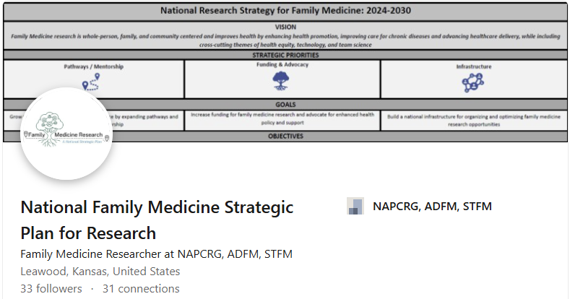
Communication &
Promotion
Website
  Overview
  Pathways/Mentorship
  Funding/Advocacy
  Infrastructure
LinkedIn Page
Connect Posts
Family Medicine Research A National Strategic Plan
Notes:
https://www.linkedin.com/in/national-family-medicine-strategic-plan-for-research/

Slide 12

https://commonfund.nih.gov/sites/default/files/care-for-health/CARE-for-Health-Network-Meeting-Open-Session-Public-Posting-508.pdf

Slide 13
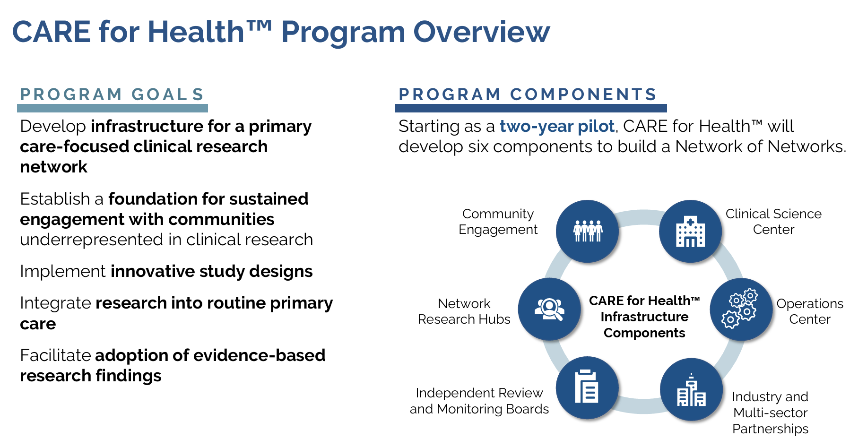
https://commonfund.nih.gov/sites/default/files/care-for-health/CARE-for-Health-Network-Meeting-Open-Session-Public-Posting-508.pdf

Slide 14
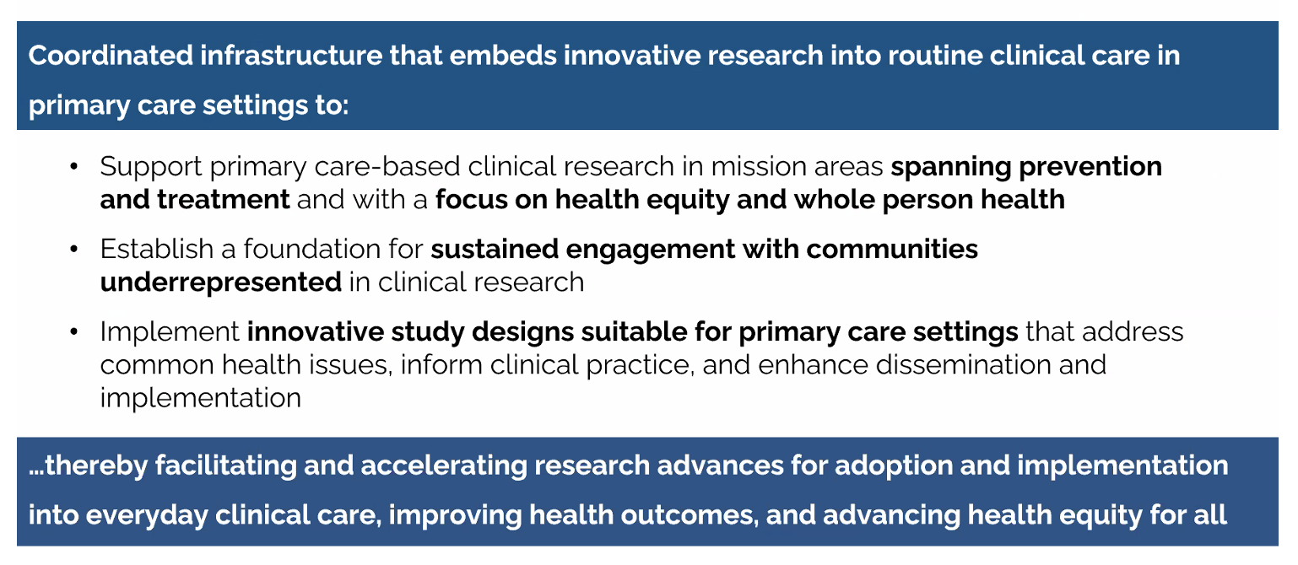
Overview (continued)
https://commonfund.nih.gov/sites/default/files/care-for-health/CARE-for-Health-Network-Meeting-Open-Session-Public-Posting-508.pdf

Slide 15
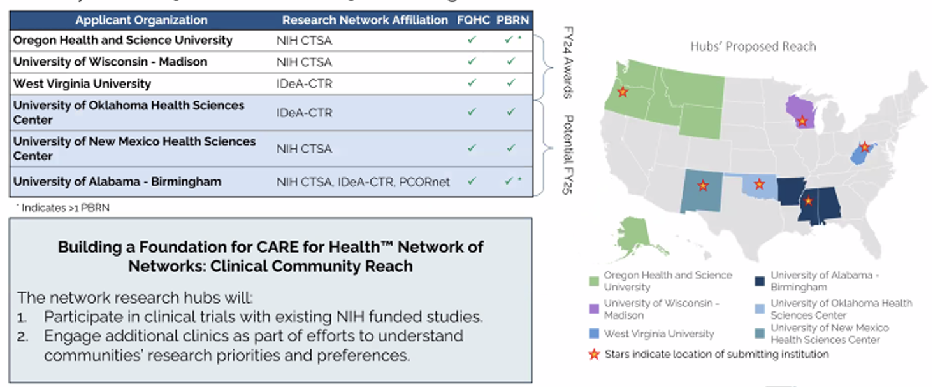
Funded Hubs
https://commonfund.nih.gov/sites/default/files/care-for-health/CARE-for-Health-Network-Meeting-Open-Session-Public-Posting-508.pdf

Slide 16
To learn more about CARE for Health
https://commonfund.nih.gov/clinical-research-primary-care

Slide 17


President’s FY 2026 Budget
What we know, so far…
Agency for Healthcare Research and Quality
Proposed funding reduction of $129 million
Ends new grants; existing contracts and interagency agreements to be offloaded.
Reorganization and integration of AHRQ functions into the new HHS Office of Strategy.
National Institutes of Health
Budget maintains $27 billion for NIH research
Continues Advanced Research Projects Agency for Health (ARPA-H)
Cuts $17 million

Slide 18
AHRQ, what’s at stake?
The Administration is restructuring the Department of Health and Human Services (HHS), the Agency for Healthcare Research and Quality (AHRQ) will be under the Office of Strategy.
AHRQ plays a unique and irreplaceable role in supporting primary care clinical and practice research and ensuring that evidence-based solutions are implemented across the country.
AHRQ has saved healthcare systems over $12 billion by implementing evidence-based improvements.
Center for Primary Care Research (uncertain)

Slide 19
National Institutes of Health
Program Consolidation/Creation of 5 New Institutes:
National Institute on Body Systems Research
National Institute on Neuroscience and Brain Research
National Institute of General Medical Sciences
National Institute on Disability-Related Research
National Institute on Behavioral Health
As of May 5, 2025, a total of 777 NIH grants awarded to U.S. institutions have been terminated, which represents a $1.9 billion loss in funding.

Slide 20
Call To Action:
What each and everyone one of us can do
Sebastian Tong, MD, MPH
U.S. Chair, NAPCRG Advocacy Committee

Slide 21
We each have agency to act!

Slide 22

Why your voice matters
Unique perspective of the health care system
Unique perspective as researchers (clinicians)
Constituent
Notes:
You have a perspective that few others have
You are an expert regarding your own experiences
You have unique insights into health and being health professions students
Because you are voters, your perspectives matter

Slide 23
Categories of Actions
Public
  Protest
  Educate the Public (op-ed, interviews)
  Talk to your patients, colleagues, friends, extended family
Political
  Communicate with your representatives and senators

Slide 24
Regular U.S. Appropriations Process
President’s Budget
Appropriations Committee
Reconciliation and Final Approval
Congressional Budget Resolution
Markup and Approval
Presidential Approval

Slide 25
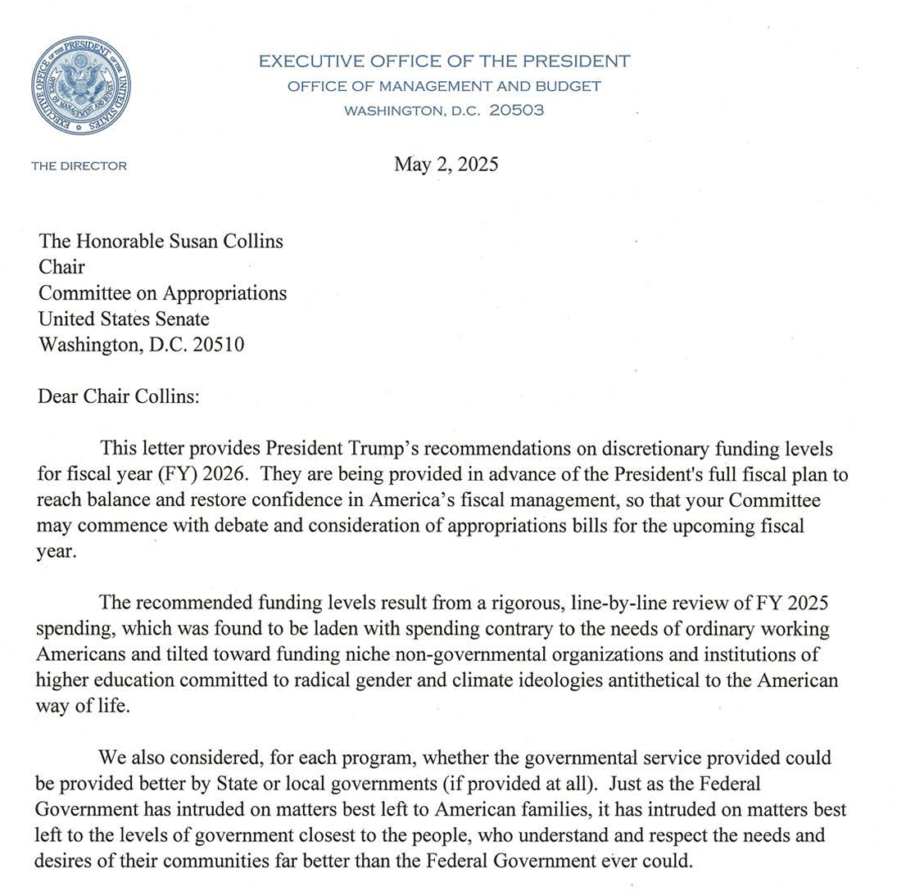
From chaos to something organized
Relatively speaking…
https://www.whitehouse.gov/wp-content/uploads/2025/05/Fiscal-Year-2026-Discretionary-Budget-Request.pdf

Slide 26
Your Role in the Appropriations Process
Advocacy: Engage with lawmakers during key stages to ensure funding for primary care is prioritized. Involvement in this stage also includes submitting appropriations requests.
Coalition Work: Collaborate with stakeholders and advocacy groups to amplify the importance of funding for HRSA, AHRQ and NIH, etc.
Education: Provide data, testimonials, and schedule meetings with policymakers, demonstrating the impact of proposed funding on healthcare access and outcomes.
Monitoring: Keep track of the legislative calendar and milestones to time advocacy efforts effectively.

Slide 27
Senate Appropriations Committee
Susan Collins (Maine)
Mitch McConnell (Kentucky)
Lisa Murkowski (Alaska)
Lindsey Graham (South Carolina)
Jerry Moran (Kansas)
John Hoeven (North Dakota)
John Boozman (Arkansas)
Shelley Moore Capito (West Virginia)
John Kennedy (Louisiana)
Cindy Hyde-Smith (Mississippi)
Bill Hagerty (Tennessee)
Katie Britt (Alabama)
Markwayne Mullin (Oklahoma)
Deb Fischer (Nebraska)
Mike Rounds (South Dakota)
Patty Murray (Washington)
Richard Durbin (Illinois)
Jack Reed (Rhode Island)
Jeanne Shaheen (New Hampshire)
Jeff Merkley (Oregon)
Chris Coons (Delaware)
Brian Schatz (Hawaii)
Tammy Baldwin (Wisconsin)
Chris Murphy (Connecticut)
Chris Van Hollen (Maryland)
Martin Heinrich (New Mexico)
Gary Peters (Michigan)
Kirsten Gillibrand (New York)
Jon Ossoff (Georgia)

Slide 28
Senate HELP Committee
Rand Paul (KY)
Lisa Murkowski (AK)
Roger Marshall (KS)
Josh Hawley (MO)
Jim Banks (IN)
Ashley Moody (FL)
Susan Collins (ME)
Markwayne Mullin (OK)
Tim Scott (SC)
Tommy Tuberville (AL)
Jon Husted (OH)
Patty Murray (WA)
Chris Murphy (CT)
Maggie Hassan (NH)
Ed Markey (MA)
Lisa Blunt Rochester (DE)
Tammy Baldwin (WI)
Tim Kaine (VA)
John Hickenlooper (CO)
Andy Kim (NJ)
Angela Alsobrooks (MD)

Slide 29
Policy Action Plan
Goal
Strategy
Target
Tools

Slide 30
Goal
What is the problem?
What is the solution?
What is the policy ask?
Example:
Insufficient infrastructure funding to promote rural research.
Grant awards to support infrastructure in rural communities
Congressional line item to support research infrastructure

Slide 31
Strategy
What resources are available to you?
Who are your allies?
Who are your opponents?

Slide 32
Target
Who are the people or organizations in power who can make decisions?
Example:
Representatives on specific committees
e.g. House Committee on Energy and Commerce, Subcommittee on Health
e.g. Senate Committee on Health, Education, Labor and Pensions

Slide 33
Tools
What actions will you direct at your target?
Potential tools
Visits
Letters, emails, phone calls
Demonstrations and press conferences to raise awareness/sway public opinion
Asking membership organizations to write letter of support
Editorials

Slide 34
How to contact your representatives
Email / phone
  Look for information about terminated grants/actions
Set up a meeting
  Talk to health policy aide

Slide 35
Crafting a message
Use storytelling techniques
Estimate the value of your work in quantitative terms
Tailor communication materials for different audiences
  What matters to which audience (e.g. patient care or stakeholder engagement)
Translate research into concise and understandable messages and usable formats

Slide 36
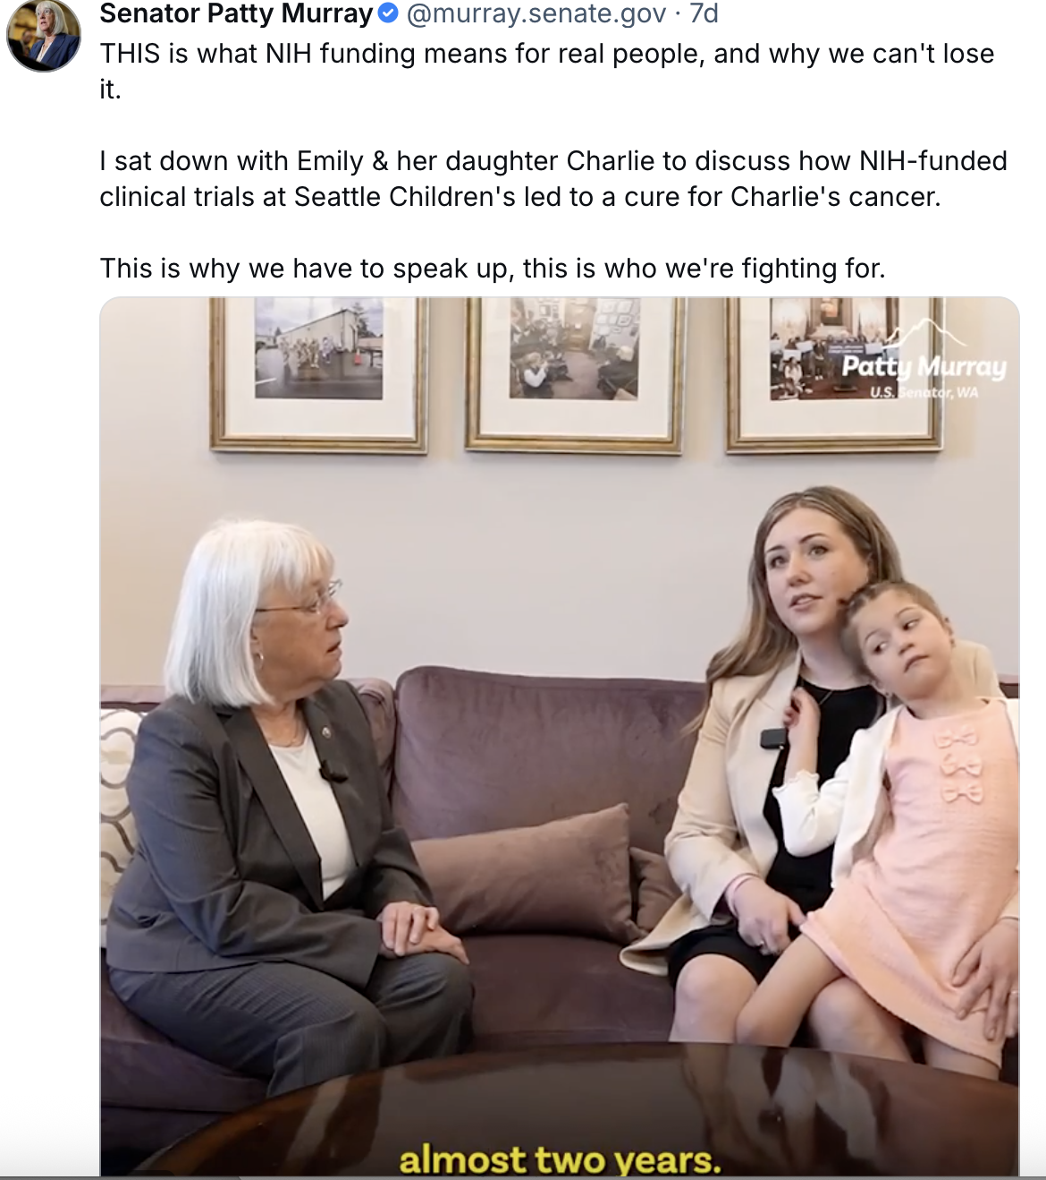

Preparing for a meeting
What positions has your representative taken before? What matters to them?
What is your ask?
  Ask for what is possible
  E.g. writing a letter to agency, asking questions at a hearing, adding specific appropriations language
  Tell them why they should support you
Bring a one-page summary
Source: X @murray.senate.gov

Slide 37
The Etiquette of Engagement
Do this:
Thank Member/Staff
Stay on Message
Listen – look for opportunities to address their needs
Make the Ask
Follow Up
Don’t do this:
Don’t Be Late
Don’t Argue
Don’t Make it Political
Don’t Have to Be Expert
Limit your Ask – what’s your top priority?

Slide 38
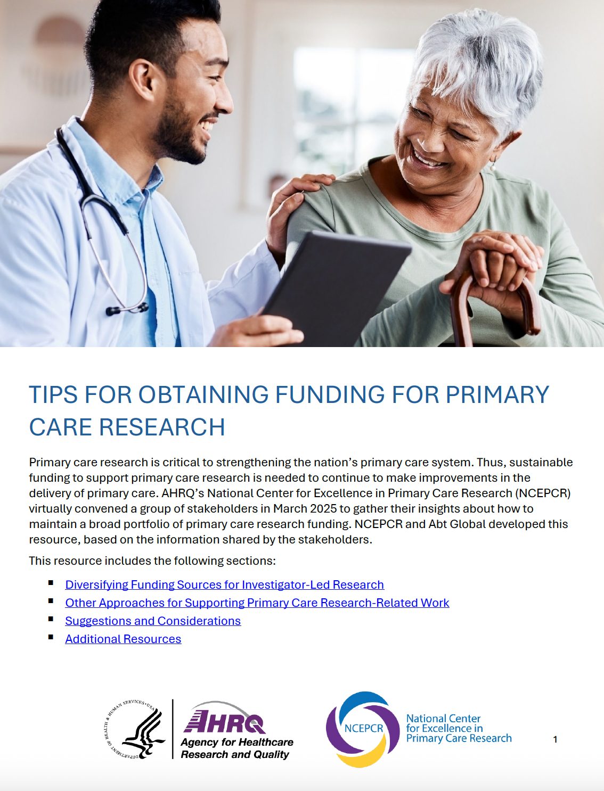
https://www.ahrq.gov/ncepcr/funding/tips-obtaining.html

Slide 39
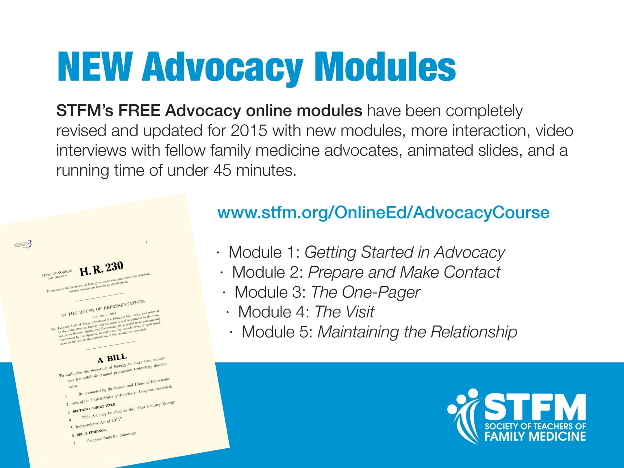
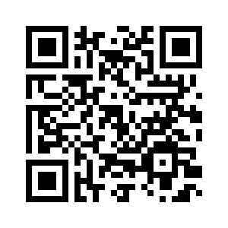

Slide 40


Slide 41
Let’s share!
What have you done that has leveraged your agency and/or brought you hope?
What ideas do you have for impact?

