Slide 1

Research Center 2.0
A Training Curriculum for Primary Care Residents in a Community Based Residency Program

Slide 2

Ed Bujold, MD, FAAFP
Director of the Research Department
UNC Blueridge Healthcare
Morganton, NC

Slide 3

UNC Blueridge Healthcare
130 Bed Two Campus Community Hospital
Nestled in the Foothills of the Blueridge Mountains
Serving a Three County Area

Slide 4

High School students
Medical Students
Residency Training Programs

Slide 5

15 Students from the North Carolina School for Math and Science
12 Junior and Senior Medical Students from Campbell University in Buies Creek, NC
An Internal Medicine Program (24 Residents)
A Gastroenterology Program (6 Residents)
A Family Medicine Program (24 Residents)
An Addiction Medicine Program (2 Residents)

Slide 6

Survey of residents
Not all residents are interested
Mentors
Monthly research meetings

Slide 7
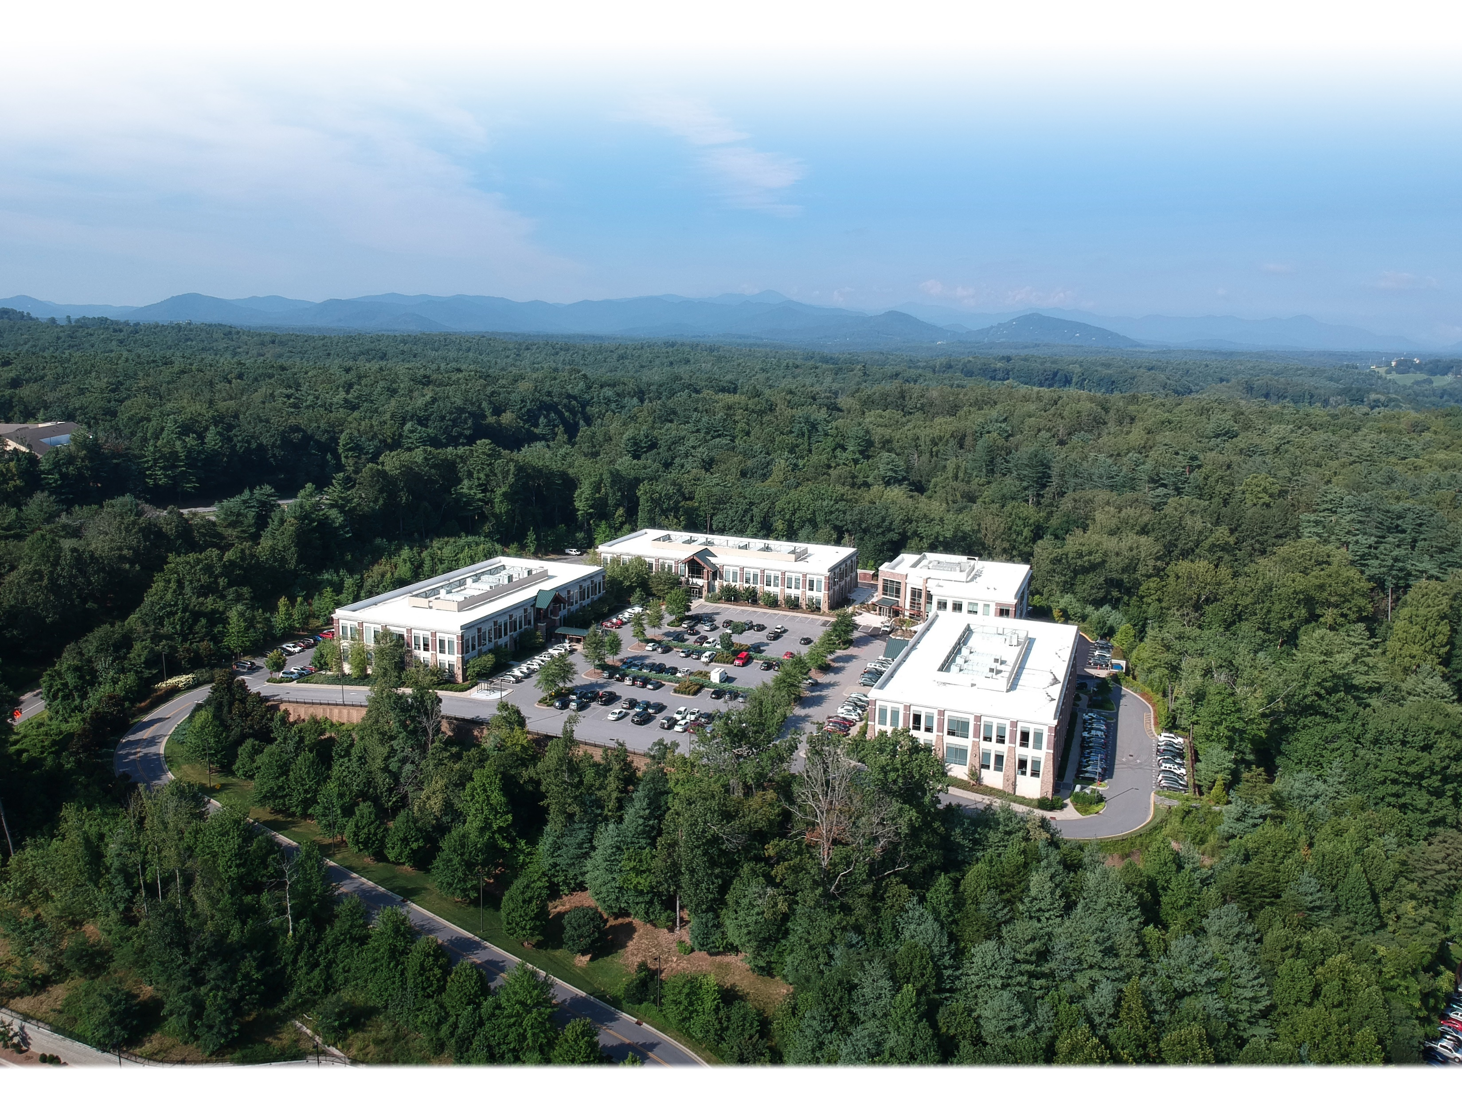
The Mountain Area Health Education Center
(MAHEC)
Research Curriculum
Research Curriculum
Defining a Research Question
Searching the Literature
Critical Appraisal
Quantitative Research
Qualitative Research
Protection of Human Subjects
Data Management
Structuring a Research Paper

Slide 8

Access to the Curriculum
https://ncahec.libguides.com/MAHEC/ResearchCurriculum/Home

Slide 9
Mountain Area Health Education Center
This Certificate is Awarded to
Edward J Bujold, MD for successful completion of
MAHEC Research Training Certificate Course
On March 24th , 2025

Slide 10

Partnerships
AAFP’s National Research Network
DARTNet Institute
UNC’s SHEP Center for Health Services Research

Slide 11
INTEREST IN RESEARCH
North Carolina School of Math and Science (2/15)
Campbell Medical Students (1/24)
Internal Medicine Residents (9/24)
GI Fellowship (2/6)

Slide 12

How to create a poster
What makes a good poster presentation
Tutorials

Slide 13

Additional Tools
Jane (Journal, Author, Name, Estimator)
EndNote

Slide 14

Have we kept Our residents within the Southeast/north Carolina region?

Slide 15
Have we kept Our residents within the Southeast/north Carolina region?
1. Internal Medicine retention rates
• 2019 – 2024 (5 years) SE regional retention rate: 42.11%
• 2019 – 2024 (5 years) North Carolina retention rate: 21.05%
2. GI Fellowship retention rates
• 2019 – 2024 (5 years) SE region retention rate: 85.71%
• 2019 – 2024 (5 years) North Carolina retention rate: 42.86%
3. Overall, residency/fellowship retention rates since program inception
• 2013 – 2024 (11 years) SE region retention rate: 54.17%
• 2013 – 2024 (11 years) North Carolina retention rate: 29.17%
4. Blue Ridge Medical Group retention rate
• 2013 – 2024 (11 years): 16.67%

Slide 16
Registry of Research Projects
15 projects to date
Case Presentations
Practice Improvement Studies
Formal Research Papers

Slide 17
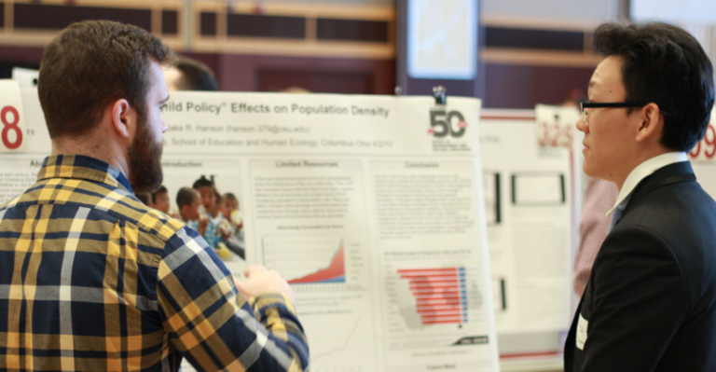
Research day with poster presentations of everyone’s work
This Photo by Unknown Author is licensed under CC BY-NC
Featured Speaker

Slide 18

Virtual Hospital During COVID we published our experience in the Journal of Patient Centered research and review
This Photo by Unknown Author is licensed under CC BY-NC-ND
Of the first 700 patients enrolled in the Virtual Hospital, 255 had no primary care physician
Those 255 patients were assigned a primary care physician upon enrollment.

Slide 19

Caldwell County opioid initiative
Who is best suited to treat opioid use disorder
A WELL-TRAINED PRIMARY CARE PHYSICIAN

Slide 20
Transform Clinical Trial
UNC Blueridge one of several sites
Enroll 7,500 patients
Enrollment criteria-Asymptomatic patients at risk for sudden cardiac death
Ai-enabled Cardiac computed tomography angiography looking at soft plaque
Risk stratified into three risk categories-low, medium and high risk
Each group will then be placed into a treatment protocol based on risk assessment and scanned yearly
Ultimate goal-Present data to the US preventative task force to consider using this as a screening test for high-risk asymptomatic patients with coronary artery disease
Added benefit-assign patients to a primary care physician much like we did for the Virtual hospital

