Slide 1



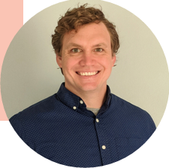



Understanding Primary Care Access
How PBRNs Can Help Primary Care Practices and the Communities They Serve

Slide 2
No financial disclosures
But tons of intellectual conflicts of interest!

Slide 3


PBRNS Are a Team Effort

Slide 4

NASEM: Implementing High Quality Primary Care
Inadequate primary care results in shorter lives and more inequities for communities
Primary care is the foundation of the healthcare system and should be considered a common good
Primary care is weakening in the U.S. when it is needed most

Slide 5
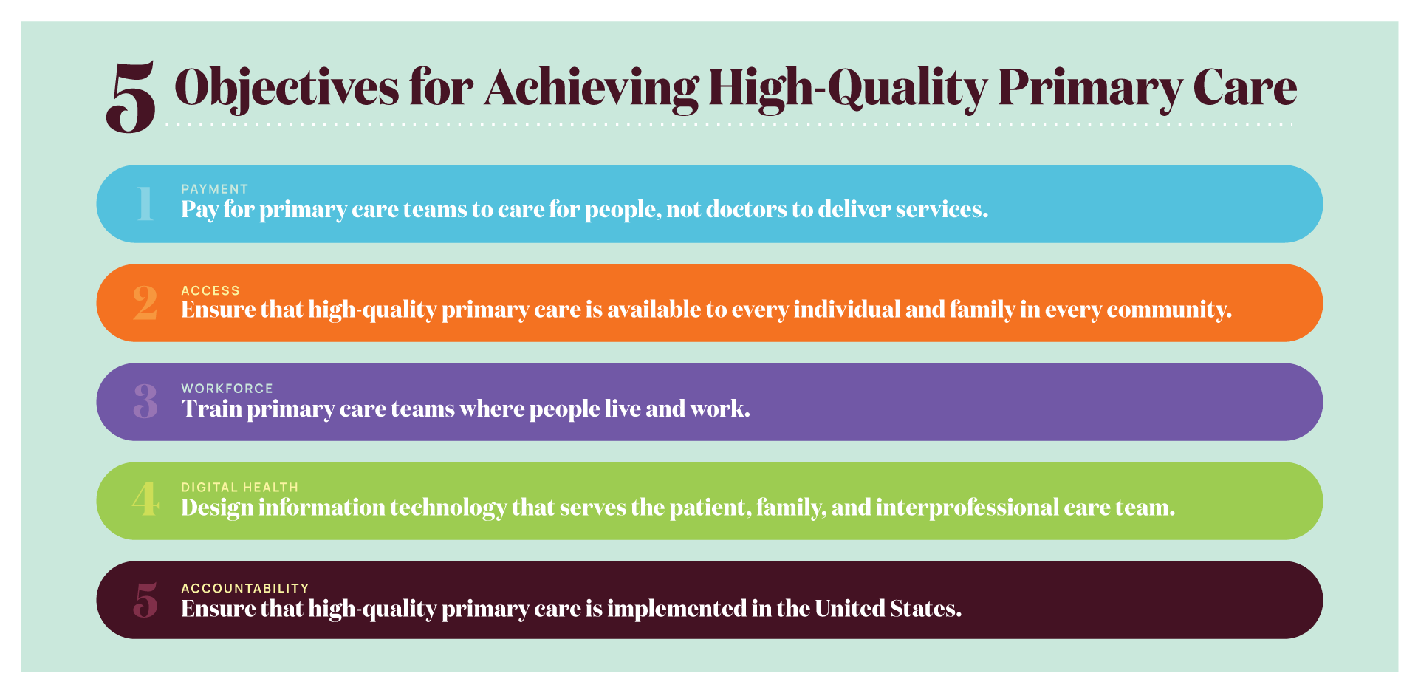
Notes:
The committee’s recommended actions that make up its implementation plan seek to achieve 5 major objectives to achieve high-quality primary care.
Pay for primary care teams to care for people, not doctors to deliver services.
The nation gets what it pays for, and payment reform that supports and encourages high-quality primary care, rather than actively discouraging it, is fundamental to the committee’s vision of high-quality primary care.
Ensure that high-quality primary care is available to every individual and family in every community.
Everyone in the country should have easy access to high-quality primary care that is person-centered, relationship-oriented, and responsive to the needs of its community.
Train primary care teams where people live and work.
When primary care training is interprofessional and located in community settings, it is more effective at developing the skills that will keep people connected and healthy.
Design information technology that serves the patient, family, and interprofessional care team.
New health information technology standards should prioritize and facilitate integrated care that is person-centered, supports relationships, and is responsive to the needs of its community.
Ensure that high-quality primary care is implemented in the United States.
Implementing high-quality primary care requires clear and meaningful measures of whole-person care, ongoing research, and leadership in the federal government to assure federal policies support its development.

Slide 6
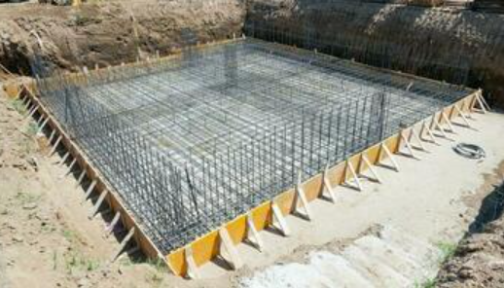
What does it even mean to be the “foundation” of the healthcare system?

Slide 7

ACORN Mission
“To do research that matters to primary care”
Inadequate access =
Poor health for communities
Burnout for primary care

Slide 8
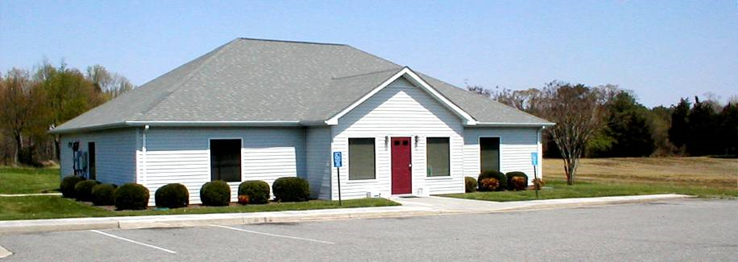
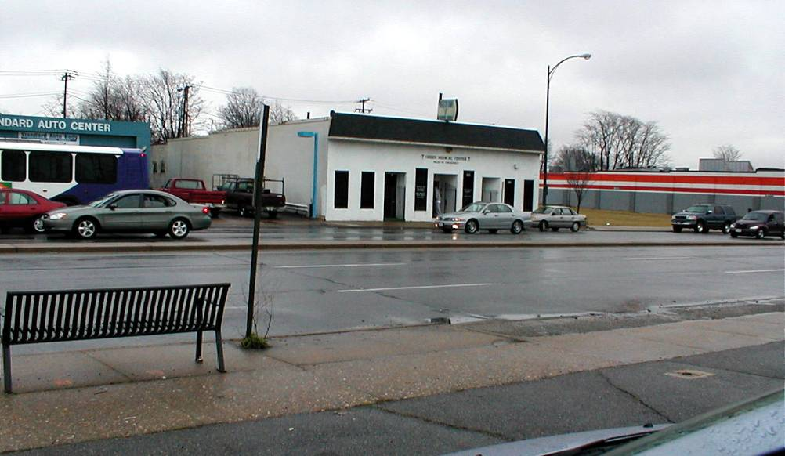
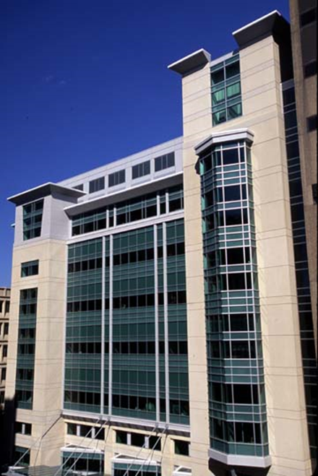
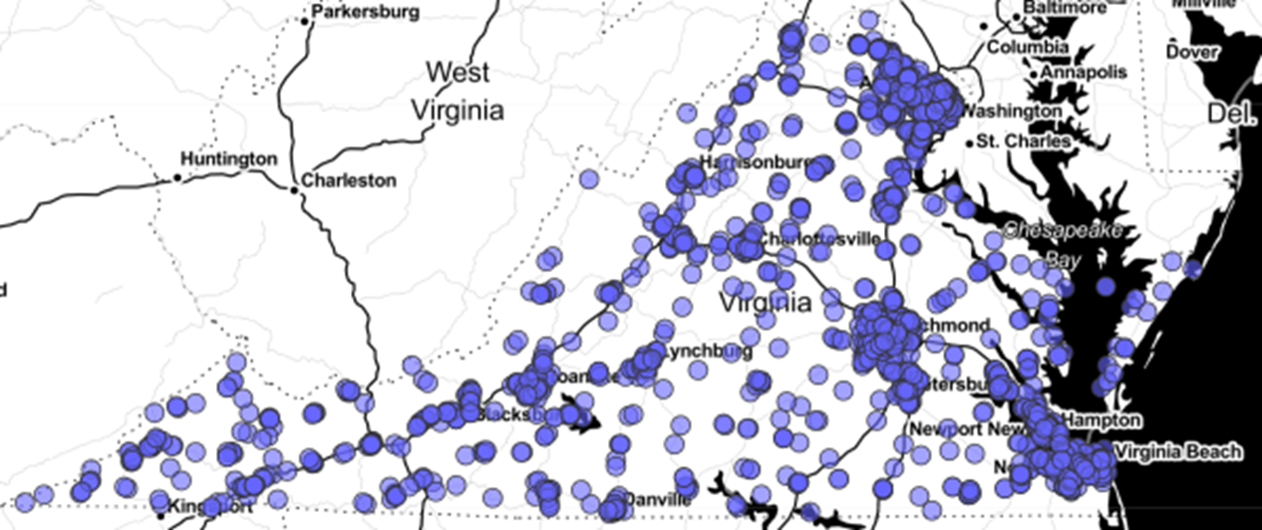

Slide 9
ACORN Overview
Established in 1996 as one of original Agency for Healthcare Research and Quality PBRNS
524 member practices – “non-denominational”
  Spanning every health system, FQHC, Accountable Care Organization, and census tract in the state
  Range in size from 1 to 64 clinicians
  Operate under the full spectrum of ownership and insurance models
  52 unique electronic health record instances, spanning 14 systems

Slide 10
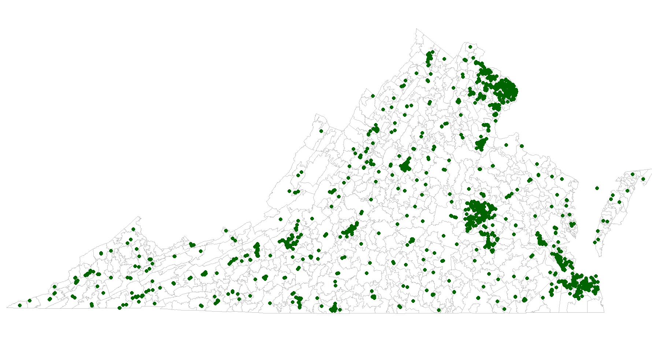
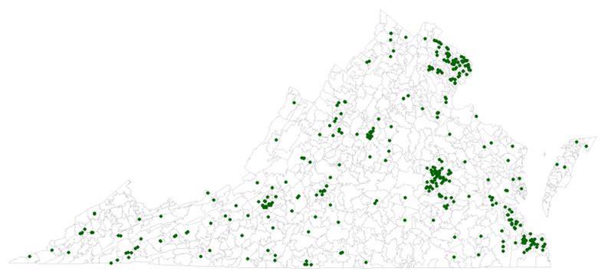
ACORN Member Practices
1,968 primary care practices in Virginia | 526 (26.7%) ACORN practices

Slide 11
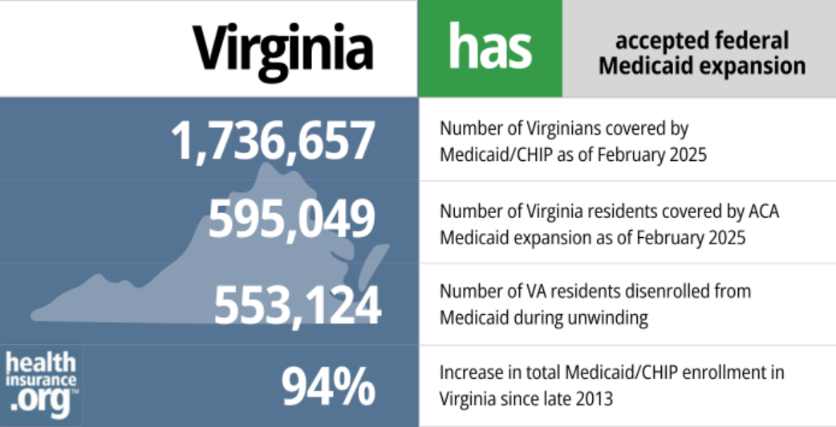
Virginia Did Medicaid Expansion in 2018
7.6% or 530,000 of all nonelderly Virginians had no health insurance in 2023
(Uninsured in 2010 was 13.1%)
4.6% of Virginians birth through age 18 had no health insurance – 92,000 children

Slide 12
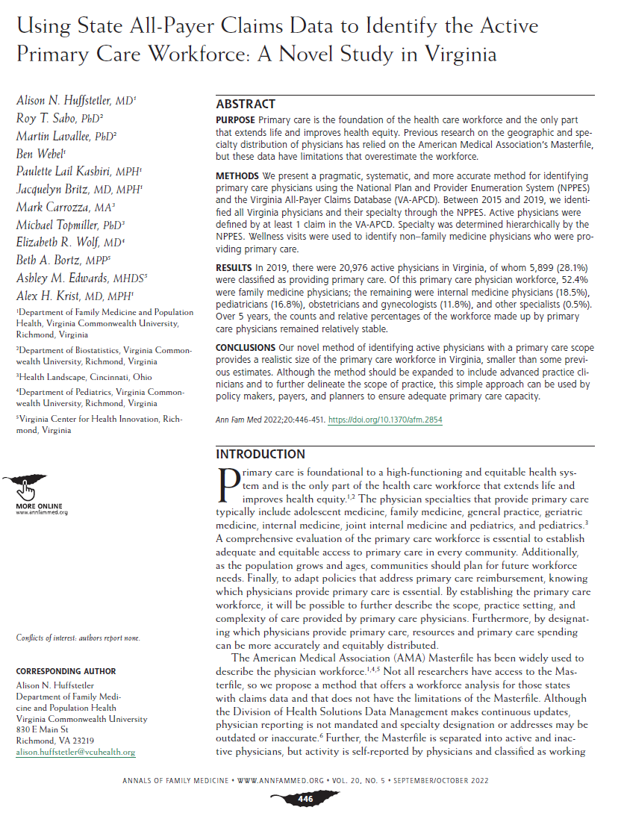
ACORN Identifies Every Primary Care Clinician and Practice in Virginia
Statewide effort to support research, policy, and clinical care
Triangulate state licensure data, National Plan & Provider Enumeration System, Virginia All-Payers Claims Data and manually verify – process evolving!
Every 4 years survey every practice

Slide 13
Identifying Primary care is hard
No clean accurate central data base
Not one specialty
Even being a family physician doesn’t guarantee being primary care
Big distinction between Primary Care Services versus Primary Health Care

Slide 14
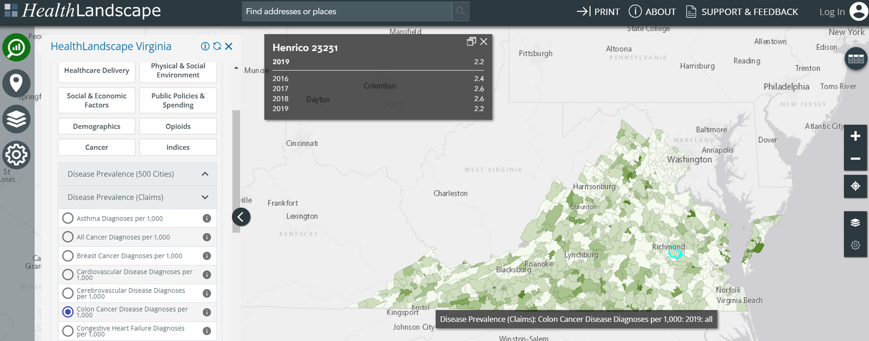
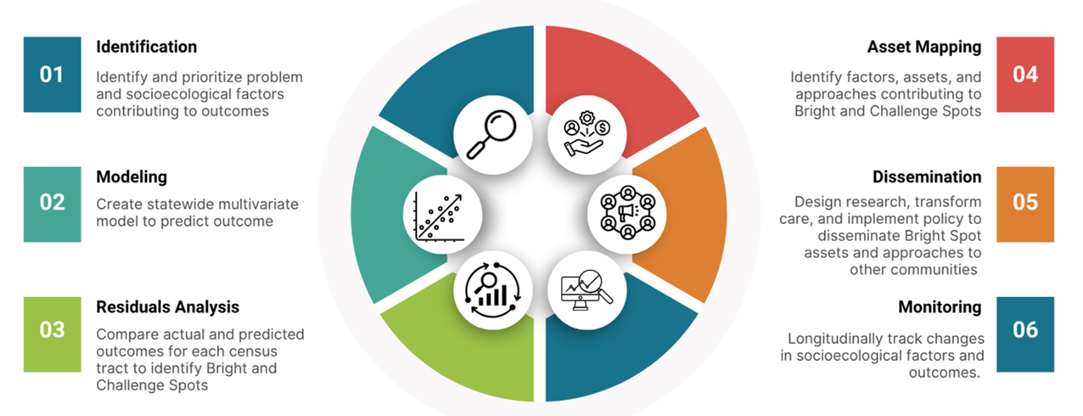
ACORN Seeks to Understand the Socio-Ecological Context of Each Community
Brightspot and Community Asset Mapping plus Community Engagement efforts
HealthLandscape Virginia utilizes All Payers Claims Data and public health data sources

Slide 15
Our Approach
Methods
Data + research + longitudinal relationships
Goals
Improve care for people and communities
Make life easier for care teams
Be a voice for primary care
Advocate for primary care locally
Inform policy

Slide 16
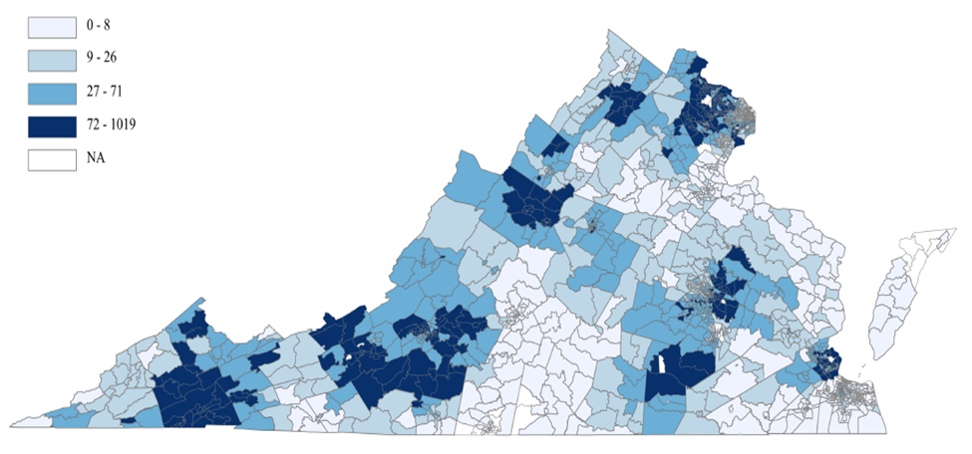
Efforts Benefit Research: We Use Denominator to Show Equitable and Inclusive Recruitment
In EvidenceNow we enrolled
76 practices
Practices care for people in
97.3% census tracts
Patients had similar demographics as Virginia generally:
  Race (21.7% vs. 20.0% Black)
  Ethnicity (9.5% vs 10.2% Hispanic)
  Insurance status (6.4% vs. 8.0% uninsured)
  Education (26.0% vs. 32.5% high school graduate or less)
J Clin Transl Sci. 2023 Apr 14;7(1):e110

Slide 17
Efforts Benefit Research: Apply Findings to Practice Reach to Assess Public Health Impact
The practices that completed practice facilitation saw 412,409 unique adults in 2021
The observed 33.4% increase in screening with recommended screening instruments in intervention practice means 114,604 additional patients will be screened annually (1.2% of Virginians)
The observed 2.4% increase in unhealthy alcohol use identification means an additional 8,235 patients will be identified and 5,155 will receive brief interventions

Slide 18
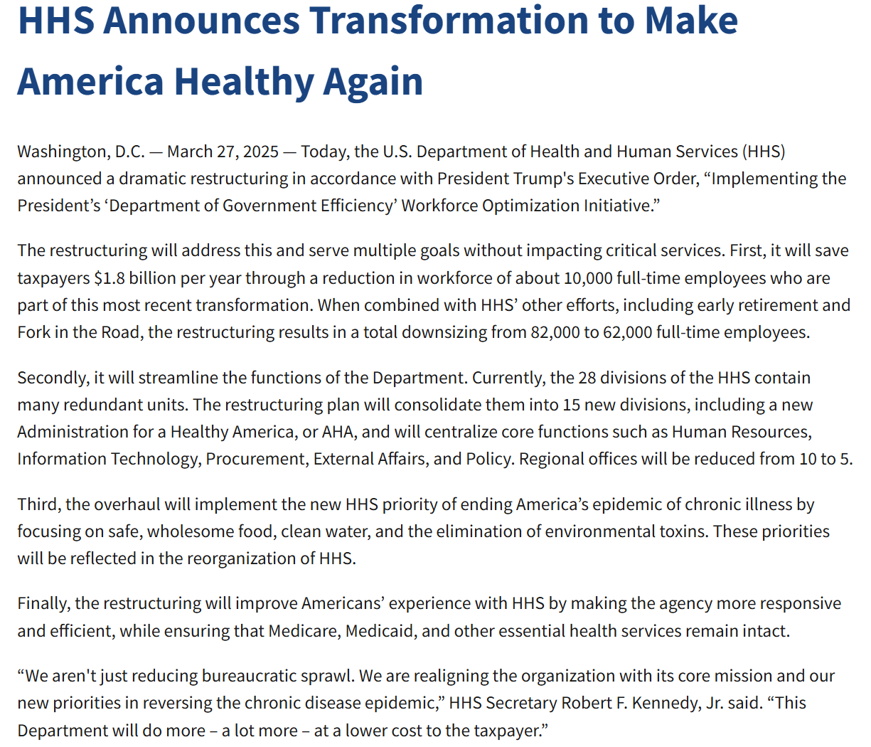

PBRN Threats

Slide 19
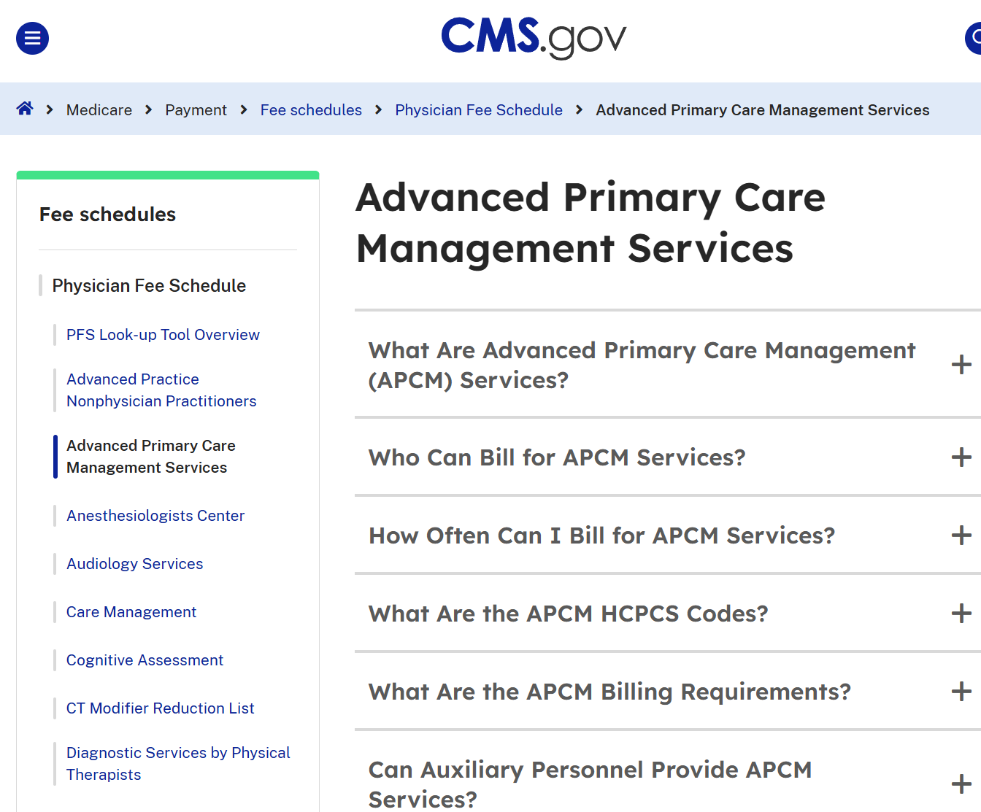

PBRN Opportunities

Slide 20
Primary Care Workforce
How PBRNs can use claims data to understand the primary care workforce and the communities they serve
Notes:
Hi everyone, as Alex mentioned I am going to speak to wayts that PBRNs can use claims data to better understand the care workorce and communities they serve

Slide 21
The Value of Data from PBRNs
Through longitudinal relationships with primary care practices, we gain valuable insights about primary care and the communities they serve
  Critical role in understanding and addressing challenges facing primary care
  Nuanced community-level data, synergistic with national-level initiatives
Notes:
Hi everyone,
Im going to show how we can do that

Slide 22

Notes:
Today I will focus on the “quantitative” gear, while Marshall will build on the qualitative piece.

Slide 23
Goals
Summary of data sources
Insights into primary care access and shortages
Exploring high quality primary care through claims data
Implications
Notes:
Describe the primary care workforce and shifting landscape (including increase in health system own practices)
Discuss balance between access and continuity/4Cs (tension between the 4Cs)
Discuss insights from community-level data on the 4Cs of primary care
Specifically understanding the people and communities receiving high-quality primary care and those with missed care opportunities
Highlighting work from the Virginia Ambulatory Care Outcomes Research Network (ACORN) to:
Practice-reported challenges with professional turnover and recruitment 🡪 Marshall
Some of this data provides nuances about primary care that may allow greater insights for national workforce discussions, and may also inform local PBRN efforts
Recognize the balance between access and continuity for primary care practices.
Explain the impact of practice ownership on the functions of high-quality primary care practices.
Identify the resources needed for PBRNs to serve as a local and national resource to understand and improve access to high quality primary care.

Slide 24





Data Sources
Survey of primary care practices (every 4 years)
All-payer claims database
American Community Survey (ACS)
Virginia Department of Health data on number of clinician hours (of 40) spent on direct patient care
2023 National Plan and Provider Enumeration System data on clinician enumeration dates
Notes:
Describe the primary care workforce and shifting landscape (including increase in health system own practices)
Discuss balance between access and continuity/4Cs (tension between the 4Cs)
Discuss insights from community-level data on the 4Cs of primary care
Specifically understanding the people and communities receiving high-quality primary care and those with missed care opportunities
Highlighting work from the Virginia Ambulatory Care Outcomes Research Network (ACORN) to:
Practice-reported challenges with professional turnover and recruitment 🡪 Marshall
Some of this data provides nuances about primary care that may allow greater insights for national workforce discussions, and may also inform local PBRN efforts
Recognize the balance between access and continuity for primary care practices.
Explain the impact of practice ownership on the functions of high-quality primary care practices.
Identify the resources needed for PBRNs to serve as a local and national resource to understand and improve access to high quality primary care.

Slide 25




2022 Primary Care Practice Survey
Survey sent to every primary care practice in Virginia in 2022 (2,296); 526 (23%) responded
53% practices report major stressor, including shortages
42% report clinician turnover
Burnout reported more often in hospital-owned systems
43% practices now owned by health systems
From 34% in 2018 (p<0.001)
From 13% in 2018 (p<0.001)
81% hospital-owned vs. 51% clinician-owned (p<0.001)
Up from 25% in 2018 (p<0.001)
Notes:
Turnover stats- losing a clinician, with 13% of practices in 2018 vs. 42% in 2022 reporting losing a clinician (p< 0.0001).
Compared to 2018, in 2022 there were increases in practices owned by health systems (25% vs. 43%, p<0.0001)
Qualitative interviews flag concerns about factors affecting burnout and worsening shortages
-EHR, admin burden
-Financial stress
-Staffing shortages
-Ownership

Slide 26
PBRNs Can Strengthen Understanding of Primary Care Access and Shortages
Primary care surveys and interviews inform analyses:
  Primary care workforce shortages and access
  Challenges and opportunities for promoting high quality primary care

Slide 27
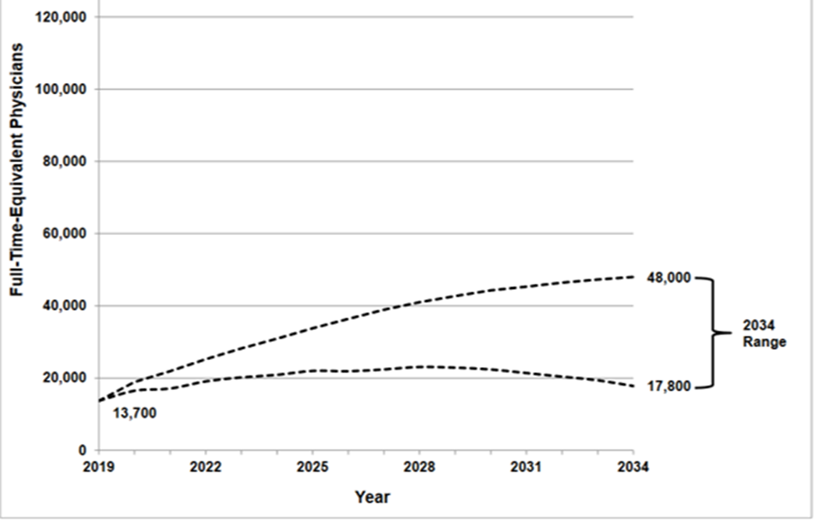
Projected Primary Care Shortage: 2019-2034
261 PCPs needed in VA based on HPSA Designation
Assumes:
  3500 residents:1 provider
  1 FTE

Slide 28
Virginia needs 24% more PCPs Today
Based on current panel sizes & FTE
1,203 (24%) more PCPs needed today for each Virginian to have a PCP*
Currently 4,872 PCPs in VA
*30% (1,541) PCPs are 60 years or older and may retire or have reduced panel of patients in the next 5 years

Slide 29
Role of Advanced Practice Providers
Next steps in our analysis include exploring the role of APPs
Many APPs attributed to primary care, but fewer than 30% of primary care APPs work in primary care
APPs are key members of the healthcare team; however, not the only solution to the workforce crisis

Slide 30
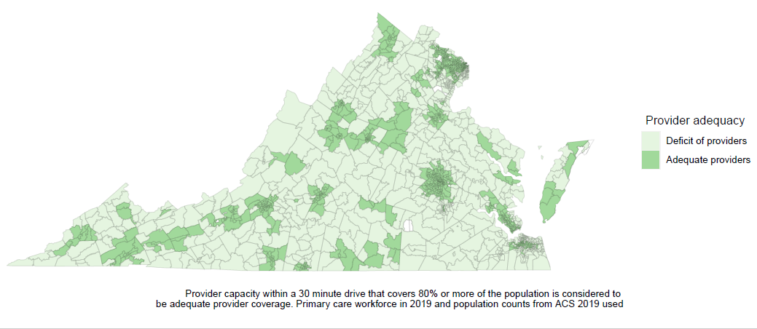
Disparities in PCP Adequacy in Virginia
Source: Hannah Shadowen, VCU Department of Family Medicine and Population Health, Ambulatory Care Outcomes Research Network
Notes:
This is an analysis done by my colleague, Hannah Shadowen, that uses a floating catchment method. This includes providers within a 30 minute drive of the center of each census tract.
It show which areas would have surplus or deficit of providers based on median average panel size of 1368
You can see here that much of VA in red has a deficit of providers
The areas in green and blue have a surplus of providers
While there is a geographic distribution, with rural areas with more deficits, we also noticed that the green areas reflect areas of VA with residency programs. So up here NW VA< this is actually a a very rural area, but has surplus of providers potentially due to the residney program
-------------------------------------------------------------
Floating catchment method
Basically I geolocated all of the providers that Evan sent us (I successfully geolocated 4,734). I then counted the number of providers that were within a twenty minute drive of the center of each census tract. I then multiplied that by the average panel size (1368) to calculate the total capacity within the driving distance of the census tract. Then to compare the capacity of the providers in the census tract to the number of actual people in the census tract, I subtracted the capacity from the number of people within the census tract. I excluded any census tracts with less than 100 people.
I provided the continuous measure in a graph and then categorized this variable. A deficit of providers was any census tract with more than 501 individuals beyond the capacity of the providers. A slight deficit was any census tract that had between 500 and 100 individuals beyond the capacity of the providers. Adequate coverage was having capacity match residents (+/- 100 residents). A slight surplus was capacity for 100 to 242756.3 residents over the number of residents that actually resided in the census tract. A surplus was capacity for 242756.3 to 400000 residents over the number of residents that actually resided in the census tract.

Slide 31
Neighborhood Determinants of Primary Care
Nearly half (44%) of Virginia’s census tracts lack adequate PCP access
Racial segregation and rurality had the greatest associations with PCP access:
  Tracts with higher proportions of Black residents had significantly greater PCP access than those with higher proportions of White residents
  Rural tracts had significantly less access
Source: Hannah Shadowen, VCU Department of Family Medicine and Population Health
Notes:
Therefore we are seeing PCPs serve in areas of social disadvantage
Primary care can promote equity

Slide 32
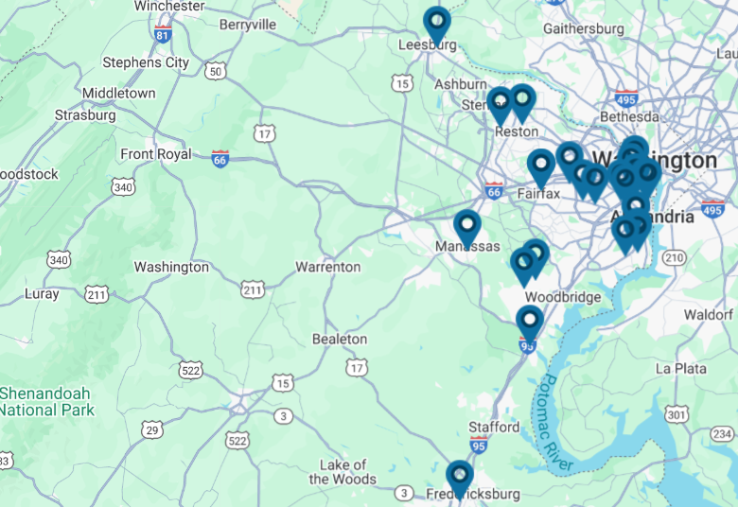
Role of Community Health Centers
Source: Virginia Community Healthcare Association, https://vcha.org/locations/

Slide 33
Policy Implications
Impact of Medicaid cuts
Changes to HPSA shortage area designations

Slide 34

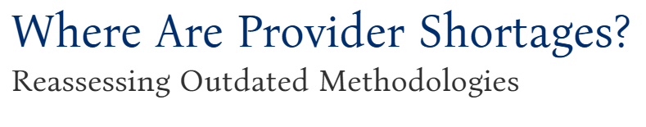
“The shortage area designations used by the federal government…reflect the primary care workforce that was available in the mid-1970s.”
“If the federal government revised the HPSA/MUA/MUP methodologies to include the primary care workforce available in 2024, thousands of communities currently designated as underserved would see their shortage area classification removed.”
“Patients now have full benefit of the nearly 600,000 currently practicing nurse practitioners (NPs) and physician assistants/associates (PAs) in the United States.”
Notes:
This report argues: ___
While I would certainly agree hpsa designations are outdated, I would argue that updating would likely increase the shortage areas
We know that while APPs are crritial, many of the same pressures facing physicians are likely facing APPs, and only 30% are going into primary care
Therefore I would argue that any efforts to update HPSA consider panel size, FTE, and PRIMARY CARE capacity of physicians and APPs

Slide 35
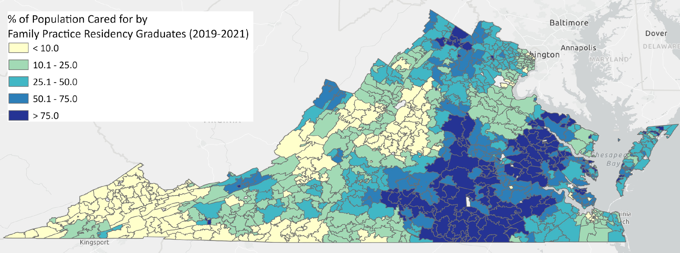
The Good News: Virginia Residency Programs Addressing the Gap
Over 3 years, 833 graduates from VCU Family Medicine residency programs cared for over 1.3 million VA residents (>15% Virginians)
  Riverside Family Medicine graduates saw over 50% of Newport News City Residents
Notes:
**As a PBRN – work closely with residency programs
Analysis on 1,677 graduates from 8 VCU family medicine residency programs (Blackstone, Bon Secours St. Francis, Chesterfield, Fairfax, Front Royal / Shenandoah, Hanover, Riverside, Virginia Beach) since 1971. They saw 1,330,504 unique patients in three years (2019-2021), about 15% of the Virginia population (map attached).
In some regions, up to 50% of the primary care visits and 1 in 4 total residents –
In three years (2019-2021), Riverside Family Medicine Residency Program graduates saw 95,640 unique Newport News City residents
This is 51.8% of all Newport News City residents or 1 in 2 Newport News City residents
This is also 86.2% of all primary care visits in Newport News City

Slide 36




Exploring High Quality Primary Care
There are many factors impacting the implementation of high-quality primary care, which cause burnout and turnover
PBRNs can identify frontline successes/challenges to better support primary care
We aim to explore:
First contact
Continuity
Comprehensiveness
Coordination
Notes:
This is still very much in process but I will present some of our data
1 liner about the methods
Even when you get into primary care, there are many factors that affect the quality of high quality primary care
Many of our surveys indicated challenge sto implemengin primary care

Slide 37

Balance of Panel Size and High-Quality Primary Care
Large panel size increases access for patients and communities
Large panel size may decrease access and continuity for current patients
Notes:
This is still very much in process but I will present some of our data
1 liner about the methods
Even when you get into primary care, there are many factors that affect the quality of high quality primary care
Many of our surveys indicated challenge sto implemengin primary care

Slide 38
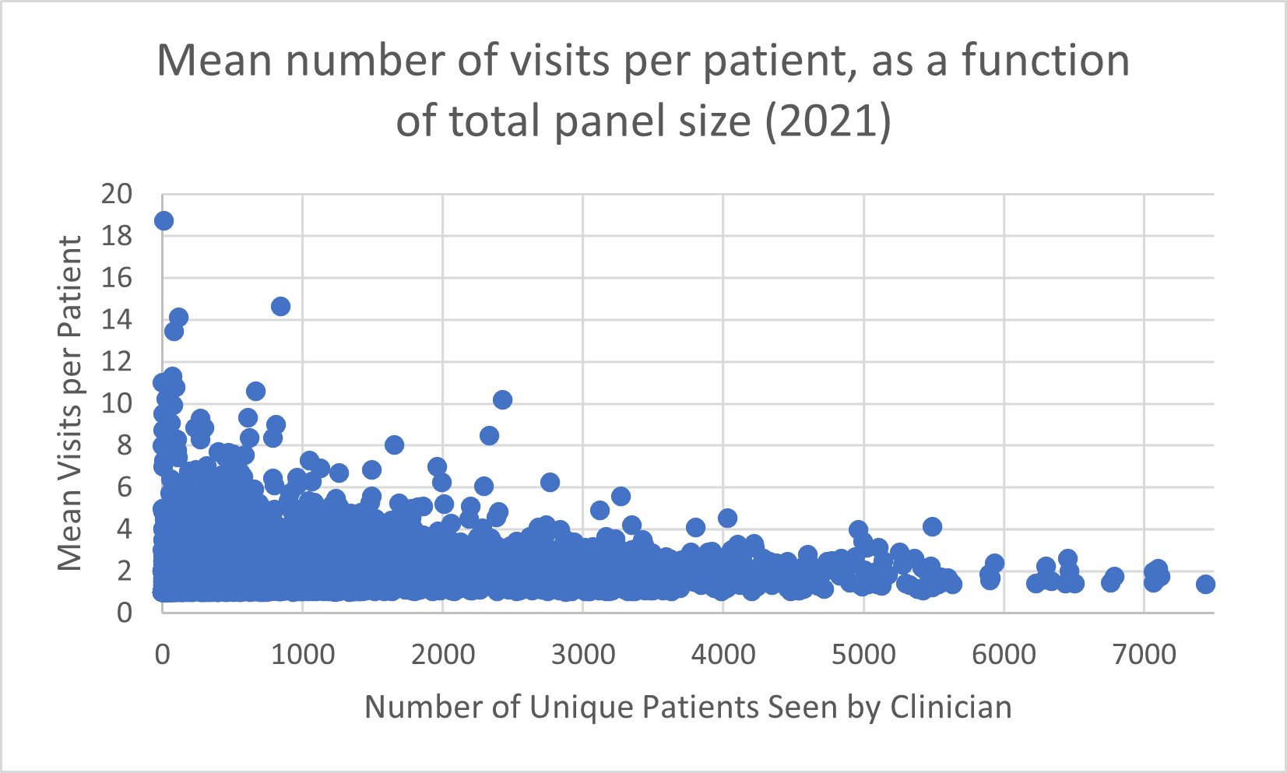
Panel Size and Continuity
Notes:
Physicians have an average of 2,370 total visits annually
Median visits per patient: 1.86*
Higher panel correlates with fewer patient visits per year
Qindividuals with higher panel tended to see their patients fweer times PER Year
*Does not include visits to other doctors
Panel may impact continuity
Lower than national stat🡪 likely because it’s just 1 doctor, not including urgent care

Slide 39
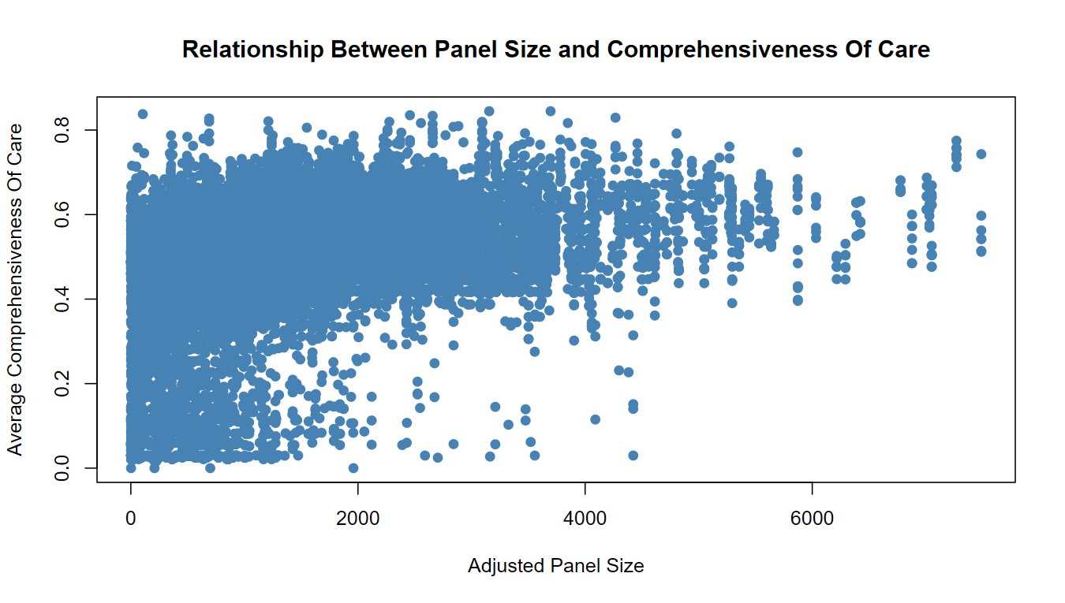
Notes:
There does not appear to be a relationship between panel size and compehrensiveness for lower panel. However, >2000, higher panel appears correlated with increased comprehensiveness
This could reflect physicians with high volume but maybe reflects scope of care, as opposed to comprehensive care

Slide 40
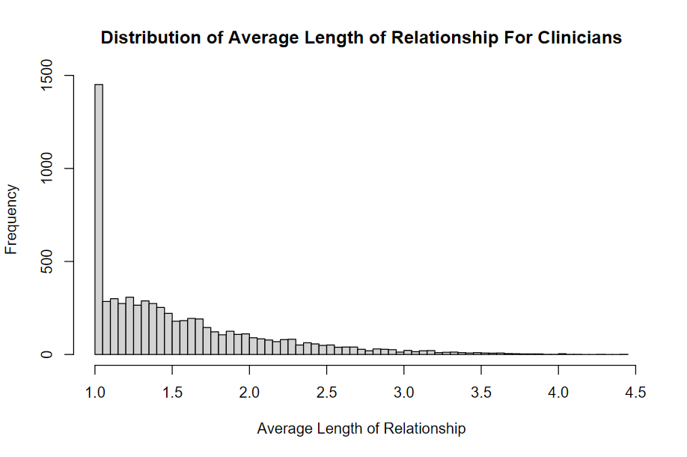
Length of Relationship
Notes:
As panel size increases, length of relationship tends to decrease
Highest length of relationship was seen in those with lowest panel size
Most notable for panel > 2000
We were surprised by a low average length of relationship for clinicians
This could be impacted by high rates of urgent care visits but this is something we need to explore more

Slide 41
Comprehensiveness Has Decreased Over Time
Year | Mean Comprehensiveness for Clinicians
2016 | 0.445
2017 | 0.438
2018 | 0.435
2019 | 0.428
2020 | 0.416
2021 | 0.413
2022 | 0.397
Notes:
There is a lot to tease out for comprehensiveness.
Decreased for clinicians MORE than it decreases for practices
Could be a few reasons?
True decrease
Needs are addressed by other providers in the practice
Are we measuring the correct things? Maybe scope of care is decreased but comprehensiveness is not
Role of urgent care

Slide 42
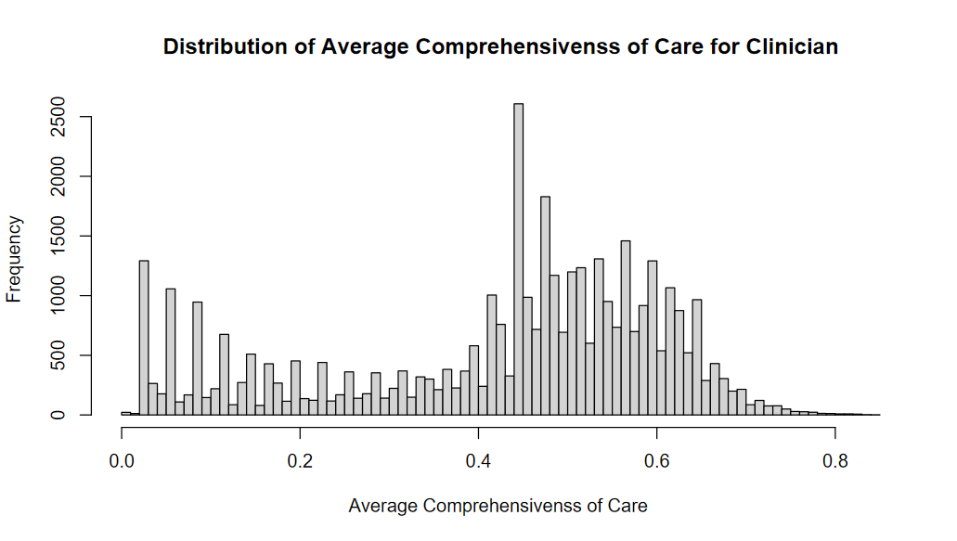
Bimodal Distribution of Comprehensiveness
Notes:
While average comprehensiveness decreasing, this could be due to relative rise in Urgent Care visits (with possibly decreased comprehensiveness)

Slide 43
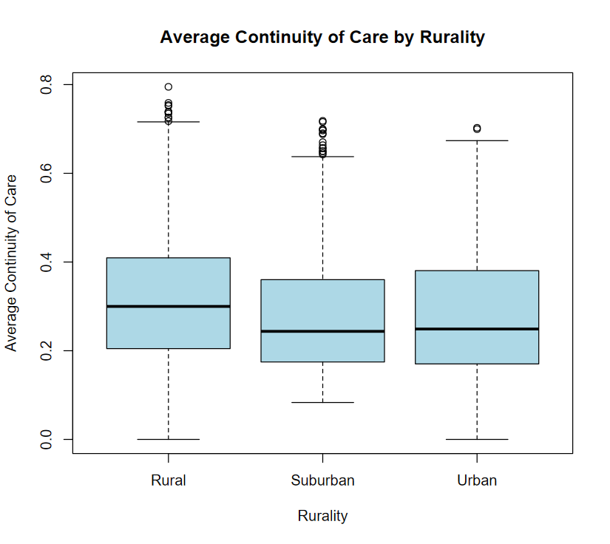
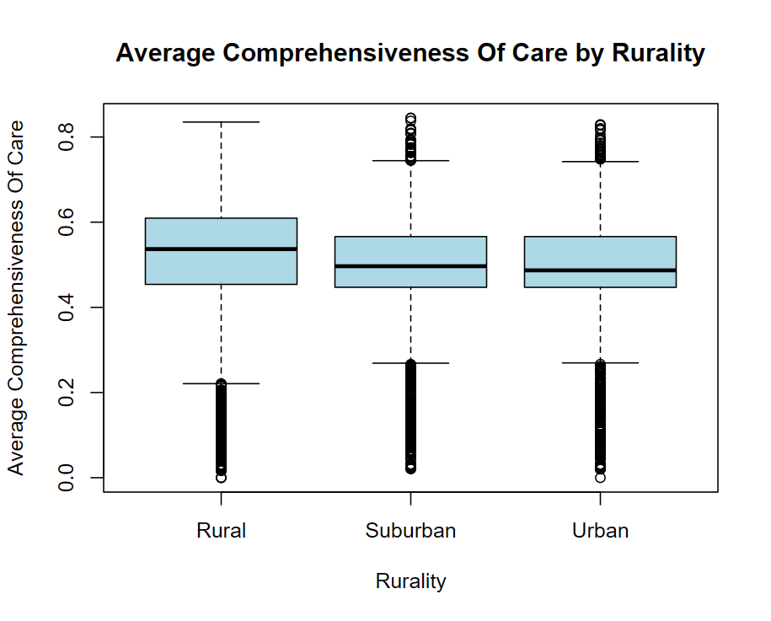
Rural Physicians Have Higher Continuity and Comprehensiveness
Notes:
Rural physicians have increased:
Comprehensiveness
Continuity
Yet also higher shortage areas

Slide 44
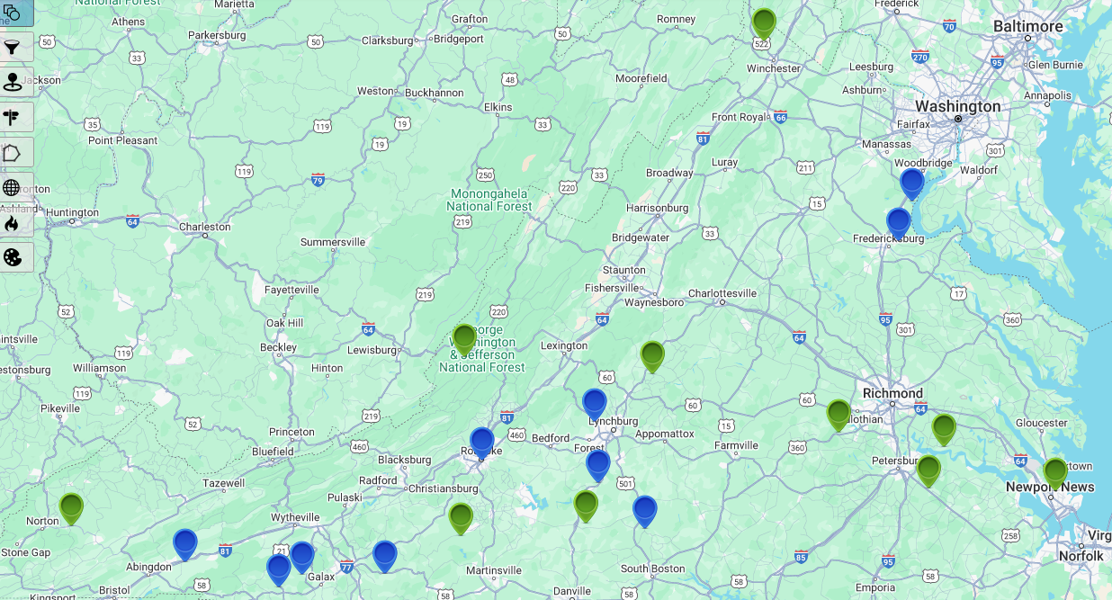
Communities with Greatest Change in Comprehensiveness (2016-2022)
Green=improved
Blue=worsened
Notes:
Green=improved 2016-2022
Blue=worsened 2016-2022
Label as community asset mapping –looka t high low performers

Slide 45
Community Asset Mapping
In communities with the greatest improvements, or declines, in comprehensiveness, we looked at what components of comprehensiveness changed the most

Slide 46
Measures Contributing to Changes in Comprehensiveness
10 Communities that Improved 2016-2022 | 10 Communities that Worsened 2016-2022
64.7 | -88.9 | Sports Medicine Care
60.0 | -88.9 | Flu Immunizations
52.4 | -72.2 | Behavioral Health Care
51.7 | -80.0 | Gynecological/Reproductive Care
49.8 | -64.4 | Geriatric Outpatient
46.9 | -66.7 | Office Lab Procedures
45.7 | -55.6 | Chronic Disease Management
43.7 | -77.8 | Pediatric Outpatient Care
42.5 | -84.4 | Immunization Others
41.3 | -88.9 | Urgent Acute Care
40.1 | -66.7 | Chronic Pain Management
40.1 | -72.2 | Orthopedic Care/ Musculoskeletal
38.6 | -43.3 | End of Life
38.6 | -64.4 | Joint tendon aspiration/injection
37.0 | -88.9 | Preventive Care
36.7 | -60.0 | Cervical cancer screening/ Pap test
34.29951691 | -54.44444444 | Smoking Cessation
33.09178744 | -58.88888889 | Newborn care
24.63768116 | -61.11111111 | Office Surgery/Minor surgery
23.91304348 | -84.44444444 | Office skin procedures
23.67149758 | -44.44444444 | Allergy shots
21.73913043 | -3.333333333 | Complementary alternative medicine
19.0821256 | -33.33333333 | Adult outpatient
17.39130435 | 0 | Implantable Reversable Contraception
13.76811594 | -60 | Vision acuity test
13.04347826 | 0 | Intrauterine device
8.695652174 | 0 | Substance use disorder care
4.347826087 | 0 | Prenatal care
4.347826087 | 0 | Cardiac stress tests
4.347826087 | 0 | Ultrasound- prenatal
4.347826087 | -4.444444444 | Warfarin therapy management
0 | 0 | Colposcopy
0 | 0 | Endometrial biopsy
0 | 0 | Neonatal circumcision
0 | 0 | Ultrasound - musculoskeletal
0 | 0 | Vasectomy
-1.207729469 | 5.555555556 | Ultrasound - Other point of care
-3.623188406 | -20 | Home Visits
-15.94202899 | -30 | Simple fracture care
Notes:
1 decimal, centetr

Slide 47
What is Comprehensiveness?
“Comprehensiveness is a multi-faceted concept that includes both the scope of services offered and the depth and breadth of health conditions managed by the PCP pending the needs of the population.”
“This physician-level measure assesses one aspect of comprehensiveness – provision of a range of services”
Source: American Board of Family Medicine (ABFM): 2024 Clinical Quality Measures

Slide 48
How do we assess comprehensiveness?
Rethinking what additional measures provide insight into high-quality primary care
Capturing the valuable care clinicians provide that may not be currently captured by current measures
Opportunity for PBRNs to use measures to identify practices doing well or who may need support, and to help practices interpret data
Notes:
Comprehensiveness can reflect a breadth of care
But we may ALSO want to look at depth
There are physicians providing comprehensive care who may not score high based on this measure
We may want measures to look at
Scope of care, breadth
Depth of care
Percent of services provided in-house

Slide 49
Implications for PBRN Data and Perspectives
Understand value of primary care
Support primary care practices
Strengthen high-value quality care
Advocacy
  Measures and data to demonstrate true value of primary care
  Identify Bright Spots
  Tension between 4Cs
  Help clinics interpret measures
  Help clinics access resources and tools (e.g., AI)
  Monitoring impact of implementation
  Learn from successful models
  Design care teams
  Reduce burdens on primary care
  Ensure PCPs are represented in policy discussions (e.g., shortages, HPSA, payment reform, tech/AI)
  Primary care spend
Notes:
***&learn from success stories
Get meaures, but get the measures to the community
Key takeaways
Supporting primary care practices and communities
Informing residency training
Policy implications (e.g., addressing shortage areas, HPSA designations)
Identifying solutions to address workforce shortages and improve high quality primary care

Slide 50
Serving Primary Care by Knowing Primary Care
E. Marshall Brooks PhD
edward.brooks@vcuhealth.org

Slide 51
How PBRNs can create a feedback loop for primary care research
Establishing longitudinal relationships with practice communities
  Practice facilitation
  Community Advisory Boards (CABs)
Conducting research that responds to local needs and challenges
  Professional shortages
  Shifts in practice ownership

Slide 52

Practice Facilitation

Slide 53
What makes practice facilitation work?
Practice facilitators are at the core of practice based research
Long term relationships across multiple projects
Knowledge about practices and practice team members
Overlap of practice facilitation team, research team and PBRN team

Slide 54

AHRQ EvidenceNOW: UAU collaborative
Six U.S.-based grantee teams
Practice facilitation to improve screening and brief interventions for UAU
  +300 practices nationally
Support strategies and services
  Education
  Workflow coaching/redesign
  Performance feedback
  Information technology support
  Data management
Interviews with practice facilitation teams

Slide 55

Practice facilitation lessons
Build and maintain close relationships with practice team members
Recruitment efforts can often heavily lean on personal connections to practice teams
Tailor change strategies to match local conditions
“Sometimes we are able to recruit just based on the relationship we have.”
“I think some did it because it's us. ‘We've been working together for so many years and now you asked me to do it, and we'll help you out.’”
“Build that relationship first. To provide value you have to show them the value of your relationship and what you can help them with.”
“I was thinking how much our entire intervention was practice-centered and practice-driven and individually tailored around a framework - not a rigid framework - a framework that was flexible.”
“Keep it customizable, meet them where they're at, make it so that if they can't implement it the exact way that we've got it designed, try to help them find a solution.”
“Write into a proposal, the level of flexibility that we know, pragmatically, practices need…Because I think we can get really caught up in making things so linear when they just never ever are.”

Slide 56

Community Advisory Boards (CABs)

Slide 57

Community Advisory Boards (CABs)
Communities to consider:
Clinician
Patient
Urban
Rural
Public housing neighborhoods

Slide 58
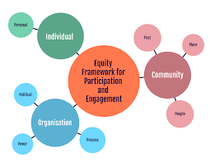
Assessing CAB collaborations
1. Capacity and Readiness
2. Collaboration Trust and Mistrust
3. Partnership Process
4. Integration of Community Knowledge
5. Empowering process
6. Community involved in research
7. Culture centered intervention
8. Partnership synergy
9. Appropriate research design
10. Research improvements
11. Individual improvements
12. Community improvements
iap2.org.au

Slide 59
CAB benefits
“We help to bring these great studies to make them usable to people, because sometimes there's so much good stuff out there, it’s like drinking from the proverbial fire hose.”
“It's educating people so that they'll be more likely to participate. And that's the part that I really like.”
I feel reinvigorated after hearing all of this stuff.”
CAB challenges
“We’re looking for things that we could actually make an impact and to take impactful actions within the community.”
“Maybe we should bring younger people to this table, like 18- to 25-year-olds, so just some different voices within the communities, because they might have different perspectives.”

Slide 60

NCI Vanguard – Multicancer Detection Tests
Community engagement studios:
154 participants, including community advisory board members (n=79), clinicians (n=58), and individual patients (n=17).
To identify clinician, patient, and community member perspectives on MCD tests and associated benefits, challenges, and risks to their routine use in practice.
Key themes identified
Potential benefits of MCD tests
Insufficient scientific evidence and clinical validation for MCD tests
How to manage abnormal test results
Financial costs and time burden associated with MCD testing and follow-up care
Potential physical and psychological harm of false positives overdiagnosis, and overtreatment
Potential inequities in access and outcomes, particularly in underserved communities

Slide 61
Research that Responds to Local Needs and Challenges

Slide 62

Professional Shortages

Slide 63
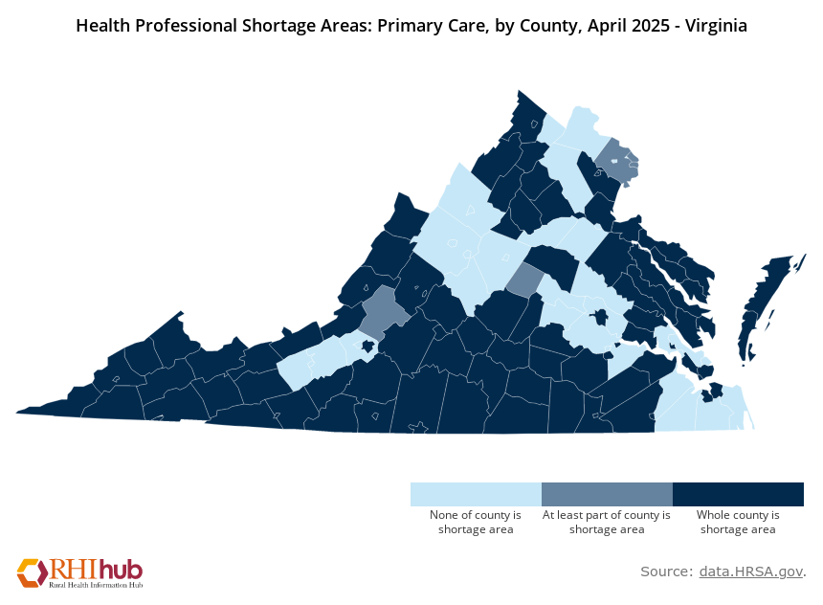
Professional Shortages
Clinician or staff turnover
13% -> 42% from 2018 to 2022
Interviews with 13 practices in Virginia HPSAs that experienced high levels of turnover

Slide 64
Challenges of rural healthcare
  Distance from urban centers and limited workforce.
High turnover of clinicians and staff, particularly mid-level providers (NPs and PAs)
  Stay less than a year - inexperience, limited training, and the desire for higher pay and specialization.
NPs using PC as training ground
  Practices hire NPs to address financial challenges and patient volume. Using PC as training ground and then moving to specialty care and higher pay.
Limited scope of work for RNs and MAs
  Low participation in chronic disease management and patient education undermining job satisfaction and retention.
"Replacing people has been incredibly difficult. Nursing, medical assistance, even front desk staff. It's just an area where the workforce is pretty limited."
"They just don't really seem to stay, but I think we attract them because that's who we have that will apply to jobs in the middle of nowhere. People with no experience."
“Many, many of the young people are jumping from job to job to get a better economic situation."
"They're offering a higher salary compared to what we can offer. So, of course, when you're competing against them, they're offering more than what we can offer."
"If you were able to allow them to do those other things, they might not leave."

Slide 65

Advanced Primary Care Management (APCM)
Fee-for-service Value-based care
Expand interprofessional teams, develop patient-centered comprehensive care plans, manage care transitions, improve communication, and strengthen population health management.
NINR collaboration to determine:
How do practice size, ownership, and patient population influence practice intention and plans to adopt APCM?
What are the perceived training needs and concerns among nursing staff related to the expanded roles and responsibilities under APCM?
How will APCM impact daily workflows, care coordination activities, and team dynamics within primary care practices?
What are the regional differences and variations in implementation strategies and challenges across Virginia?

Slide 66

Practice Ownership

Slide 67

Shifts in Ownership
Between 2019 and 2022, U.S. hospitals and other corporate entities acquired 36,200 additional clinician practices (a 38%increase)
Unprecedented stresses and financial challenges put on primary care amidst the COVID-19 pandemic
    Saved practices on the brink of foreclosure
68% of active AAFP members are now employed
    90% of positions offered to new residency graduates are employed rather than independent
In Virginia, shift from 25% -> 43% of practices owned by a health system between 2018-2022
(theispot.com/Harry Campbell)

Slide 68

Research Gaps
Lack of research on how primary care clinicians respond to and are affected by these shifts, and to what extent this facilitates or undermines practices’ ability to promote NASEM elements of high-quality care and whole health
Previous studies have overlooked:
  Impact of regional differences
  Micro-level variations in experiences across different health systems
  Impact of specific socioeconomic conditions unique to a given historical moment

Slide 69
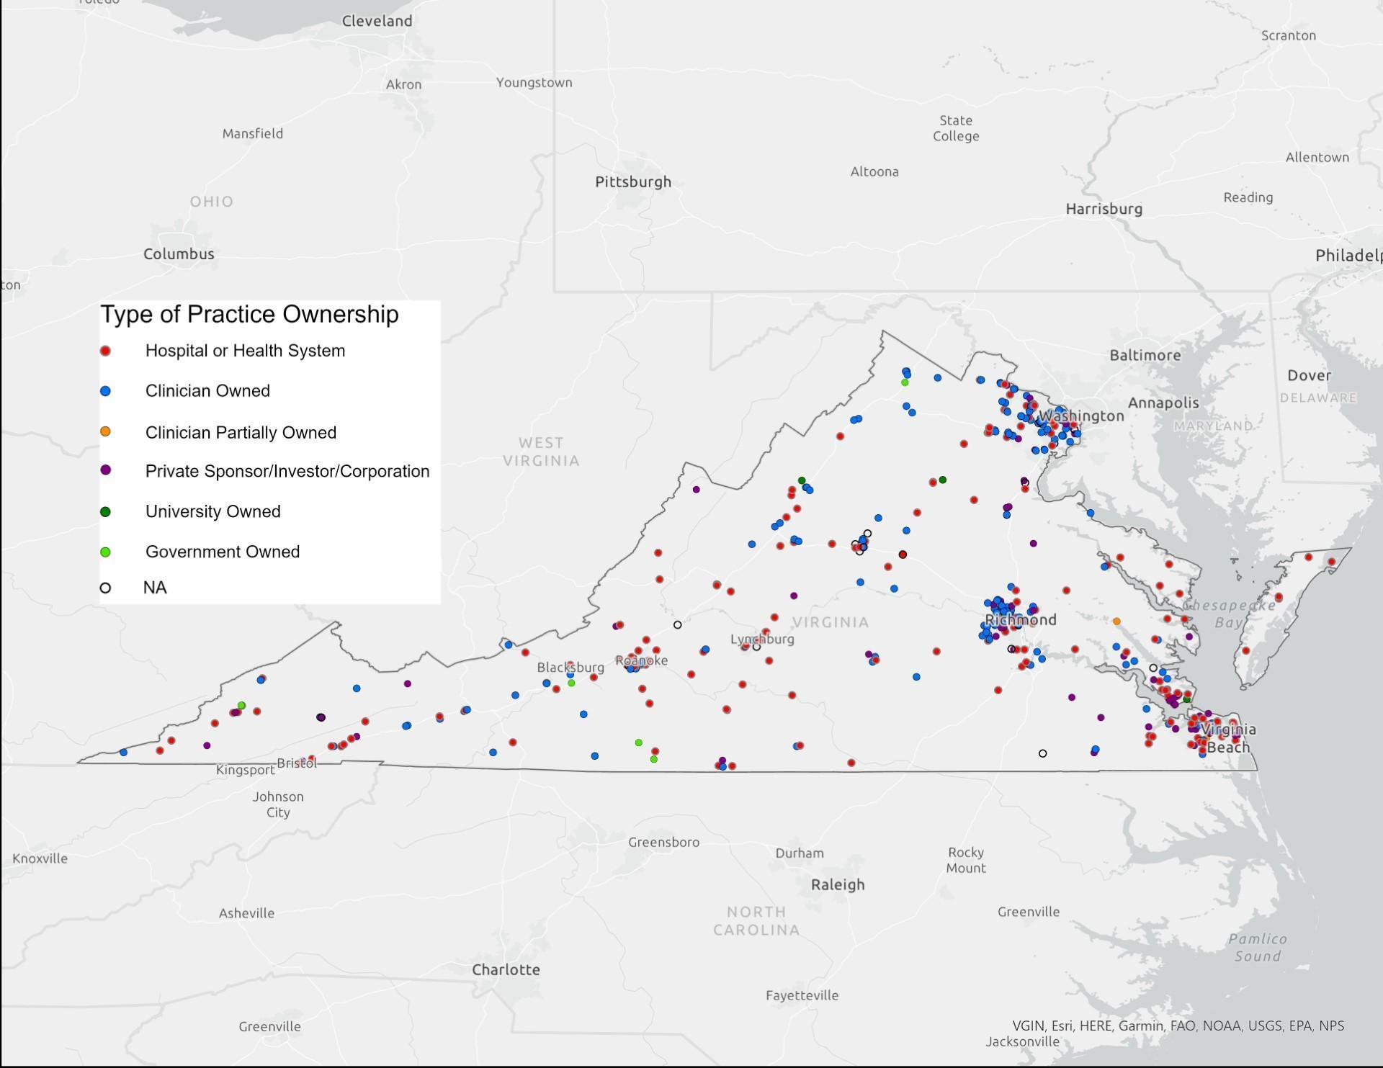
Study Sample
Random sample of 30 practices (10 of each of the following types) that have in the past five years either:
(a) moved from clinician to hospital/health system ownership
(b) stayed clinician owned
(c) stayed hospital/health system owned

Slide 70
Multimedia Survey & Interviews
Collaborate with NASEM report authors to develop a multimedia elicitation survey that presents a brief overview of the reports’ findings
Assess perspectives attitude, current practice, confidence of future improvement on the 5 core NASEM elements
Interview practice teams to assess the impact of ownership and practice setting on their ability to deliver high-quality primary care, and identify and describe other organizational, practice, and individual factors influencing care quality

Slide 71





Serving Primary Care by Knowing Primary Care
Develop mechanisms for regularly gathering information about practices
Invest in cultivating person-centered, long term relationships with practices
Elicit feedback on current challenges, priorities, and interests
Incorporate perspectives and experiences into study design and engagement activities
Conduct research responsive to practice identified needs

Slide 72
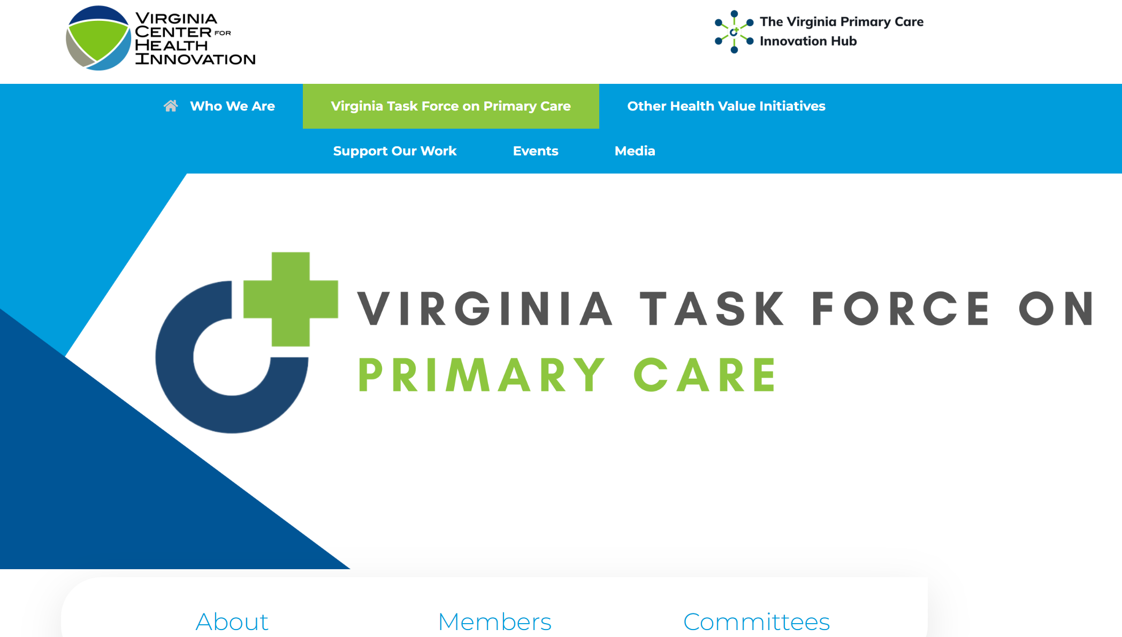

Slide 73
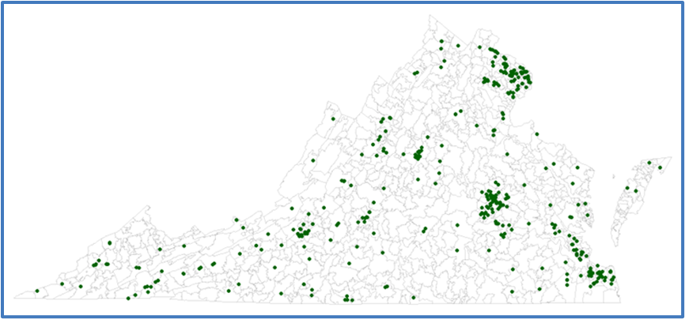
Changing What it Means to Be in ACORN
Create an Advanced Primary Care Management (APCM) learning community
Provide practice- and clinician-level benchmarked feedback
526 (26.7%) ACORN practices

Slide 74
PBRNs matter
Primary care, communities, and policy-makers need PBRNs

Slide 75

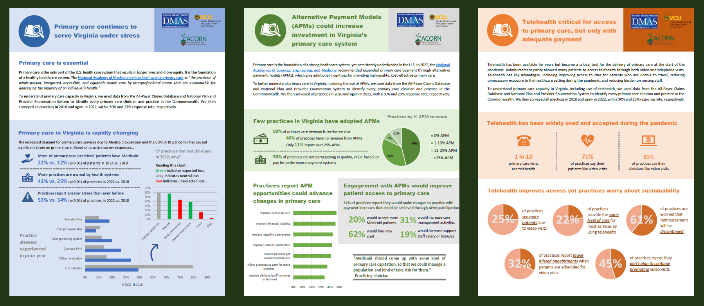


Read more about our primary care evaluations!
Alexander.krist@vcuhealth.org
Jacqueline.britz@vcuhealth.org
Edward.brooks@vcuhealth.org
Notes:
Exploring the role of APPs
Further exploration of the 4Cs including identifying factors correlating with high quality primary care
Exploring new measures to full measure high quality primary care (e.g., additional measures of comprehensiveness)
Pbrn data helping both to understanding
Access
High quality primary care
What to do about that- solution, policy framing + training
Take aways – reiterate that these data sets & methods, give snapshot/profile of what primary care looks like from access +quality at local level

