Slide 1

Increasing Implementation and Assessing Affordability of Continuous Glucose Monitoring in Primary Care
PRimary Care Education & Practice Adoption Resource Evaluation for Continuous Glucose Monitoring (PREPARE 4 CGM) study
Sean Oser, MD, MPH
Douglas Fernald, MA
Tristen Hall, PhD, MPH
Kristin Crispe, MPH
Jessica Parascando, MPH
Kimberly Wiggins, MA, MEd
Chelsea Sobczak, MPH
Danika Buss, BA
W. Perry Dickinson, MD
L. Miriam Dickinson, PhD
Tamara Oser, MD

Slide 2
Session Overview:
Why is CGM in primary care important?
Overview of PREPARE 4 CGM Study
Practice characteristics and choice of CGM implementation strategy
CGM implementation outcomes
Patient outcomes: BMI and willingness to pay
Q & A

Slide 3
Objectives
Describe three strategies for implementation of continuous glucose monitoring in primary care settings.
Describe changes in implementation of CGM workflows to identify patients for CGM, facilitate insurance authorization for CGM, use CGM data to inform diabetes care, engage patients in CGM education and shared decision-making, bill for CGM-related services, and maintain CGM use.

Slide 4
The Importance of Primary Care in Use of CGM
50% of adults with type 1 diabetes and 90% of people with type 2 diabetes receive their diabetes care in primary care settings.
A recent national study demonstrated only 38.6% of primary care clinicians and physicians have ever prescribed CGM.
The same study showed that having prescribed CGM previously was associated with increased likelihood to prescribe CGM in the future (OR 7.44, p<.001).
Many people can’t see endocrinology due to health-related social needs (e.g., work attendance, transportation, lack of insurance).
Many people also prefer to receive their diabetes care through their PCPs.

Slide 5
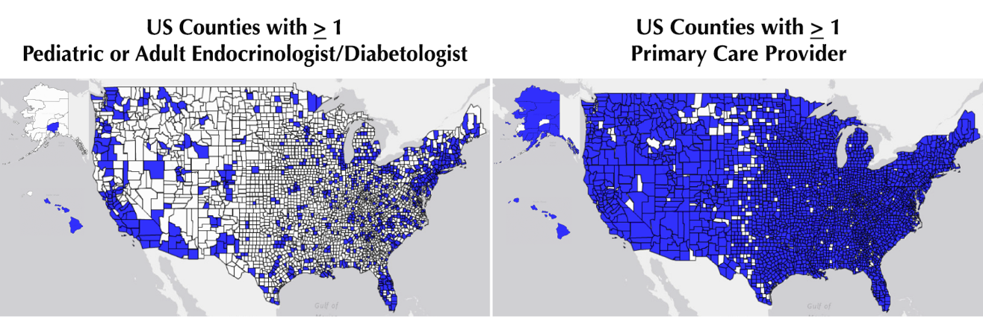
We need both primary care and endocrinology to care for people with diabetes—we are all in this together.
Distributions of Endocrinologists/Diabetologists and Primary Care Providers Across the United States
Oser SM, Oser TK. Diabetes Technologies: We Are All in this Together. Clinical Diabetes 2020 April;38(2):188-9. https://doi.org/10.2337/cd19-0046. PMID: 32327892.
‹#›

Slide 6
Evidence continues to build, and insurance is following
ADA Standards increase CGM recommendations for people with diabetes as evidence is generated
Insurance is following….as of 2023 Medicare now covers CGM for people with diabetes on “insulin” or with “problematic hypoglycemia”
Professional CGM is an option for people who may benefit and not have insurance coverage/authorization for personal CGM
‹#›

Slide 7
Project Overview:
To evaluate the effectiveness and scalability of
three CGM implementation strategies
for primary care practices:
  AAFP Transformation in Practice Series (TIPS) CGM alone
  AAFP TIPS with the addition of practice facilitation
  Refer to a local Virtual CGM Initiation Service (virCIS) with a one-time virtual CGM workshop.

Slide 8
Project Overview
AAFP TIPS CGM
alone
Goal: n=20
Practice-level implementation using
AAFP TIPS CGM
Goal: n=40
Randomization
Practices approached for participation across Colorado
Goal: N=60
AAFP TIPS CGM
+ practice facilitation
Goal: n=20
Practice choice
1-time webinar on CGM basics plus referral to virtual CGM initiation clinic (virCIS)
Goal: n=20

Slide 9
Recruitment: CGM interest in primary care is high!
AAFP TIPS CGM
alone
Goal: n=20
Practice-level implementation using
AAFP TIPS CGM
Goal: n=40
Randomization
Practices approached for participation across Colorado
Goal: N=60
AAFP TIPS CGM
+ practice facilitation
Goal: n=20
Actual: 46
Practice choice
Actual: 76
1-time webinar on CGM basics plus referral to virtual CGM initiation clinic (virCIS)
Goal: n=20
87
-8 (chose not to participate)
-3 (ineligible)
N=76
Actual: 30

Slide 10
TIPS & TIPS + PF Study Arms
Providers & Team
Patients
Completed American Academy of Family Physicians (AAFP) Transformation in Practice Series (TIPS): CGM online educational modules:
  Four interactive lessons including team-based tools and slide decks to assist primary care practice with CGM implementation, including patient identification, patient education, data interpretation, using CGM for therapeutic decisions, ordering CGM, documentation, and billing
Prescribed CGM by primary care provider.
Received CGM initiation support, education, interpretation, and ongoing diabetes care and management from primary care team.
Completed surveys at baseline, 3, and 6 months.

Slide 11
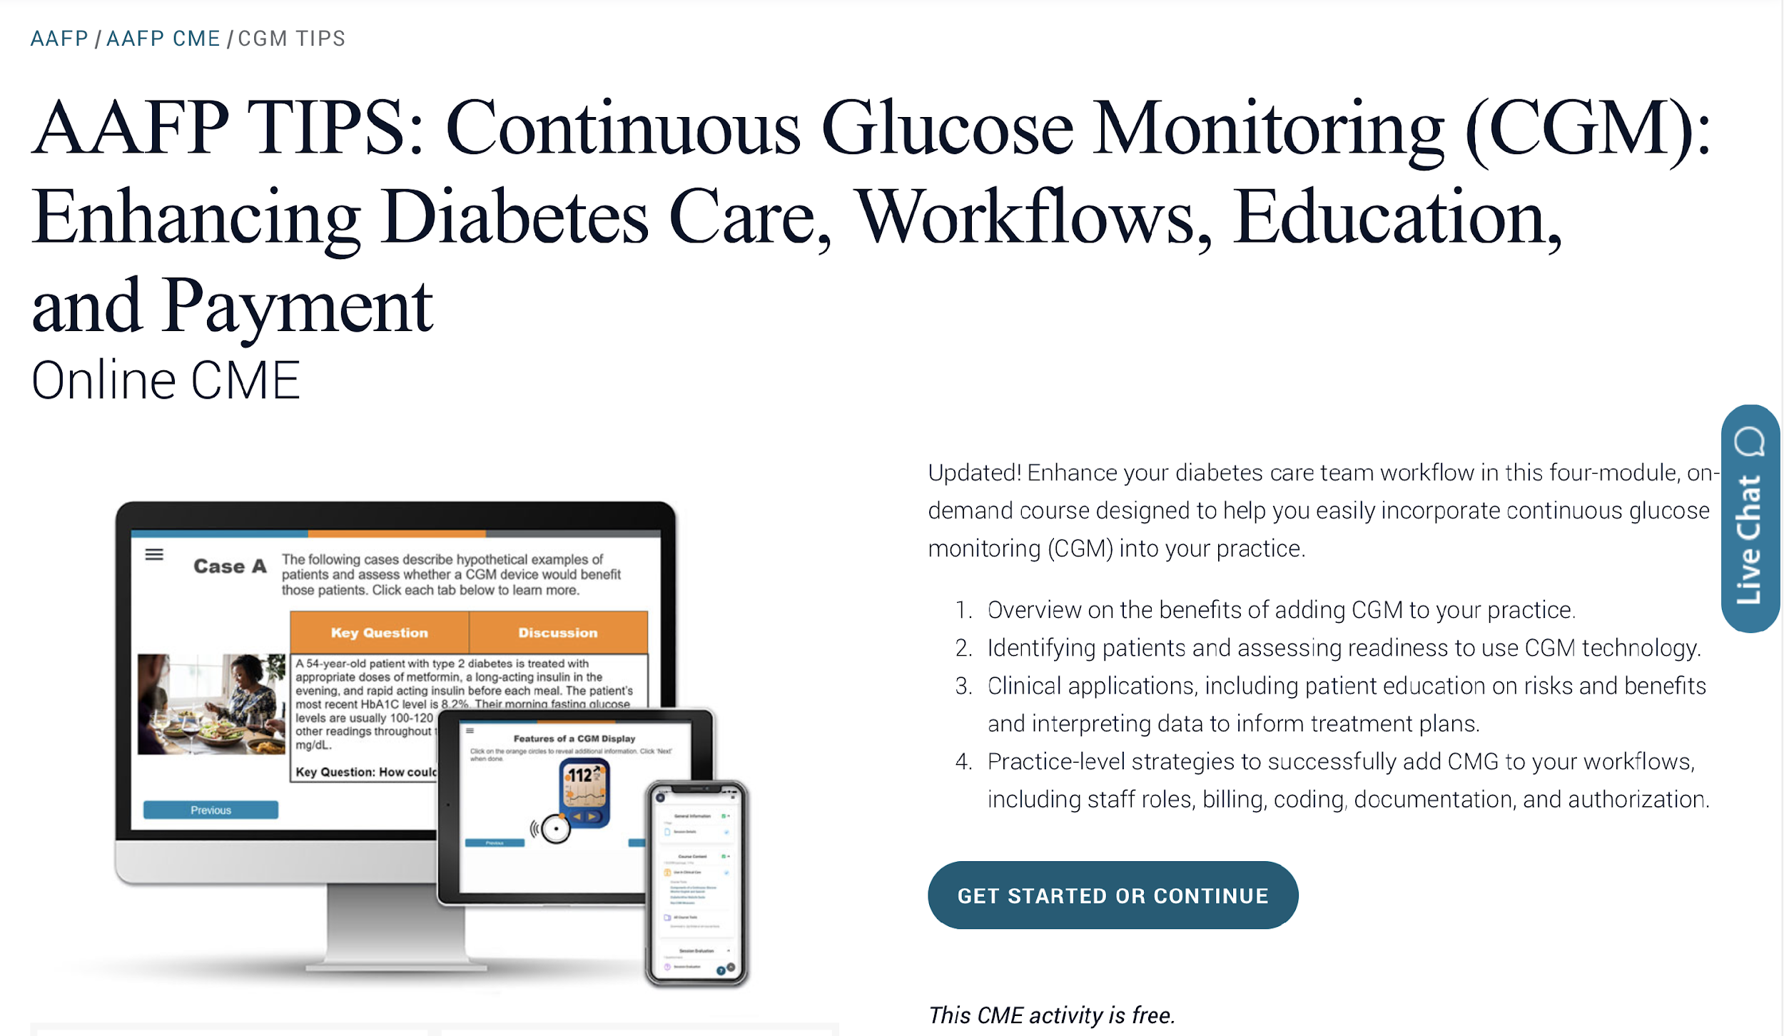

www.aafp.org/cme/all/endocrinology/cgm.html

Slide 12
TIPS + PF Study Arm
Providers & Team
Also received six sessions of remote or in-person practice facilitation over 6-12 months.
Facilitators used QI tools and strategies to assess priorities for and support CGM implementation.
(In addition to completing AAFP TIPS: CGM)

Slide 13
virCIS Study Arm
Providers
Patients
Attended a brief webinar on identifying patients who may benefit from CGM use, best practices for prescribing, and CGM interpretation.
Referred patients with diabetes for CGM initiation and management for 6 months.
Attended a virtual (video) CGM initiation visit and up to three 1-on-1 interpretation visits with a diabetes care and education specialist/RDN and pharmacist, with primary care physician supervision.
Received CGM, education on medications, diet and exercise and completed surveys at baseline, 3, and 6 months.

Slide 14
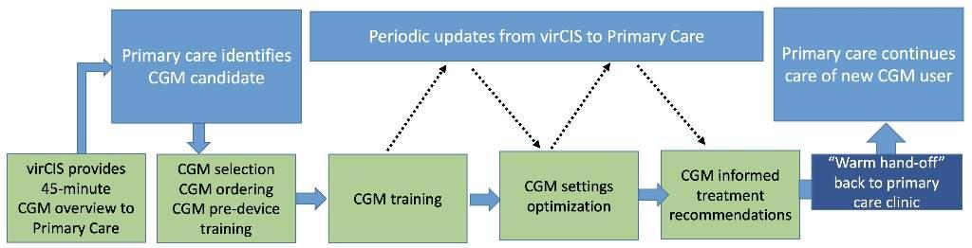
virCIS workflow: Primary Care Helping Primary Care
virCIS Staff
  RDN-CDCES
  Clinical pharmacists
  Primary care physicians
  Administrative lead and support
Notes:
Two goals: get pt on CGM 2) educate your practice / ultimately self-sufficient (NOT like referring out patients to a specialist and you never see them again – they reintegrated and we’re going to teach you about how to do this on your own). So after we see your patient three times over 6 months the practice is ready to do tha ton their own

Slide 15
virCIS Visit Schedule
Visit # ​ | Visit Topic and Timing ​ | Staff ​ | Visit Timing ​
1- Warm Up ​ | Explain virCIS workflow and timeline; discuss patient questions about virCIS and determine CGM best suited for patient. Determine if patient may be eligible for CGM prescription coverage, and if yes, initiate process. | RSP ​ | Upon referral from primary care provider​
2- CGM Initiation #1 ​ ​ | Initiate CGM and set up phone app or reader and connect to virCIS account. ​ | RDN/CDCES or PharmD ​ | As soon as patient receives CGM ​
3- CGM Interpretation #1 ​ | Interpret CGM data and discuss diet, physical activity, and DM medications. Goal setting for CGM and lifestyle changes. ​ ​ | RDN/CDCES or PharmD ​ | 10-14 days after initiation #1 ​
4- CGM Initiation #2 ​ | Initiate 2nd CGM sensor and adjust virCIS account connections as needed. | RDN/CDCES or PharmD ​ | 90 days after initiation #1 ​
5- CGM Interpretation #2 ​ | Interpret CGM data and compare with Interpretation visit #1. Adjust diet and physical activity and discuss DM medications. Goal setting for CGM and lifestyle changes. ​ | RDN/CDCES or PharmD ​ | 10-14 days after initiation #2, or 30 days after interpretation #2 ​
6- CGM Initiation #3 ​ | Initiate 3rd CGM sensor and adjust virCIS account connections as needed. | RDN/CDCES or PharmD ​ | 90 days after initiation #2 ​
7- CGM Interpretation #3 ​ | Interpret CGM data and compare with Interpretation visits #1 and #2. Adjust diet and physical activity and discuss DM medications. Goal setting for CGM and lifestyle changes. Discuss transition of CGM care to PCP; offer warm hand-off consult to PCP. ​ | RDN/CDCES or PharmD ​ | 10-14 days after initiation #3 or 30 days after interpretation #2 ​

Slide 16
Analysis Methods
Data sources: Practice surveys and clinical measures
General linear mixed models:
  Change over time in CGM implementation scores overall and by implementation strategy, adjusted for presence of CDCES, location, organization type, and specialty.
  Change over time in patient BMI overall and by study arm
Tests of association (chi-square, t-test): Comparison of practice characteristics by implementation strategy.
Descriptive statistics: Patient-level willingness to pay for CGM.

Slide 17
Results

Slide 18
Study arm selection: Evaluated ~40 practice characteristics related to choosing TIPS or virCIS.
  Practice size
    Staff number
    Provider number
    Visits/week
  Practice staff
    RN
    LPN
    MA
    CNA
    Front desk staff
    Administrative staff
    Behavioral health provider
    Care manager
    DCES
    Pharmacist
    Social worker
    Community health worker
  Diabetes profile
    T1D patients
    T1D patients using CGM
    T2D patients
    T2D patients using CGM
  Practice specialty: Family Medicine
  Practice Rurality
  Organization type
    Clinician-owned (solo/group)
    Hospital/System-owned
    Federally Qualified Health Center/Lookalike, RHC
  Payer mix
    Medicare
    Medicaid
    Dual-enrolled
    Private
    Other
    Uninsured
  Panel demographics
    Male
    Female
    Non-binary
    White
    Black
    Native American
    Asian
    Pacific Islander
    Other
    Unknown

Slide 19
Only 1 practice characteristic was associated with choice of TIPS or virCIS.
  Practice size
    Staff number
    Provider number
    Visits/week
  Practice staff
    RN
    LPN
    MA
    CNA
    Front desk staff
    Administrative staff
    Behavioral health provider
    Care manager
    DCES (X²=11.05, p<0.001)
    Pharmacist
    Social worker
    Community health worker
  Diabetes profile
    T1D patients
    T1D patients using CGM
    T2D patients
    T2D patients using CGM
  Practice specialty: Family Medicine
  Practice Rurality
  Organization type
    Clinician-owned (solo/group)
    Hospital/System-owned
    Federally Qualified Health Center/Lookalike, RHC
  Payer mix
    Medicare
    Medicaid
    Dual-enrolled
    Private
    Other
    Uninsured
  Panel demographics
    Male
    Female
    Non-binary
    White
    Black
    Native American
    Asian
    Pacific Islander
    Other
    Unknown
Practices selecting TIPS were more likely than those selecting virCIS to have a Diabetes Care and Education Specialist (DCES) in the practice (X²(1, N=62)=11.046, p <.001).
All other p>0.05

Slide 20
Increased Ratings of CGM Implementation
There was overall improvement over 12 months in CGM implementation scores (F(2,102)=64.71, p<.0001), with no overall difference between arms (F(4,102)=2.32, p=.0622).

Slide 22
Decreased BMI
There was a significant decrease in BMI of 0.33 kg/m² across arms (F(1,156)=5.32, p=.02).
  Among only patients using a CGM device, there was significant BMI reduction of 0.53 kg/m² (p<.01).
There was no difference in BMI change by study arm (F(2,177)=0.05, p=.96).

Slide 23
Willingness to Pay
59% (n=63) of patient participants agreed or strongly agreed that CGM was worth the cost.
52% (n=69) of patient participants indicated willingness to spend at least $75 per month on CGM sensors and all other required supplies.
Item | N | %
CGM is worth the cost I paid. Agree or strongly agree Neutral Disagree or strongly disagree | 107 63 33 11 | 58.9% 30.8% 10.3%
Maximum willing to pay $0 $75 $200 $500 [No response] | 133 64 57 9 3 7 | 48% 43% 6.8% 2.3% --
Maximum would recommend a friend pays $0 $75 $200 $500 [No response] | 130 54 60 12 4 10 | 42% 46% 9.2% 3.1% --

Slide 24
Conclusions
This study identified effective strategies to implement CGM in PC settings.
All three implementation strategies showed improvement in CGM implementation scores without differences between strategies.
Selecting an implementation strategy may depend on practices’ available resources, especially whether they have a DCES in the practice.
A DCES-led virtual CGM initiation service can extend DCES access to practices lacking access.

Slide 25
AAFP CGM resource page:
aafp.org/cgm
Provider videos – Acknowledging implicit bias, Shared decision making
Additional Resources:
DiabetesWisePro: https://pro.diabeteswise.org/
ADCES – diabetes technology for healthcare professionals: https://www.adces.org/education/danatech/home
‹#›

Slide 26






PREPARE 4 CGM has been
generously funded by:
THANK YOU
Study PIs:
Sean Oser, MD, MPH
Sean.Oser@CUAnschutz.edu
Tamara Oser, MD
Tamara.Oser@CUAnschutz.edu

