Slide 1
Factors predicting poor weight gain in newborns to guide weight monitoring: retrospective unmatched case-control study
Bryce Ringwald, MD and Emily Gorman, DO
OhioHealth Riverside Methodist Hospital Family Medicine Residency Program

Slide 2
The Research Question
Our study aimed to:
1) Identify characteristics (neonatal, maternal, social, or nutrition) related to not regaining birth weight by DOL 14
2) Determine criteria to guide recommendations for weight monitoring.
Hypothesis: We hypothesize that newborns with significant weight loss on initial weight check, prolonged fasting times, nulliparous birthing persons, documented feeding difficulties, and those negatively affected by social determinants of health are at increased risk of not regaining birth weight by DOL 14.

Slide 3
Research Design and Method
Exploratory retrospective unmatched case-control study
  Inclusion:
    Initial patient visit date range (07/01/201921 through 06/30/2022)
    Patient cared for by the Riverside Family Practice Center residency team in the well-baby nursery and established care at Riverside Family Practice Center
    ICD-10 codes: Z00.110 or Z00.111
    Completion of recommended follow-up
  Exclusion:
    Initial visit outside of the date range
    Initial visit performed after DOL 14
    Family members of practice staff or physicians
    Gestational age <35 weeks at birth
    Infants requiring care in the NICU

Slide 4
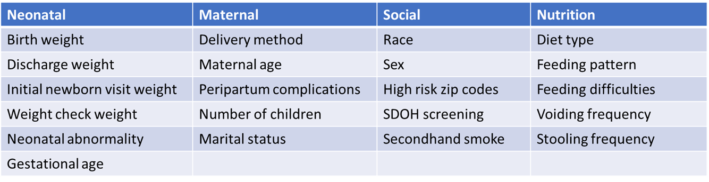
Research Design and Method
Characteristics Assessed

Slide 5
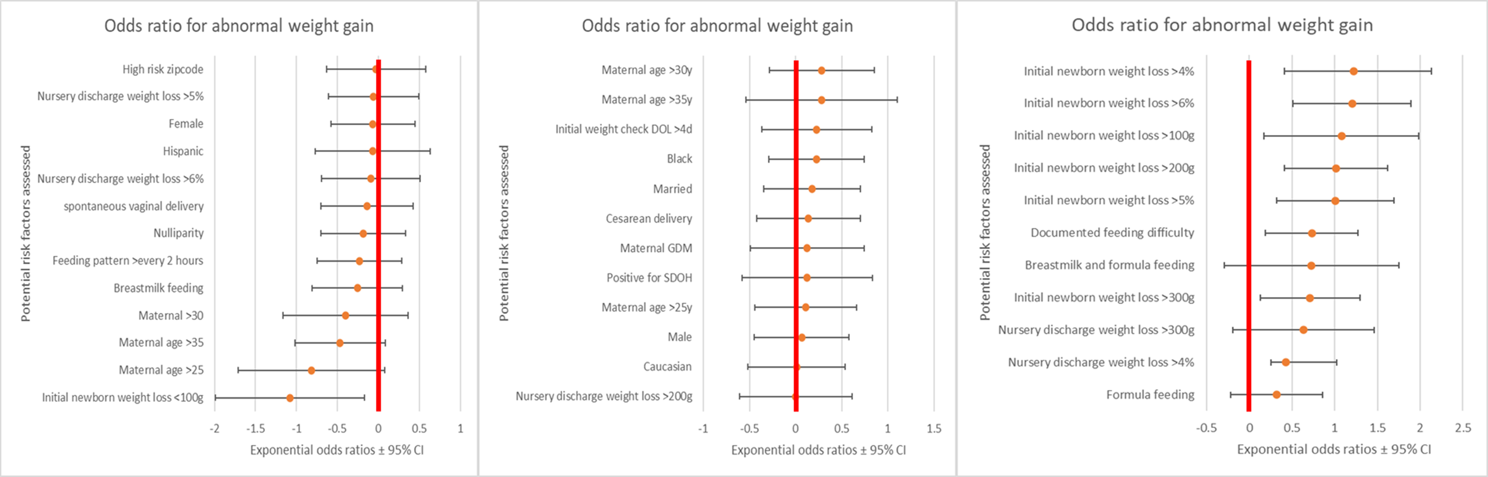
What the Research Found

Slide 6
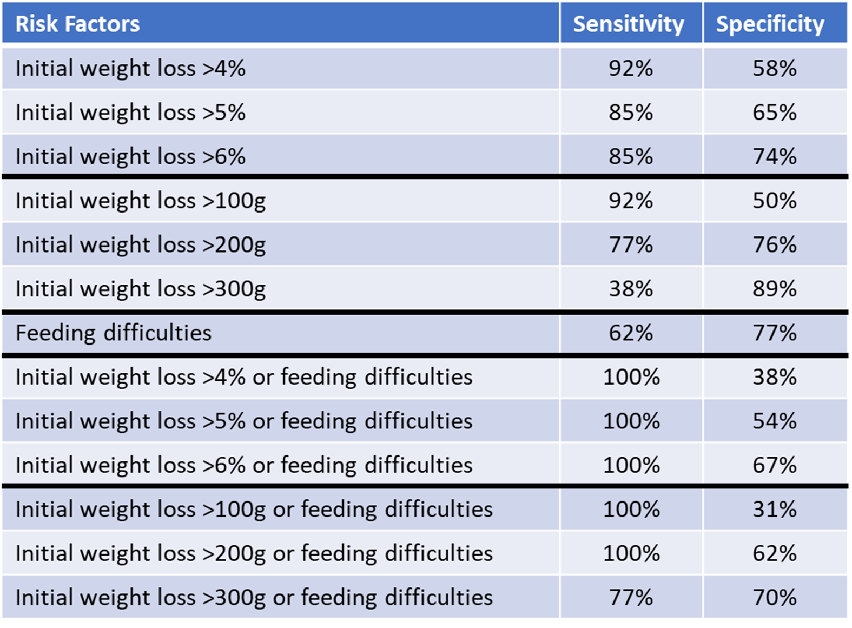
What the Research Found

Slide 7
What this means for Clinical Practice
Significant weight changes at initial newborn exam and documented feeding difficulties can predict newborns at risk of not regaining birth weight at DOL 14.
Utilization of these characteristics can decrease needed appointments on providers schedules, decrease travel time and costs for families.

