Slide 1
Lower Dementia Risk in Patients Vaccinated Against Herpes Zoster
Jeffrey F. Scherrer, PhD; Joanne Salas, MPH;
Christine Jacobs, MD; Daniel Hoft, MD; John Morley, MBBCh
Funder: Benter Foundation
Affiliation: Saint Louis University School of Medicine.
St. Louis MO. USA

Slide 2
The Research Question
Are patients, 65 years of age and older, less likely to develop dementia if they receive herpes zoster vaccination?

Slide 3
Research Design and Method
Retrospective Cohort Study 2009-2019
Hypotheses tested in Veterans Health Administration medical record data
Analyses replicated in MarketScan medical claims
Confounding controlled using propensity scores and inverse probability of treatment weighting
Variables created from ICD-9 and ICD-10 diagnostic codes, vaccinations, prescriptions, lab results, vital signs, provider type, geographic location in the United States and demographics

Slide 4
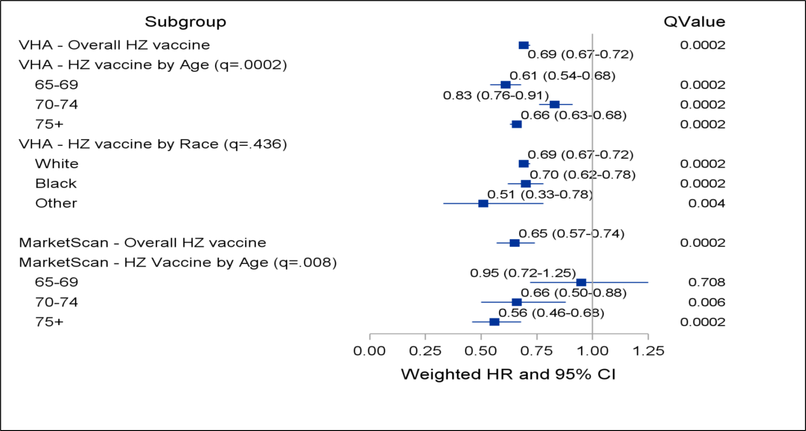
What the Research Found
Survival modeling results estimating association between HZ vaccination and incident dementia

Slide 5
What this means for Clinical Practice
Secondary benefits of vaccination may encourage some patients to obtain appropriate herpes zoster vaccination.
If confirmed as a causal association, vaccination could offer an inexpensive, readily accessible means to reduce risk for, or prevent dementia?

Slide 6
citation
Scherrer JF, Salas J, Wiemken TL, Hoft DF, Jacobs C, Morley JE. Impact of Herpes Zoster Vaccination on Incident Dementia: A Retrospective Study in Two Patient Cohorts. PLoS One. 2021;16(11):e0257405. PMID: 34788293

Slide 8
Risk of overdose and mental health crisis associated with dose disruption in patients on long-term lower dose opioid therapy
Alicia Agnoli, MD, MPH, MHS; Guibo Xing, PhD; Daniel Tancredi, PhD; Elizabeth Magnan, MD, PhD; Anthony Jerant, MD; Joshua Fenton, MD, MPH

Slide 9
The Research Question
Given large pressure to de-prescribe long-term opioid therapy, and recent findings suggesting opioid tapering may be associated with increased risk for drug overdose and psychological distress…
What is the risk of overdose and mental health crisis associated with opioid dose disruption in patients prescribed long-term lower dose opioid therapy?

Slide 10
Research Design and Method
Data source: OptumLabs Data Warehouse, 2008-2019
Study population: Adults taking stable, long-term, lower dose opioid therapy
  Oral or transcutaneous opioid therapy 10-49 MME/day, <10% monthly fluctuation in dose
  Observed for up to 12 months after cohort entry
Exposure: 50-100% relative reduction of average daily opioid dose during any one of six overlapping 60-day windows within the first 7 months of follow-up.
Outcomes: Modeled monthly counts of outcome events using event history analysis with tapering status specified as a time-varying covariate
  Drug Overdose: Hospitalization or ED visit for overdose, alcohol intoxication, or drug withdrawal during the 12 month follow up
  Mental Health Crisis: Hospitalization or ED visit for depression, anxiety, or suicide attempt
Negative binomial regression to estimate adjusted incidence rate ratios and rate differences by tapering status

Slide 11
Six overlapping 60-day periods for ascertaining dose disruption/discontinuation*
Baseline period
(6 months)
Period 1
Period 3
Period 5
Stable baseline period
(12 months)
Period 2
Period 4
Period 6
Month
1
Month 2
Month 3
Month 4
Month 5
Month 6
Month 7
Month 8
Month 9
Month 10
Month 11
Month 12
Up to twelve 30-day follow-up periods (person-months) for identifying outcome events
*Dose disruption: ≥ 50% reduction in average daily dose (compared to baseline)

Slide 12
What the Research Found
N= 369,085 patients
  9.6% of patients had a ≥50% dose reduction
  5.6% of patients completely discontinued opioids
Dose reduction ≥50% (compared to continuing at baseline dose) associated with increased risk of
  Overdose: aIRR of 1.28 (95% CI: 1.14-1.44)
  Mental health crisis: aIRR 1.57 (95% CI: 1.36-1.82)
Discontinuing opioids:
  aIRR 1.25 (95%CI: 1.08-1.45) for overdose, aIRR of 1.79 (1.46-2.20) for mental health crisis.

Slide 13
What this means for Clinical Practice
Among patients prescribed stable, long-term lower dose opioid therapy, large relative dose reductions (50% or more) were associated with increased risk of overdose and mental health crisis.
These findings suggest greater caution is needed in opioid dose reduction or discontinuation among long-term patients, even among those at lower doses

Slide 15
Achievement of Glycemic Control and Antidepressant Medication Use in Comorbid Depression and Type II Diabetes
Jay Brieler, MD, Joanne Salas, MPH, Jeffrey Scherrer, PhD
Saint Louis University Department of Family and Community Medicine
North American Primary Care Research Group 2021

Slide 16
The Research Question
In patients with depression who are diagnosed with uncontrolled type 2 diabetes mellitus, is treatment with anti-depressant medication associated with achievement of glycemic control?

Slide 17
Research Design – Patient Identification
Diabetic patients identified using ICD-9 and ICD-10 codes (n=374,630)
Inclusion criteria for age and co-morbidity (n=142,802)
  18-64 yo
  No Cancer or HIV
  Cannot have had 3 or more steroid prescriptions in previous year
Diagnosis of depression at least a year prior to first DM diagnosis (n=23,487)
A1c available with 3 months prior to first DM diagnosis, >7.0 (n = 9,972)
Complete data set including follow-up available (n = 7,332)

Slide 18
Research Design – Exposure and Outcome
3 level exposure variable:
  Adequate ADM: Prescription of ADM for >12 weeks in the year prior to DM diagnosis including >= 3 prescriptions within a 4 week period
  Inadequate ADM: less than 3 prescriptions in all 4 weeks periods for ADM
  No ADM
Outcome = glycemic control at follow-up
  Defined as A1c < 7.0% (ADA 2015)

Slide 19
Research Design – Co-Variates
Baseline A1c
Oral diabetic medication
Insulin use
Anxiety Disorder
Hypertension
Hyperlipidemia
Vascular Disease
Obesity
Smoking history
Gender
Race
Insurance status
Volume of Health Care Utilization

Slide 20
Research Design – Analysis
A Cox proportional hazards model in unweighted and weighted data assessed the association of adequate ADM treatment and time to glycemic control, expressed with hazard ratios and 95% confidence intervals
Bivariate analyses using chi-square tests for categorical variables and one-way ANOVA for continuous variables estimated the association between covariates and adequate depression treatment group.
All baseline covariates and demographic factors were balanced across exposure groups using propensity scores and inverse probability treatment weighting (IPTW).
Standard mean differences before and after IPTW weighting estimated effect size differences between all adequate ADM treatment group pairwise comparisons.

Slide 21
What the Research Found
Association between antidepressant medication (ADM) group and glycemic control. Results from extended Cox Models with heaviside function (time < 36 months vs. 36 to < 72 months vs. time ≥ 72 months), crude (unweighted) and weighted
 | Crude HR (95% CI) | Weighted HR (95% CI)
Observation months < 36
No ADM treatment | 1.00 | 1.00
Inadequate ADM treatment | 1.19 (1.10-1.29) | 1.06 (0.96-1.17)
Adequate ADM treatment | 1.29 (1.17-1.43) | 1.17 (1.02-1.34)
Observation months 36 - < 72
No ADM treatment | 1.00 | 1.00
Inadequate ADM treatment | 1.09 (0.88-1.37) | 1.09 (0.83-1.43)
Adequate ADM treatment | 0.77 (0.54-1.10) | 0.78 (0.51-1.20)
Observation months ≥ 72
No ADM treatment | 1.00 | 1.00
Inadequate ADM treatment | 0.82 (0.36-1.88) | 1.02 (0.37-2.81)
Adequate ADM treatment | 0.50 (0.11-2.21) | 0.33 (0.06-1.94)
Note: Proportional hazard assumption met in each model, p>0.20

Slide 22
What the Research Found
In patients with depression who are subsequently diagnosed with uncontrolled type 2 diabetes mellitus, adequate treatment with antidepressant medication is associated with achievement of glycemic control within the first 36 months from diagnosis.
This statistically significant effect remains after controlling for a variety of co-variates.
No statistically significant effect was seen beyond 36 months.

Slide 23
What this means for Clinical Practice
In patients with co-morbid depression and diabetes, adequate medical treatment of the depression is associated with better control of blood sugar.

Slide 25
Medical Assistant Perceptions of Influences on Job Satisfaction and Job Burnout
Tristen Hall, MPH
University of Colorado Department of Family Medicine

Slide 26
The Research Question
What are medical assistants’ (MAs) perceptions of factors that influence their employee outcomes, such as job burnout and job satisfaction?

Slide 27
Research Design and Method
Study Design: Qualitative phase of exploratory sequential mixed methods study
Data Collection Method: In-person focus groups (before March 2020) and individual interviews by Zoom or phone
Analysis Method: Qualitative analysis – grounded editing approach

Slide 28
What the Research Found
Influences on job satisfaction and burnout, according to MAs:
  Heavy workload from added responsibilities, staffing levels leads to burnout, other negative feelings
  “I think the job burnout is largely… they keep adding things for us to do. It's, ‘Oh, it only takes one or three or five or ten more clicks.’ And it's like OK, but that's with 26 patients a day.”
  Lack of recognition from practice leadership and general public hinders job satisfaction
  “Sometimes you do feel with the work overload that you have in one day that you that you're just so tired. And you just don't feel like you get the same respect as somebody else.”

Slide 29
What the Research Found
Influences on job satisfaction and burnout, according to MAs:
  Low pay is inadequate for workload, reflects lack of recognition
  “We get paid very low. I have a daughter in law that works in the grocery store and she gets paid more than I do. So that's painful because I went to school. I got a degree and we also work so hard, we're on our feet. I average about 10,000 steps a day up and down the halls and the pay just doesn't compensate.”
  Work support, both tangible and emotional, from leadership, clinicians, and other MAs can alleviate burnout, promote satisfaction
  “I think it's just balance, it's taking the load off of the people that you consciously know are doing just a little bit more with their providers and pick up longer hours or do more things that way. I think that is the biggest help.”

Slide 30
What the Research Found
Influences on job satisfaction and burnout, according to MAs:
  Other positive influences :
    Helping and getting to know patients
    Learning from the job
    High levels of responsibility and job variety

Slide 31
What this means for Clinical Practice
Primary care practices can promote job satisfaction and prevent burnout for MAs in the following ways:
  Ensure pay is competitive for market
  Institute pay scales that reward taking on additional tasks or education
  Foster a work environment that encourages social support and sharing workloads
  Balance increasing workloads with variety in the work that MAs perform
Supporting MAs in these ways may help with retention

Slide 33
The association between trauma exposure and prescription opioid use duration in non-cancer pain
Ivana Massabki¹, Lisa Matero², Brian Ahmedani², Lynn Debar³, Joanne Salas⁴, Sarah Gebauer⁴, Patrick J. Lustman⁵, Mark D. Sullivan⁶, Jeffrey Scherrer⁴
1) Saint Louis University School of Medicine, St. Louis, MO. 2) Center for Health Policy and Health Services Research and Behavioral Health Services, Henry Ford Health System, One Ford Place, Detroit, MI. 3) Kaiser Permanente Washington Health Research Institute, WA. 4) Department of Family and Community Medicine, Saint Louis University School of Medicine, St. Louis, MO. 5) Department of Psychiatry, Washington University School of Medicine,. St. Louis, MO. 6) Department of Psychiatry and Behavioral Science, University of Washington School of Medicine, Seattle WA

Slide 34
The Research Question
Context: The relationship between trauma exposure and opioid misuse has been investigated extensively. However, less is known about the association between traumatic stress and chronic prescription opioid use in patients with non-cancer pain. As opioid prescribing remains a common strategy for pain management, understanding this association is important to mitigate patient harm.
Objective: To determine whether non-cancer pain patients with trauma exposure have longer prescription opioid use than those without trauma.

Slide 35
Research Design and Method
Study Design: Cross-sectional
Dataset: Survey data obtained from ongoing baseline assessment of longitudinal study.
Population Studied: 489 patients who had been using prescription opioids for 30-90 days and had not used opioids for at least 3 months prior to the current episode of use.
Exposure: trauma (Life Events Checklist-5)
Outcome: opioid duration (≥90-day opioid use)

Slide 36
What the Research Found
Patients were on average 52.3 (SD±12.4) years of age, 66.5% female and 67% white race.
62.8% reported trauma history, and compared to those without trauma, they were significantly (p<0.05) younger, female, and had more pain sites, higher pain interference, as well as depression, anxiety, and smoking histories.
Unadjusted analysis revealed trauma vs. no trauma was associated with >90 day opioid use (OR=1.37; CI:0.94-1.99). After adjusting for age, gender, race, number of pain sites, pain severity, pain interference, anxiety, depression, substance use disorder history, and smoking, the association remained (OR=1.42; CI: 0.96-2.10).
No significant association was found between positive PC-PTSD-5 screen and opioid use duration in patients with trauma history.

Slide 37
What this means for Clinical Practice
Patients with trauma history have prolonged prescription opioid use. This relationship appears to be independent of PTSD symptoms.
Exposure to traumatic stress should be considered among other risk factors, such as depression, that are correlated with chronic prescription opioid use.
This study highlights the need for trauma-informed, patient-centered pain management.

Slide 39
Does De-implementation of Low-Value Care Impact the Patient-Clinician Relationship? A Mixed Methods Study
Michelle S. Rockwell, PhD, RD
Kenan C. Michaels, BA
John W. Epling, MD, MSEd
Department of Family & Community Medicine
Virginia Tech Carilion School of Medicine
Roanoke, Virginia

Slide 40
The Research Question
Low-value care is a health service that offers no patient benefit in specific clinical scenarios.
  It is prevalent, costly, and causes harm.
  De-implementation has proven to be very difficult.
One barrier to low-value care de-implementation is clinicians’ fear of negatively impacting the patient-clinician relationship.
Thus, our mixed-methods study aimed to answer:
Does de-implementation of low-value care impact the patient-clinician relationship?

Slide 41
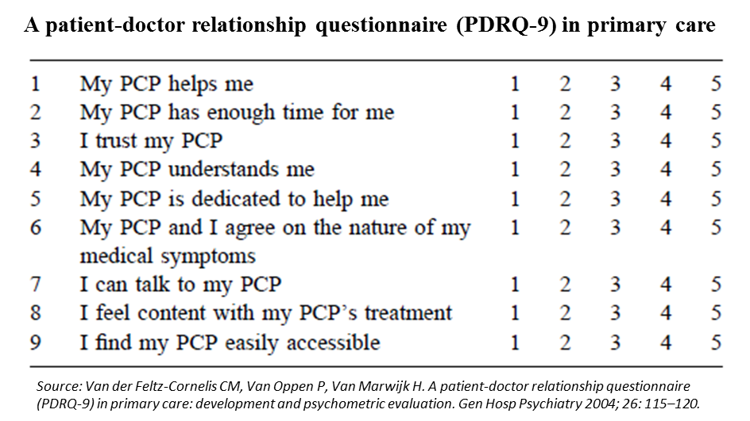
Research Design and Method
Participants
  Primary care patients from a large health system in southwest Virginia
Qualitative (interviews)
  After hearing a vignette about a patient who desired low-value 1)antibiotics for viral URI or 2)EKG screening, participants responded to semi-structured interview questions.
  Transcripts were coded and themed using open-coding and directed content analyses.
Quantitative (survey)
  After reading a vignette about a patient who desired low-value 1)antibiotics for viral URI, 2)EKG screening, 3)vitamin D screening, OR a 4) control vignette, participants responded to the PDRQ-9.
Data integration
  At the interpretation/reporting level

Slide 42
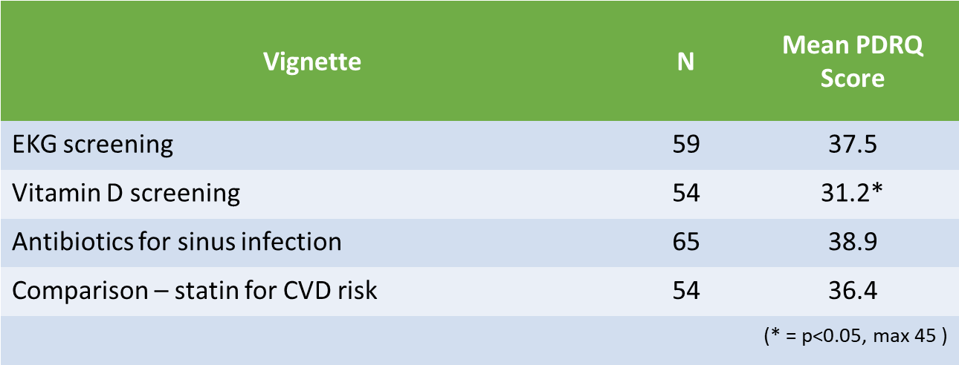
What the Research Found
Impact of de-implementation on the patient-clinician relationship
 | Understand? | Agree? | Impact Relationship?
Low-value antibiotics | 100% yes | 100% yes | 8% yes
Low-value EKG | 100% yes | 42% yes | 8% yes
Interview
Survey
Although there was some variation by service, we observed minimal evidence that the patient-clinician relationship would be negatively impacted by de-implementation.
* Higher PDRQ-9 score = greater relationship integrity

Slide 43
What the Research Found
Several participants expressed that if their clinician withheld low-value care, it would increase their trust in them.
Other themes:
  The majority of participants demonstrated incomplete understanding of the concept of low-value care.
  The low-value care topic consistently elicited memories of poor quality care and other negative experiences with healthcare.
  Participants repeatedly expressed their trust in their primary care clinician and the value they place in that relationship.

Slide 44
What this means for Clinical Practice
In the presence of a trusting, communicative patient-clinician relationship, patients stand ready to play a role in de-implementing low-value care.
But it’s important to keep in mind that the concept is very difficult for many patients to understand and service-specific differences may exist.

Slide 45
Rockwell, M.S., Michaels, K.C. & Epling, J.W. Does de-implementation of low-value care impact the patient-clinician relationship? A mixed methods study. BMC Health Serv Res 22, 37 (2022). https://doi.org/10.1186/s12913-021-07345-9

Slide 47



General practitioners' perspectives and experiences when screening for primary aldosteronism
Mr Abhir Nainani, Dr Sanne Peters, Dr Jun Yang, Prof. Grant Russell

Slide 48
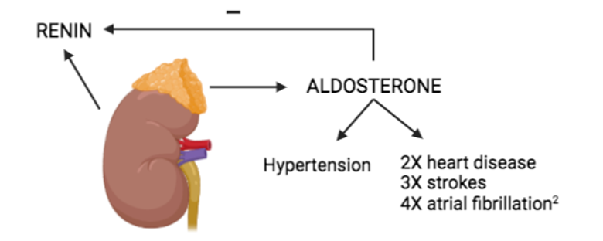
The Research Question
Primary aldosteronism (PA) is the commonest treatable cause of secondary hypertension
  4-16% of primary care patients with hypertension
PA is easy to detect by screening with an aldosterone-renin ratio
  But frequently overlooked
We taught a group of family physicians (FPs) how best to screen for PA
  But still found highly variable screening rates…
So… are there other factors that may impact on screening?
Our research question was:
  What factors influence a FP’s decision to screen for PA?

Slide 49
Research Design and Method
Design: Qualitative study using a phenomenological approach
Participants: Purposeful sample of FPs working in Melbourne, Australia who had received a 30-minute educational session on PA within the last 12 months
  FPs varied by practice location, experience and the number of patients screened for PA
Data collection: Semi-structured interviews
  Face-to-face or online lasting 30-45 minutes
  Participants received a summary of their interview (member checking)
Analysis: Coded inductively using NVivo 12.0
  2 independent coders (investigator triangulation)

Slide 50
What the Research Found
We interviewed16 FPs – their screening decisions were influenced by their knowledge of the screening process, perceptions about the cost & convenience of screening, conceptualization of risk related to PA, and a desire to improve clinical care.
Most were positive to the concept of screening once it was introduced to them
However, many found it challenging to follow guidelines to alter antihypertensives prior to performing the aldosterone-renin ratio
  Hence, they overwhelmingly preferred screening newly diagnosed hypertensive patients
Most were also reluctant to screen patients who fitted a “clinical picture of essential hypertension”
  These were hypertensive patients with metabolic syndrome and/or cardiovascular disease

Slide 51
What this means for Clinical Practice
FPs require:
Clear and concise guidelines on PA screening
  Including information on how to safely replace antihypertensives before screening for PA
FPs should understand that:
Metabolic syndrome and cardiovascular complications are more common in PA than essential hypertension
  PA is generally clinically indistinguishable from essential hypertension
Future research should:
Evaluate simpler methods of PA screening that do not require replacing antihypertensives
Explore system-based strategies to increase screening rates in primary care

Slide 53


Video Visit Triage and Clinical Effectiveness in a Primary Care Setting
Elyse Gonzales, BS; Doris Chen, MD; Marcy Winget, PhD; Jonathan Shaw, MD, MS; Ian Nelligan, MD, MPH

Slide 54
The Research Question
The COVID-19 pandemic has catalyzed the use of video visits in primary care
While it’s estimated that a majority of primary care visits can be effectively completed via video…
  There are currently no guidelines to inform video visit triage nor are there studies that demonstrate clinical effectiveness of video visits for specific chief complaints
Which common acute chief complaints can be effectively evaluated via video visits?

Slide 55
Research Design and Method
Study Design
  Retrospective chart review of video visits in our institution’s outpatient urgent care clinics during the month of August 2020, restricted to the following most common presenting chief complaints:
    Low back pain, headache, joint pain, abdominal pain, dizziness, chest pain
Outcome Measures
  Frequency of clinician recommendation for an urgent office or ED visit after initial video visit
    To evaluate triage (i.e., does the clinician judge video visit to be sufficient)
  Frequency of follow-up visits within 3 weeks of initial video visit
    To evaluate quality of care

Slide 56
What the Research Found
After completing a visit, clinicians were more likely to recommend patients with chest pain, dizziness, and abdominal pain cases to come for an in-person evaluation
  40% (n=27) of chest pain, 37% (n=30) of dizziness, and 23% (n=63) of abdominal pain cases were recommended for in-person evaluation
    Compared to 19% (n=21), 12% (n=68), and 5% (n=42) of low back pain, joint pain, and headache cases respectively
In the 3-week period following a video visit, low back pain, joint pain, abdominal pain and headache cases were less likely to ‘bounce back’ for follow up care
  39% (n=11/28) of low back pain, 30% (n=27/88) of joint pain, 29% (n=20) of abdominal pain and 20% (n=10/50) of headache
    Compared to 58% (n=21) of chest pain, 50% (n=19) of dizziness

Slide 57
What this means for Clinical Practice
A majority of headache, joint pain, and low back pain cases CAN be effectively evaluated via video visit
Chest pain and dizziness might NOT be effectively evaluated via video visit
While abdominal pain rarely ‘bounced back’, providers often felt video evaluation was insufficient, preferring in-person follow up
Understanding which conditions can be effectively evaluated via video visit will:
  Optimize visit triage to decrease ‘waste’ or duplicate visits by scheduling the appropriate visit type the first time
  Ensure patient safety
  Decrease delays in accessing care

Slide 59
Who Provides Care to Vulnerable Populations?
Anuradha Jetty, MPH; Julie Hyppolite, MD;
Aimee Eden, PhD MPH; Yalda Jabbarpour, MD

Slide 60
The Research Question
Vulnerable populations face difficulties in healthcare access and are at higher risk of experiencing health disparities.
Family medicine educators prepared family physicians to work with under-resourced and marginalized populations.
Are there differences in the rates of family physicians working with vulnerable populations by race or gender?

Slide 61
Research Design and Method
Cross-sectional study that identified key factors associated with family physicians serving vulnerable populations.
We used the American Family Board of Family Medicine Certification Application Survey data (2016-2019).
Vulnerable population were defined as uninsured, insured by Medicaid, homeless, non-English speaking, racial or ethnic minority and traditionally underserved populations.
Outcome: Binary measure of family physicians’ provision of care to vulnerable populations (≥50% of patient panel consisted of vulnerable populations) .
We performed univariate, bivariate and logistic regressions.

Slide 62
What the Research Found
Of the total FPs (N=29,936) in the study sample, 19% reported provision of care to vulnerable populations.
Female compared to male, and younger compared to older family physicians were more likely to serve vulnerable populations.
Black and Hispanic family physicians were thrice as likely as White family physicians to serve vulnerable populations.

Slide 63
What this means for Clinical Practice
Our study findings have implications on access to healthcare for vulnerable populations.
Increasing diversity in physician workforce, exposing trainees to settings with vulnerable populations and increasing cultural competency training for all clinicians can help bolster the family physician workforce in these settings and reduce healthcare disparities.

Slide 65
Walking habits during the COVID-19 pandemic are associated with functional health among primary care patients with multiple chronic conditions
Levi N. Bonnell, Jessica Clifton, Mariana Wingood, Nancy Gell, Benjamin Littenberg
This work was funded through a Patient-Centered Outcomes Research Institute (PCORI) Award (PCS-1409-24372). The views, statements, and opinions presented are solely the responsibility of the authors and do not necessarily represent the views of PCORI, its Board of Governors or Methodology Committee.

Slide 66
The Research Question
Did walking habits change during the COVID-19 pandemic?
Is there a relationship between walking habits during COVID-19 and mental and physical health?

Slide 67
Research Design and Method
We used survey data from Integrating Behavioral Health and Primary Care (IBH-PC).
IBH-PC is a multicenter clinical trial of a toolkit to support integration of Behavioral Health (BH) and Primary Care services.
Population: 2,825 adults seen in primary care with both chronic medical AND behavioral concerns
Setting: 44 Family Practice and Internal Medicine
clinics in 13 states

Slide 68
What the Research Found
Nearly one-third of individuals are walking less than before the COVID-19 pandemic.
Adults who walked less since the COVID-19 pandemic began have worse mental and physical health than those who walked the same.
Those who walked more saw a positive improvement in physical health.

Slide 69
What this means for Clinical Practice
Promotion of physical activity should be taken into consideration when mandating restrictions to slow the spread of disease.
Promoting walking in primary care may mitigate the reduction in walking and negative health consequences caused by COVID-19.

Slide 71
Nebulizer Use by Black and Latinx Adults with Moderate to Severe Asthma
A sub-study of the PeRson EmPowered Asthma RElief (PREPARE) study
Jennifer Carroll², Andrea Apter¹, Victoria Forth³, Nancy Maher³, Brianna Ericson³, Juan Carlos Cardet⁴, Abigail Tulchinsky³, Jacqueline Rodriguez-Louis³, Rubin Cohen⁵, Alex Colón-Moya⁸, Wilfredo Morales-Cosme⁶, Elizabeth W. Staton², Elliot Israel³
on behalf of all PREPARE Investigators, Patient Partners and Stakeholders
¹University of Pennsylvania, ²American Academy of Family Physicians, ³ Brigham and Women’s Hospital,
⁴University of South Florida, ⁵WG (Bill) Heffner VAMC, ⁶University of Puerto Rico, ⁸Patient Partner, Puerto Rico
Research supported by the Patient-Centered Outcomes Research Institute® (PCORI®) Award PCS-1504-30283. All statements in this report, including its findings and conclusions, are solely those of the authors and do not necessarily represent the views of the Patient-Centered Outcomes Research Institute (PCORI), its Board of Governors or Methodology Committee.

Slide 72
The Research Question
Short-acting beta-agonists (SABAs) are used for quick relief of asthma symptoms.
Asthma guidelines recommend delivering the SABA with a metered-dose inhaler rather than a nebulizer except for severe exacerbations.
The PeRson EmPowered Asthma RElief (PREPARE) trial found 67% of the 1201 Black and Latinx participants reported using a nebulizer at least once a week and 38% twice a week.
The research question was: What are patterns of nebulizer use and patient preferences, practices, and decision-making about nebulizer use among Black and Latinx adults with asthma?

Slide 73
Research Design and Method
Phone interviews of a subset of participants from the PREPARE trial who reported using a nebulizer at least once a week
The sample included 20 Black and 20 Latinx adults (age 18-75) with moderate to severe asthma.
Questions asked about preferences and decision-making regarding nebulizer use and were conducted in English or Spanish.
Analysis was informed by grounded theory and utilized Rapid Assessment Procedures qualitative approach.
Patient partners and other stakeholders participated at all stages.

Slide 74
What the Research Found
Daily nebulizer use was common; frequency ranged from less than daily to up to six times daily.
Most described using the nebulizer as the next step in rescue therapy if the inhaler was ineffective or to avoid emergency room use or hospitalization.
Symptoms that were refractory to the inhaler or escalating despite use of the inhaler were the predominant scenarios leading to nebulizer use.
Most felt that the nebulizer was more effective than the inhaler.
Overall results were more similar than different for participants regardless of ethnicity and language spoken. Two Spanish-speaking Latinx participants mentioned using nebulizers prophylactically. Latinx participants commented more commonly than Black participants that the nebulizer was lower cost and more convenient.

Slide 75
What this means for Clinical Practice
Nebulizer use was common, longstanding, and often preferable to metered dose inhaler therapy.
In order to adequately address asthma control and ensure that people receive appropriate treatment, clinicians should routinely explore use of nebulizers among individuals with asthma.
If a patient is using a nebulizer frequently to control symptoms and the clinician is not aware, poor asthma control may not be adequately addressed.

Slide 76
Citation
Apter A, Carroll JK, Cardet JC, Cohen R, Colon-Moya AD, Ericson B, Forth VE, Gaefke C, Maher N, Morales-Cosme W, Rodriguez-Louis J, Tulchinsky A, Israel E. Nebulizer Use by Black and Latinx Adults with Moderate to Severe Asthma. J Allergy Clin Immunol Pract. 2022 Feb;10(2):517-524.e2. doi: 10.1016/j.jaip.2021.10.016. Epub 2021 Oct 18. PMID: 34673286.

