Slide 1
ENTER PRESENTATION
TITLE HERE
2020

Slide 2
Sustainability
Sharon E. Straus MD MSc FRCPC
Tier 1 Canada Research Chair in Knowledge Translation

Slide 3

Acknowledgement of Traditional Land
I wish to acknowledge the land on which we work. I recognize this territory’s long history, predating European colonies and also acknowledge this territory’s significance for the Indigenous peoples who lived, and continue to live upon it – people whose practices and spiritualities were tied to the land and continue to develop in relationship to the territory and its other inhabitants today.
For thousands of years it has been the traditional land of the of many nations including:
Mississaugas of the Credit,
Anishinaabe
Chippewa
Haudenosaunee
Wendat, and
is now home to many diverse First Nations, Inuit and Métis peoples.
Today, this meeting place is still the home to many Indigenous people from across Turtle Island and I am grateful to have the opportunity to work on this land and acknowledge a responsibility to care for this land that we use.
I acknowledge that we are committed to recognize, honour and take action on the Truth and Reconciliation Commission and Missing and Murdered Indigenous Women and Girls Inquiry calls to action.

Slide 4
Competing Interests
No Pharma funding
Associate editor for ACP Journal Club, Implementation Science; Editorial Board for JCE
Wrote a book on knowledge translation, royalties go to a trainee fund

Slide 5
Objectives
Increase knowledge of what sustainability is and why it is relevant to implementation
Increase knowledge in the use of a framework for implementation sustainability
Increase knowledge for evaluating implementation sustainability

Slide 7

‘Evidence-based medicine should be complemented by evidence-based implementation’

Slide 8
How many people have tried to:
Exercise more regularly
Lose weight
Stop smoking
Reduce ETOH intake ...

Slide 9
Sustainability is challenging!
Systematic review of professionals’ adherence to guidelines
  - 14 studies with 18 sustainability evaluations
  - Mean timeframe of 2.6 years (1.5 to 7 years)
  - Adherence decreased after more than 1 year in half of the cases
        Ament et al. BMJ Open 2015;5(12):e008073

Slide 10
Why is sustainability important?
Canada is a nation of pilot projects
        Bégin, CMAJ, 2009;180(12):1185.
Lack of sustainability contributes to the global research waste
        Chalmers et al. Lancet 2014;383;101-4.

Slide 11
Why is sustainability important?
Failure to sustain a successful intervention even if it has a small beneficial effect, has substantial long-term impact
Failure to sustain diminishes confidence and support in future implementation efforts
Identified as one of the most important challenges in implementation, and a threat to health globally
        Proctor et al. Impl Sci 2015;10:88

Slide 12
What is sustainability?
Proctor et al identified a lack of a consistent definition
        Impl Sci 2015;10:88
We defined it as:
  after a defined period of time, clinical and implementation interventions continue to be delivered;
  clinician, patient, organisation behaviour change is maintained; and,
  clinical and implementation interventions may adapt while continuing to produce benefits
        Moore et al. Impl Sci. 2017 Sep 2;12(1):110

Slide 13
The importance of defining it
To clarify whether we are talking about:
  Sustainability of the implementation strategy?
  Sustainability of the clinical/evidence intervention?
  Sustainability of the impact/effect?
  Sustained ability to deliver?
  Sustained ability to adapt to the changing environment…

Slide 14
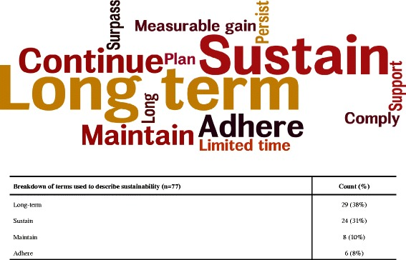
Impl Sci 2016 Apr 21;11:55

Slide 15



What are we sustaining?
Clinical intervention/Evidence-based practice (WHAT we are implementing)
KT intervention/Implementation strategies (HOW we are implementing it)
Education sessions
Educational materials
Reminders
Audit and feedback
Local champions

Slide 16
What theories/models/frameworks can be used to inform sustainability?
Scoping review of implementation theories/models/frameworks for chronic disease assessment/management or cancer prevention/control
597 studies reporting on the use of 159 implementation theories/models/frameworks to inform 669 interventions.
The three most common theories/models/frameworks were:
  Prochaska and DiClemente’s Transtheoretical Model of Behaviour Change (144 studies),
  Bandura’s Social Cognitive Theory (143 studies),
  Rosenstock’s Health Belief Model (65 studies)
60% were used only once
26 were ‘full spectrum’ theories/models/frameworks
        Strifler et al J Clin Epi 2018;100:90-102

Slide 17
Which t/m/f?
Of the 26 full spectrum t/m/f:
  10 addressed behaviour change at
    Individual
    Organisational
    Community and,
    System levels
        Strifler et al J Clin Epi 2018;100:90-102

Slide 18
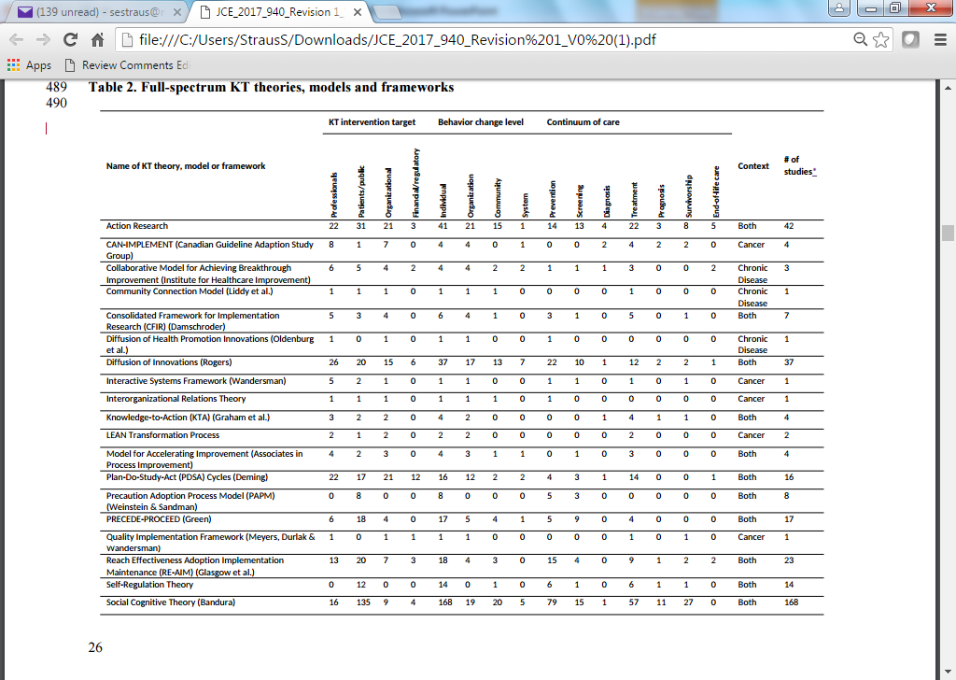

Slide 19
There are also frameworks focused on sustainability alone

Slide 20
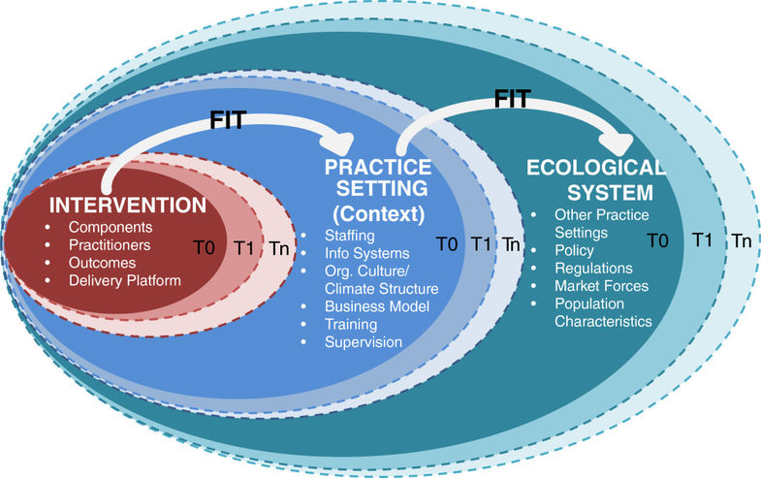
Dynamic Sustainability Framework. Chambers et al. Impl Sci 2013;8:117

Slide 21
Is sustainability being measured?
Scoping review of implementation interventions in chronic disease
  62 studies assessing 13 interventions
    Duration ranged from 61 to 522 weeks
    Interventions commonly targeted patients
  61% of studies reported on patient-level outcomes
  31% of studies reported on system-level outcomes
  Few reported adaptation of the intervention over time
  None of the studies reported using a framework to develop, implement or measure sustainability
        Tricco et al. Impl Sci 2016;11:55

Slide 22
Is sustainability being measured?
Systematic review of community-based public health interventions
  26 studies from 2004-2019
  6 reported specific sustainability strategies
  9 reported outcomes
    6 reported on implementation process outcomes
    3 reported on the evidence-based intervention outcomes
        Hailernariam et al. Impl Sci 2019;14:57

Slide 23
Is sustainability being measured?
50% of the 84 R01 studies funded in the D and I Research in Health Study Section mentioned sustainability
  2 studies mentioned an implementation framework that included sustainability
Interviews of those funded:
  Lack of agreement on sustainability constructs
  Most didn’t consider sustained individual behaviour change as a relevant outcome
        Johnson AM et al. Impl Sci 2019;14:50.

Slide 24
How is sustainability measured?
Scoping review of sustainability of chronic disease health programs found that maintenance of the program was the most common measure of sustainability
>50% assessed the sustainability outcome immediately post implementation
  Measured once
        Francis et al. BMJ Open 2016;6:e010944
Other reviews have looked at instruments to measure sustainability, adaptation etc.
        Cooper et al. Annu Rev Publ Health 2018;39:55-76.

Slide 25
Is it examined prospectively or retrospectively?
Systematic review of sustainability approaches
  67 articles included
  Prospective approaches
    focused on building relationships and stakeholder buy-in throughout
    highlighted adaptation
    focused on building the initiative into the organization
  Retrospective approaches focused on ongoing funding for the initiative
        Lennox et al. Impl Sci 2018;13:27

Slide 26
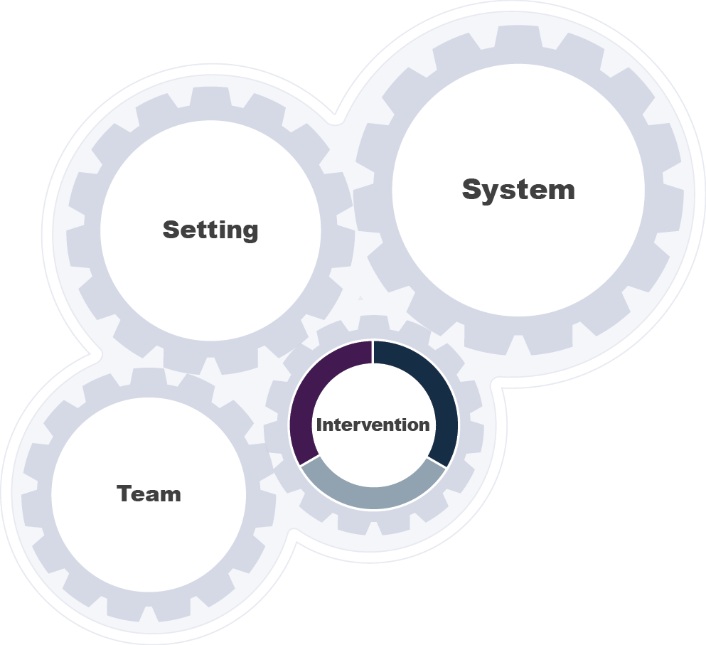
What influences sustainability?
  An evidence-based program
  Implementation strategies
  An evidence-based clinical practice
Impl Sci 2017;12:110.
26
Notes:
Remember intervention can refer to – a program, practice, and/or implementation strategies

Slide 27
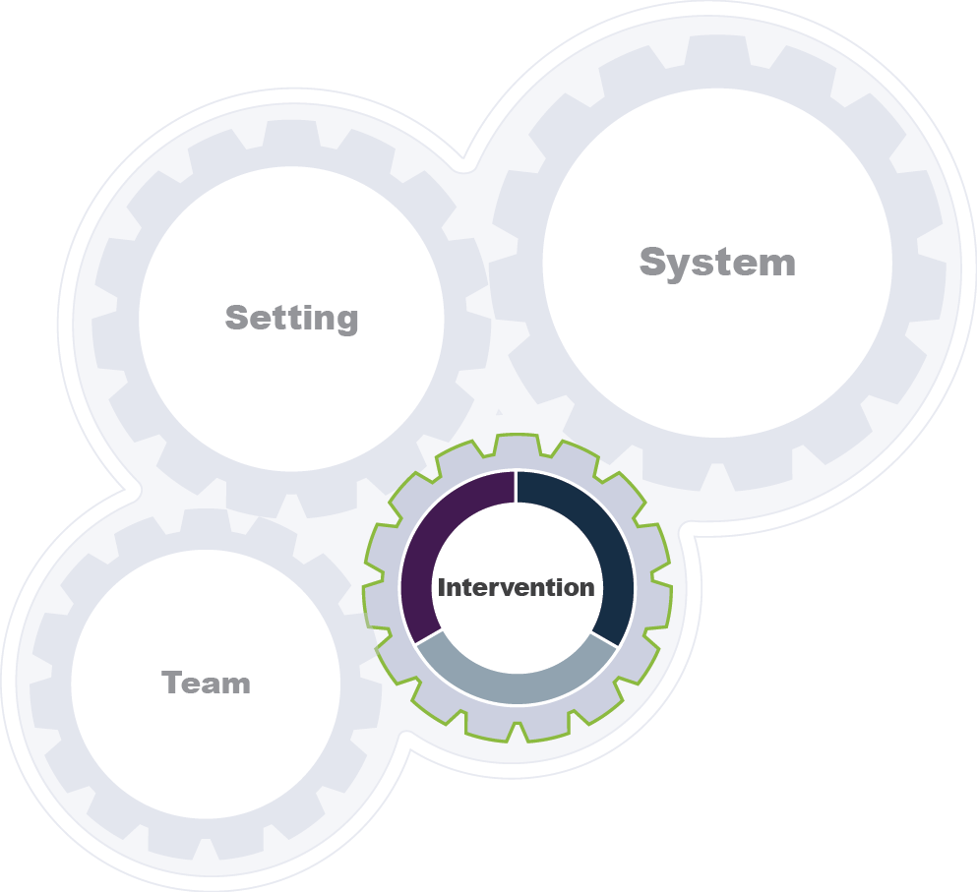
What influences sustainability?
Intervention characteristics
Effectiveness and outcomes
Adaptability
Evaluability
Accessibility
Implementability
  An evidence-based program
  Implementation strategies
  An evidence-based clinical practice
Impl Sci 2017 Sep 2;12(1):110
27
Notes:
you have a copy of all of these definitions of the factors so you don’t need to write them
At the intervention level, we need to consider each of these factors for the program OR practice and implementation strategies
For instance…
How easy is it to evaluate your implementation strategies?
How accessible are your implementation strategies? (e.g., what are the recurring costs?)
Etc…

Slide 28
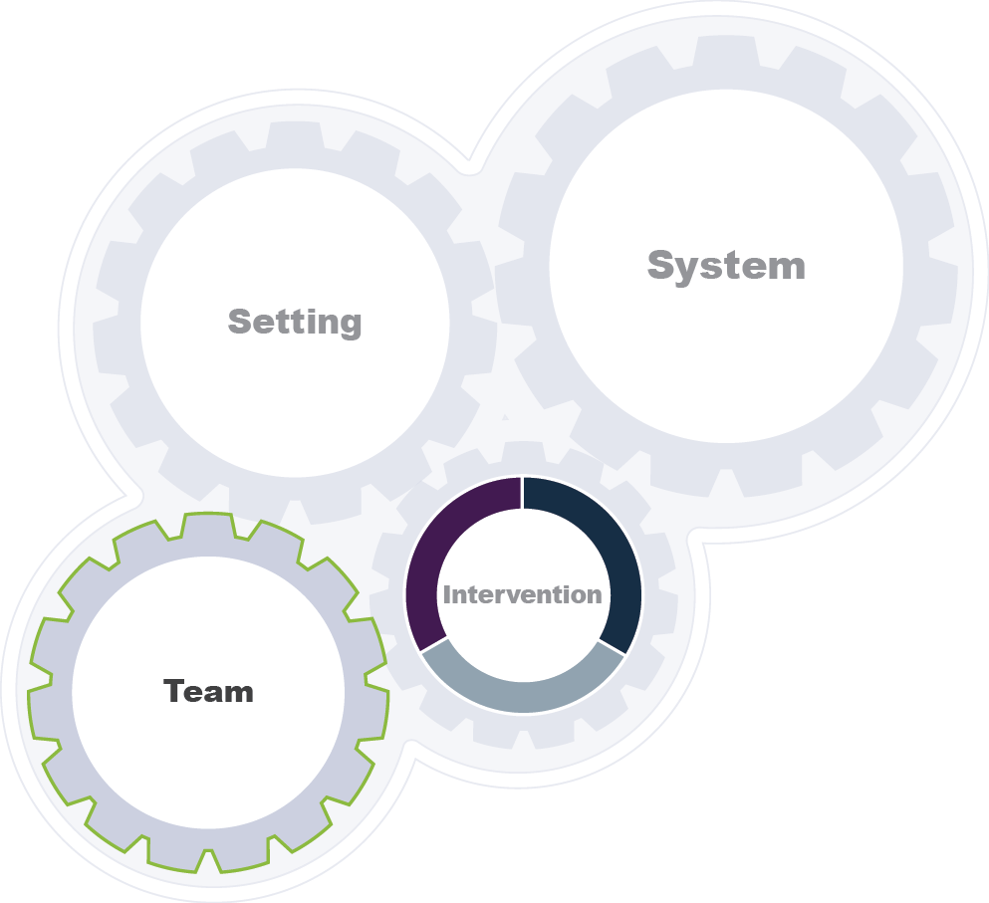

What influences sustainability?
Implementation team
Front-line stakeholder engagement
Openness to sustaining change
Team capacity
Training and coaching
Social network support
Informal interdisciplinary collaborations
Incentives and feedback
Impl Sci 2017 Sep 2;12(1):110
Notes:
What if the implementation team includes the front line stakeholders? Or what if you don’t have an implementation team?

Slide 29
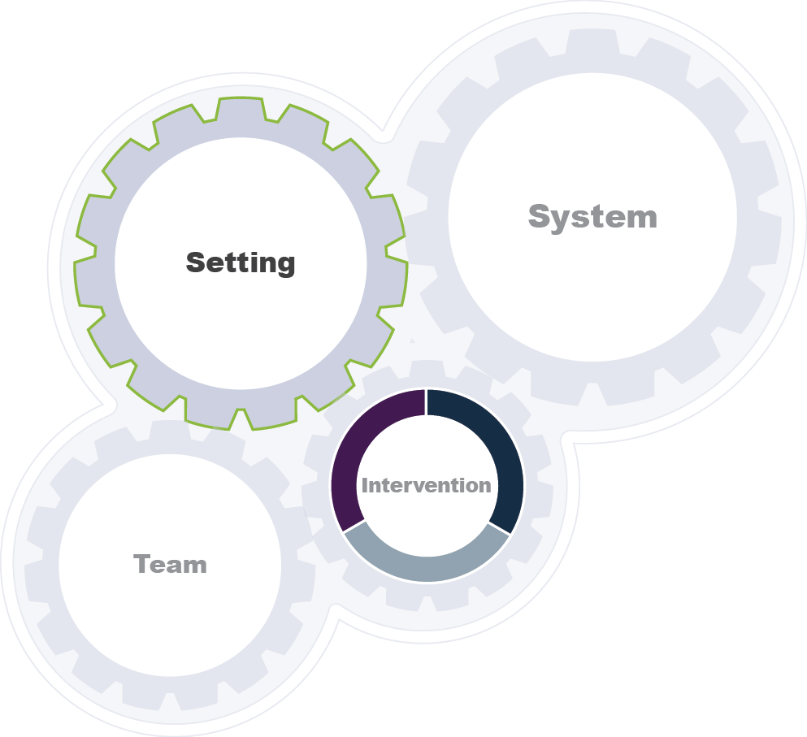
What influences sustainability?
Organization characteristics
Implementation setting
Ability to plan for sustainability
Culture of monitoring and evaluation
Commitment to EBP implementation
Perceived need for change
Leadership
Community engagement
Internal funding
Impl Sci. 2017 Sep 2;12(1):110
Notes:
You mentioned org, community or system, but what if the setting is smaller?

Slide 30
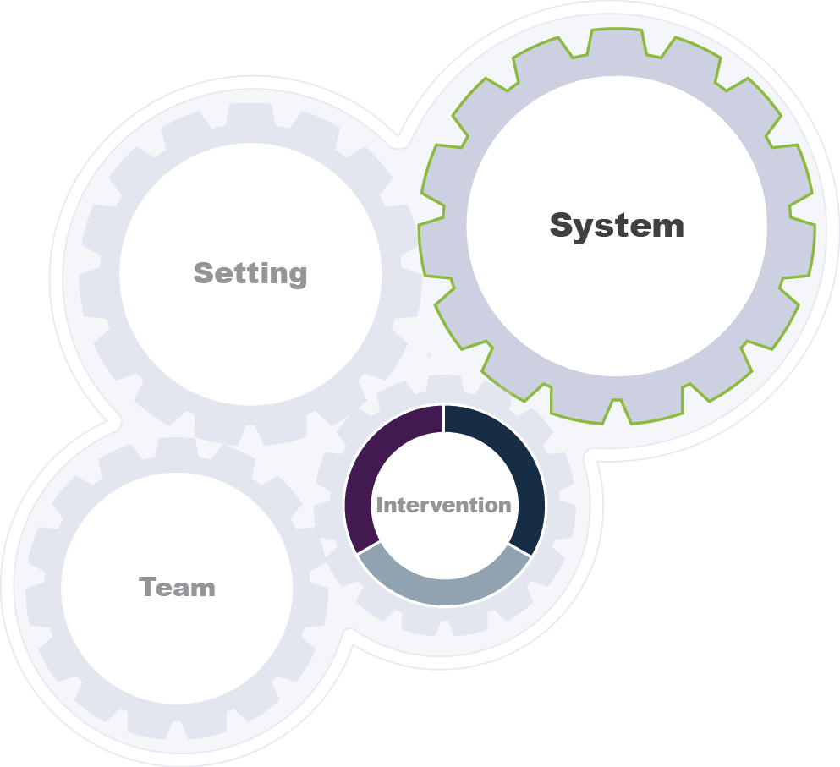
What influences sustainability?
System
Implementation funding
Characteristics of health/social service system
Population characteristics
Networks across organizations
Economic factors
Impl Sci 2017 Sep 2;12(1):110

Slide 31

Sustainability planning steps
  Define our sustainability domains
    What is being sustained
    Where is it being sustained
  Identify our sustainability stakeholders
  Assess the context for sustainability
  Develop sustainability strategies
  Execute, evaluate, and revise our plan
Notes:
may want to identify how you collect this information. You have the questions to think about, but not really how would you answer them.

Slide 32
An example
Sustainability and scalability of a volunteer-based primary care intervention (Health Tapestry)
  Used the NHS sustainability survey to develop, implement and pilot the intervention
  Used to develop recommendations to optimize intervention to facilitate sustainability
        Kastner et al. BMC Health Serv Res 2017;17:514.

Slide 33
Additional Considerations

Slide 34
Intersectionality
How is gender and its intersection with other characteristics/factors considered in the development, implementation, and sustainability of implementation interventions?

Slide 36
Using an intersectionality lens
Implementation of an intervention requires decision making on the part of individuals or organizations
  Different leadership traits, influenced by intersectionality
Stakeholder engagement may be influenced by intersectionality
  Different approaches to consensus building etc.
        BMC Med Res Methods 2016;16:145

Slide 37
Using an intersectionality lens
Communication strategies may differ and response to different communication strategies (such as persuasive techniques) may differ
Negative stereotypes may impede uptake/outcomes
  School-based interventions to prevent domestic abuse for children reported that LGBTQ youth felt excluded from the programs
  Women/men physicians treat women/men patients differently with different outcomes (for some conditions)
How can sustainability be considered using an intersectionality lens?
  Stakeholder engagement, tailoring of the intervention and outcomes…
        BMC Med Res Methods 2016;16:145

Slide 38
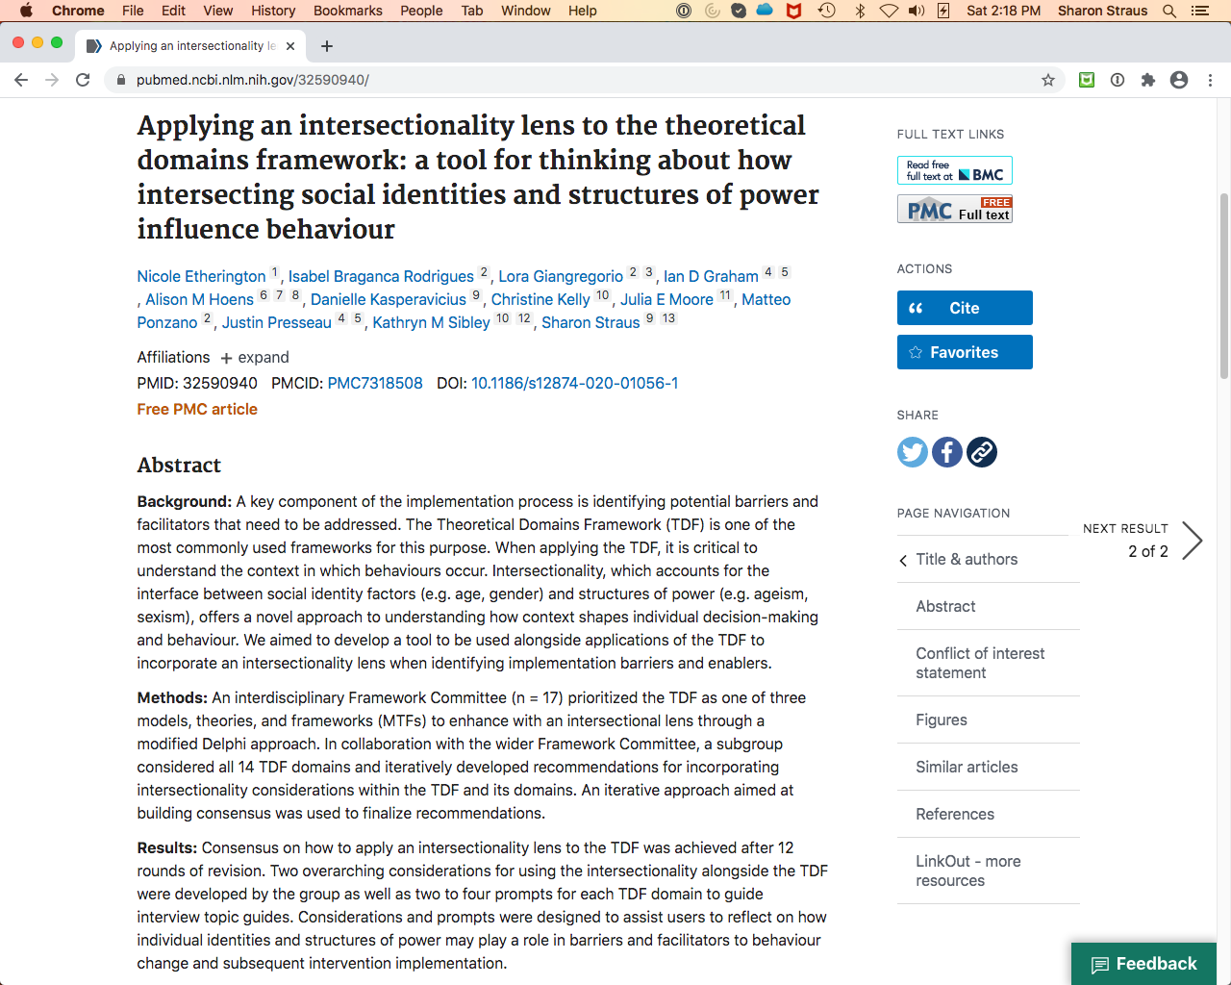

Slide 39
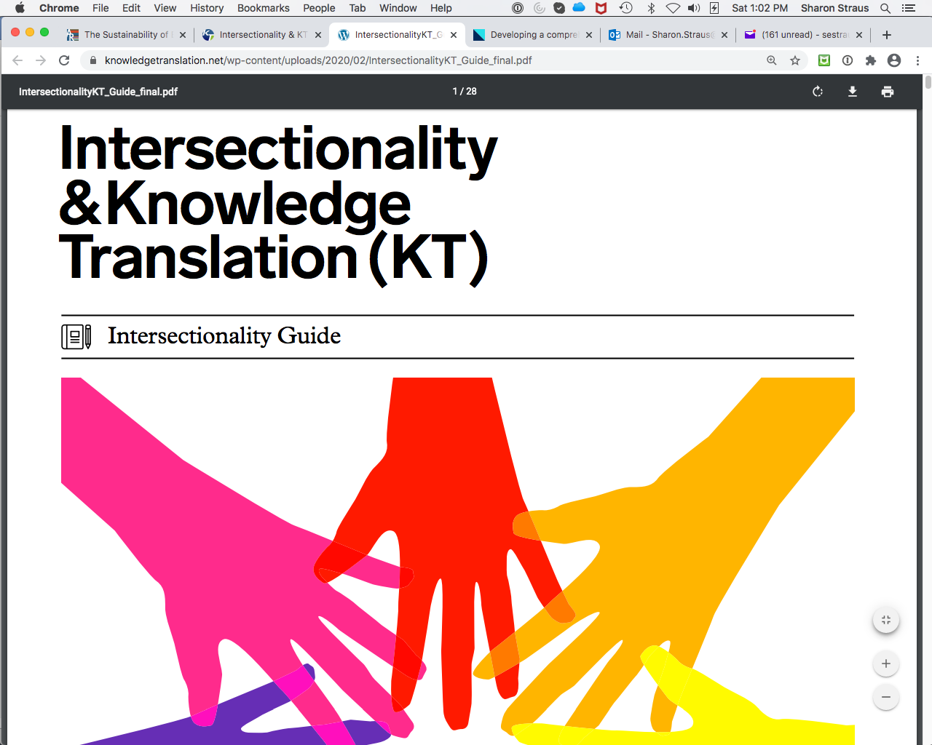

Slide 40
An example
The National Diabetes Prevention Program Implementation
  164 participating sites across 38 states
  24% of participants reported racial/ethnic minority status
  Reach into underserved population groups was limited (20% male participants)
In 2017, CDC began funding 10 organization to deliver in underserved areas
        Nhim et al. Impl Sci 2019;14:81.

Slide 41
Additional considerations
We need to know when to stop doing something
  De-adoption
    And, how to sustain de-adoption

Slide 42
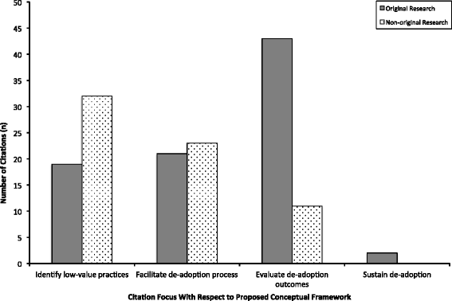
Niven et al. BMC Med 2015;13:255

Slide 43
Additional considerations
Policy cycles/interests are often different from organisational and research timelines
?Academic credit for staying engaged with a project

Slide 45
Summary
Plan for sustainability at project onset and select an appropriate theory/model/framework
Consider what we are trying to sustain and how/when we are going to measure it
Consider using an intersectionality lens

Slide 46
Other tools/products
https://knowledgetranslation.net/kt-tools
Sharon.straus@utoronto.ca

Slide 47
Acknowledgements
Andrea Tricco
Tina Fahim
Deb White
Noah Ivers
Onil Bhattacharyya
Lisa Puchalski-Ritchie
Andrea Page
Lisa Strifler
Jennifer Watt
Eric Wong
Jayna Holroyd-Leduc
Monika Kastner
Barbara Liu
Catherine Yu
Tom Stelfox
Camilla Wong
Samir Gupta
Argie Veroniki
Meghan Elliott
Charlene Soobiah
My KT Program!

Slide 48
What are the research gaps?
Identify determinants of implementation intervention sustainability across settings, interventions, conditions, and time
Identify how and why these interventions are adapted and impact on sustainability
Determine the return on investment of implementation intervention sustainability over different periods and stakeholder perspectives
Leverage existing and planned projects across settings and countries!
Use of AI to model sustainability
Notes:
Probably easier to say where there aren’t gaps
Enola’s nice article should be mentioned here

