Slide 1



Project funded by:
Teen Speak-Out: Engaging rural teenagers to develop community
driven interventions to address stress
Maureen Boardman, APRN, FAANP Deborah Johnson, MHA
Ardis Olson, MD
Sarah Lord, PhD
Dartmouth CO-OP Primary Care Research Network Dartmouth Geisel School of Medicine
Special thanks to Melanie Lawrence, MD, MPH

Slide 2

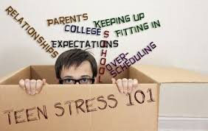


Stress is associated with teen risk behavior
substance misuse
mental health difficulties
academic problems
poor decision-making
diminished physical well-being

Slide 3
OBJECTIVES
Identify individual & social factors associated with stress among teens, living in rural communities, by convening a series of community “Teen Speak-Out” dinners in targeted catchment areas.
Design & evaluate the feasibility & acceptability of at least one measurable intervention to address stress among teens that can be reproduced.

Slide 4
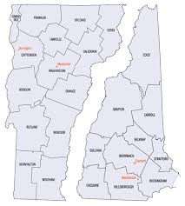

Community- engagement & qualitative research
Design and Setting
Several rural underserved rural communities

Slide 5
Participants
Teens, 13-19 years of age
Teen Advisory Board (TAB), including teenagers, community member advocates/stakeholders, primary care clinicians, members of the research team

Slide 6



“Engagement” dinners with prompt questions, discussion, brainstorming
Study Phases
Identify perceptions
of approaches to addressing stress
Establishment of a Teen Advisory Board (TAB)
Design & implement intervention

Slide 7

Five events
More than 35
teens with some attending multiple sessions
“Teen Speak-Out” Dinners
Two youth leaders
Community stakeholders

Slide 8
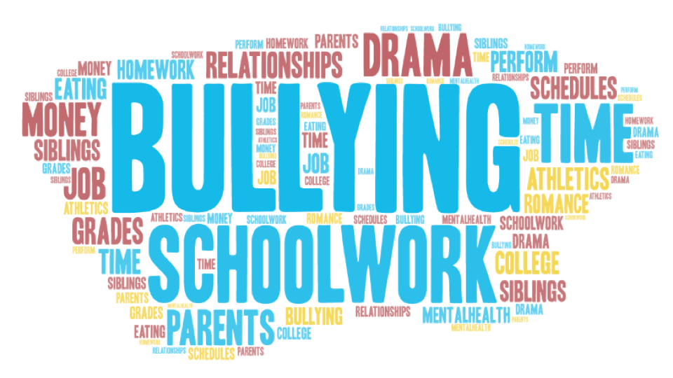

Slide 9
Teens want:
Safe space for discussing stressors
More coordination of school schedules
More adult guidance
“Therapy” available at school
School mechanism for dealing with bullying
"LIFE 101” course

Slide 10
Suggested Interventions
Mindfulness apps or programs
Counseling/therapy available at school
Free Yoga, dance or Zumba classes at school
Discussion groups like Teen Speak-Out
School-wide on-line and coordinated schedule
Project similar to the “Humans of New York” or Tumblr site

Slide 11


Intervention
Researched apps on stress,
anxiety apps rated for
“Teens” on Google Play
(Dartmouth Center for Technology and
Behavioral Health)
7 Cups – Anxiety & Stress
Pacifica – Stress and Anxiety
SuperBetter

Slide 12
Outcome Measures
Teen well-being pre/post intervention
Acceptance of intervention
Perceived relevance & usefulness
Intention to use Pacifica in the future
Ideas about strategies for broad dissemination

Slide 13
Results Post-Pacifica Evaluation N 16
83% of students polled felt like learning to how to use Pacifica was easy for them
91% felt that Pacifica helped them accomplish the three goals they set for themselves at the beginning of the process
70% of students reported they planned to continue to use Pacifica in the next 2 months

Slide 14
Limitations
Small feasibility pilot
Teen assent/parental consent for participation in Phase 2
Commercial product Pacifica (tracking teens data)

Slide 15
Actions to date
Full-time counselor/therapist hired through FQHC and placed at local K-12 school, a middle/high school and K-6 Elementary School
Significant stakeholder support = expanding network of school-based counselor/therapist positions through FQHC
Multiple other FQHC’s in Vermont and New Hampshire interested in reproducing FQHC model

Slide 16
Other Actions
Teen Speak-Out project recently presented at The New Hampshire Youth Summit (very well received)
Dartmouth CTSA (SYNERGY) interested in disseminating the Teen Speak-Out project

Slide 17
Thank you!
Questions? Comments?

