Slide 1
A Comprehensive Curriculum for Primary Care in Medication Assisted Treatment for Opioid Use Disorder
Linda Zittleman, msph
University of Colorado dept of family medicine
High plains research network co-director
Notes:
Co-Director for the HPRN. HPRN is based at the Univ of CO, DFM. It works with primary care practices and communities in rural eastern Colorado. I’m happy to talk with you today about the IT MATTTRs Colorado study and to share with you what I think of as the Phase 1 results of a curriculum we developed to train primary care practice TEAMS in MAT for OUD.

Slide 2
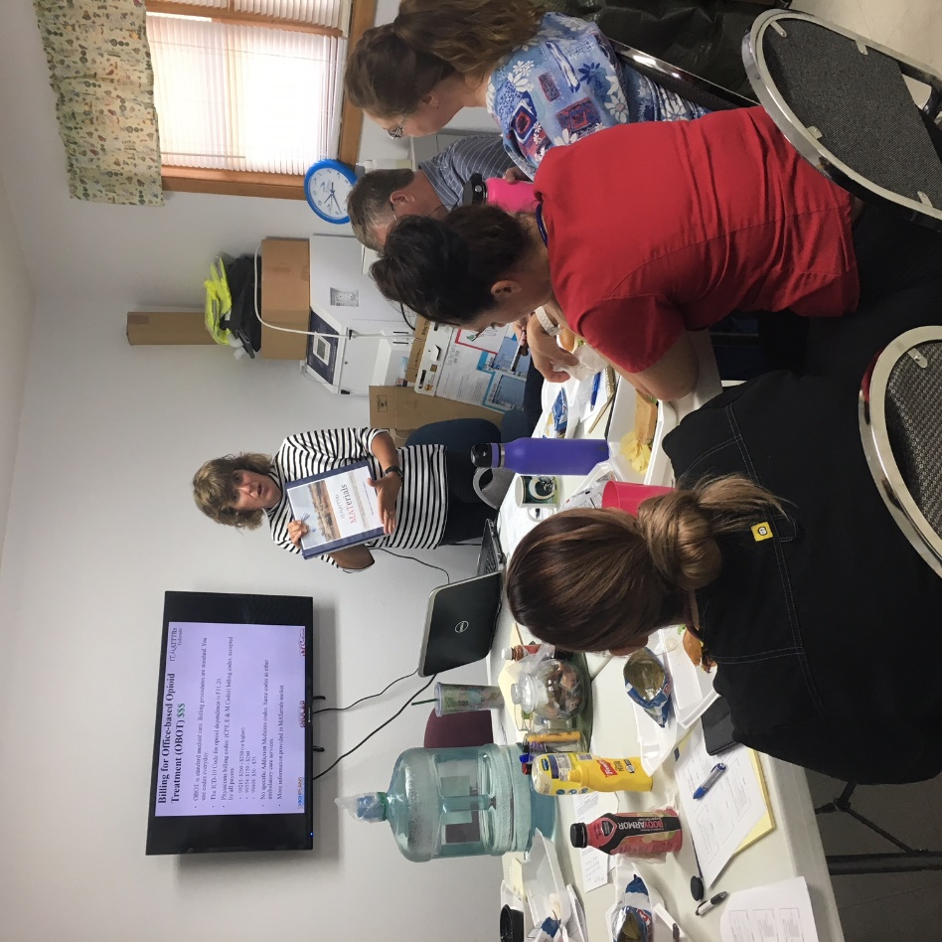
IT MATTTRs™ – a SNOCAP Study to Build MAT Capacity
A multi-faceted intervention to build primary care and behavioral health practices’ capacity to provide medication assisted treatment (MAT) for opioid use disorder (OUD).
Community Intervention
Training providers
Training the practice team
Notes:
IT MATTTRs stands for:
The goal is to increase the capacity of rural primary care practices to provide treatment for OUD with MAT.
The project has 3 main components: community intervention, we support the training providers need to complete to obtain the waiver to prescribe medication (buprenorphine) for OUD. And, our focus today, we train full practice teams in how to deliver MAT.
And our focus today – a training in OUD and MAT for practice teams, which we believe is really necessary in order to see a culture shift to where MAT is more often part of primary care practices than not.

Slide 3
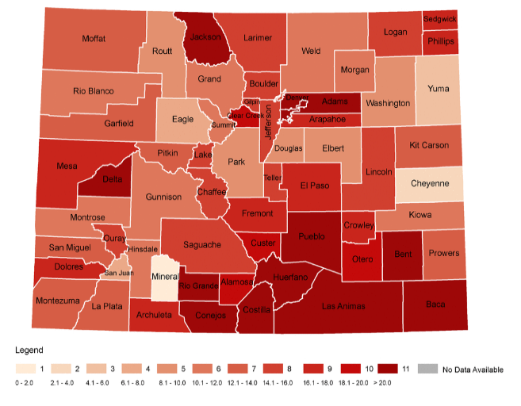
IT MATTTRs: a SNOCAP Study
24 counties
16 counties in eastern Colorado (High Plains Research Network)
6 counties in southcentral Colorado (part of CaReNet)
2 additional rural counties
Notes:
IT MATTTRs was developed for and implemented in a 24 county region that included the HPRN and parts of the Colorado Research Network (CaReNet), both are part of the SNOCAP PBRN consortium in Colorado.
At the beginning of this study, we identified 2 providers and 1 psychiatrist in this entire region that were providing MAT for OUD.
We were hearing from practices and community members that they needed help. They didn’t know what to do with patients that they suspected might have an opioid use disorder.

Slide 4
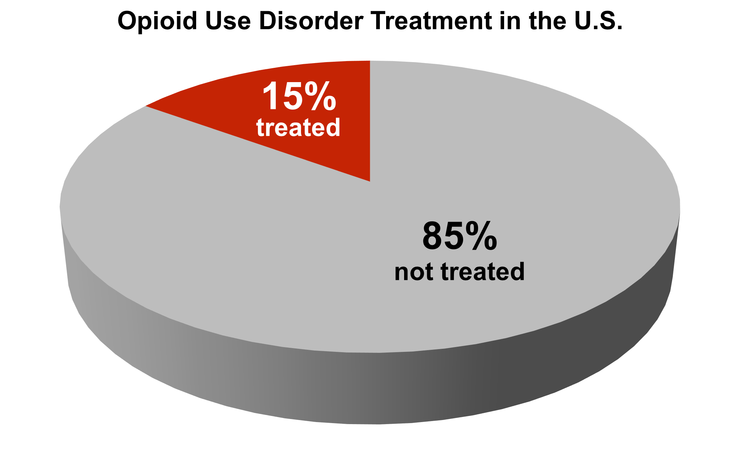
Treatment Gap
For what other condition
is this acceptable?
Egan et all 2010
Notes:
What we were hearing from folks on the ground looks like this on paper. When it comes to OUD, there is a huge treatment gap. Nationally, approximately 85% of people in need of treatment for OUD do not receive it.

Slide 5
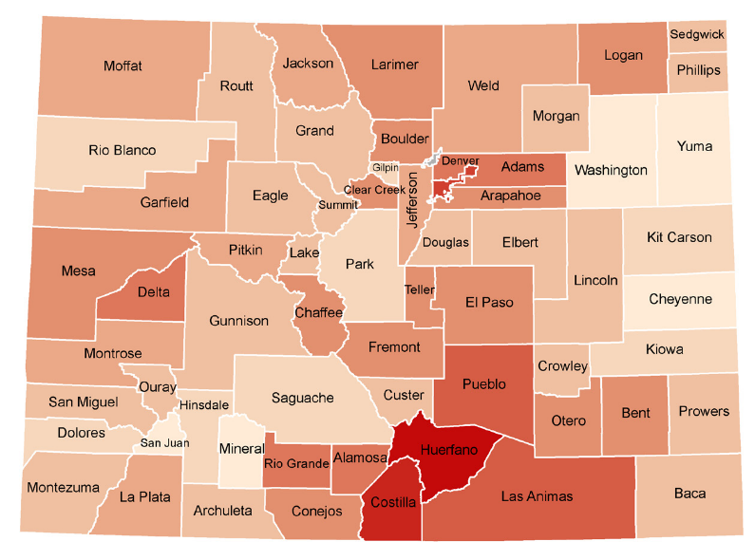
Colorado drug overdose death rates: 2002
Notes:
In Colorado, here is what the impact of that treatment gap looks like. Drug overdose death rates in 2002. Red is worse.

Slide 6
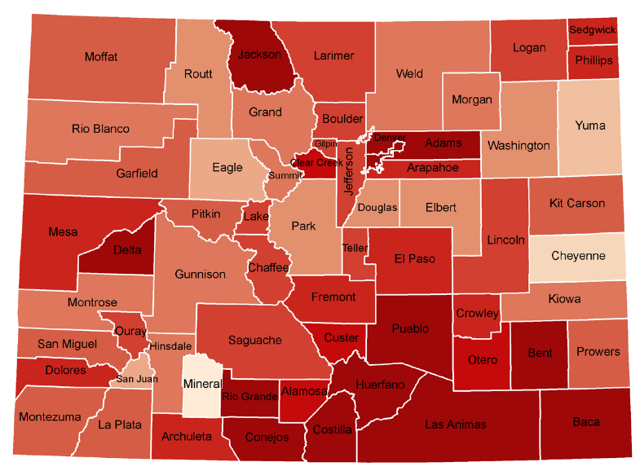
Colorado drug overdose death rates: 2014
500% Increase
Notes:
Drug overdose death rates in 2014.
Darker is worse. Middle shade red is the national average rates.

Slide 7
Intervention: Primary Care Practice Team Training
Developed by research team, with collaboration from local MAT experts, community members, and professional practice facilitators
Designed for full practice team and practices at different stages of readiness
Covers epidemiology, neurobiology of addiction, pharmacology, and MAT steps
Based on evidence-based guidelines (American Society of Addiction Medicine and CDC)
Comprehensive companion scripts accompanied each module
Notes:
When we started, this study there was no adequate team curriculum for primary care practices available. So this curriculum was developed by the research team, in collaboration with MAT experts, community members, and practice facilitators.
The training is for primary care teams – front desk, medical assistants, nurses, medical records, care coordinators, and providers.
The training aims to give all members of the practice team a common set of knowledge and common language for the members of the practice team around OUD and MAT. Topics cover epidemiology of OUD, neurobiology of addiction, pharmacology (how buprenorphine works, its safety), and MAT steps (treatment agreements, induction – getting patients started, stabilization, maintenance, billing/coding, how the practice will define success (how will it handle patients that use).
Comprehensive companion scripts were created to accompany each module. These include notes to the trainer on content to emphasize, additional information to present based on participants’ needs, and suggestions for facilitated discussions

Slide 8
Methods: Training Delivery
Practices randomized prior to recruitment to receive:
Shared Onsite kNowledge Dissemination (SOuND) Team Training:
In-person at the practice
Delivered by trained Practice Facilitator/Health Educator
4 modules with built-in practice facilitation support
4 sessions, 50-60 minutes each, 4-8 weeks apart
OR
ECHO Colorado program:
Web-based tele-health model
Delivered by a session Facilitator and expert panel
8 sessions, 30-60 minutes each, weekly for eight straight weeks
Notes:
In the study region, we identified 79 practices. Our goal was to recruit 40 practices into the study to receive this Team Training.
Prior to recruitment, practices were randomized to receive training 1 of 2 ways. Either with SOuND Team Training or through the ECHO Colorado program. SOuND Team Training delivers training in-person.
ECHO Colorado uses the ECHO telehealth, tele-education model, with web-based sessions and featuring case-based learning.

Slide 9
Evaluation Goals
Evaluate implementation
Number of practices trained
Number and types of participants (attendance)
Evaluate immediate impact of curriculum:
Satisfaction
Perceived ability to deliver MAT

Slide 10
Methods: Data Collection & Analysis
Practice Member Numbers and Attendance Logs maintained to evaluate practice and individual participation number and types of staff
Survey
Administered within one month of completion of training to evaluate curriculum
Developed and regularly used by the ECHO Colorado program
Analysis
Overall (total)
By study arm (SOuND vs ECHO)
By role in practice
Provider: MD, DO, PA, NP
Clinical Support Staff: nurse, medical assistant, navigator, behavioral health
Administrative Support Staff: Manager, medical records, billing, front & back office

Slide 11
Results: Number of Practices and Individuals Trained
Number of practices = 42 (goal = 40)
SOuND = 22
ECHO = 18
Number of Participants = 441
Proportion of possible team members participating = 65%
Table 1 IT MATTTRs Practice Team Training Attendance for All Participants and by Study Arm
ROLE | All Participants (n = 441) % | Within SOuND arm (n = 345) % | Within ECHO arm (n = 96) %
Providers | 22 | 21 | 27
Clinical Support Staff | 47 | 49 | 40
Admin Support Staff | 24 | 26 | 18
Other | 7 | 4 | 16
Notes:
Great distribution of participation across roles.
We were able to collect practice and role data for everyone that attended training. We were able to collect demographic data for the participants that completed the curriculum survey. Those will be presented next.

Slide 12
Results: Attendance by Session
Table 2 Session Attendance for Each Session of the IT MATTTRs Practice Team Training
Session | SOuND Team Training™ (n=345) | ECHO (n=96)
1 | 241 | 72
2 | 245 | 80
3 | 224 | 86
4 | 227 | 72
5 | na | 78
6 | na | 69
7 | na | 65
8 | na | 68
Average # sessions attended per attendee | 3 (75%) | 6 (75%)
Notes:
This table simply shows that attendance remained fairly steady over the course of training – for both study arms.
On average, training participants in both arms attended 75% of the training sessions.

Slide 13
Results: Survey Respondent Characteristics
 | SOuND (N = 152) % within arm | ECHO (N = 51) % within arm | Total (N = 208) % | P value
Gender |  |  |  | .0276
Male | 6 | 18 | 9
Female | 86 | 77 | 84
Prefer Not to Answer/Missing | 8 | 5 | 7
Race and Ethnicity (check all apply)
American Indian or Alaskan Native | 3 | 0 | 2 | 0.102
Asian | 0 | 2 | 0.5 | 0.0645
Black or African American | 0.6 | 0 | 0.5 | 0.2135
Nat Haw/Pac Islander | 0.6 | 4 | 1 | 0.0737
White | 45 | 50 | 46 | .19
Other | 1 | 5 | 2.4 | 0.0597
Hispanic or Latina/o | 45 | 36 | 42 | 0.144
Prefer not to answer | 8 | 5 | 7
Role
Provider | 6 | 34 | 13 | <.0001
Clinical Support Staff | 60 | 30 | 52
Administrative Support Staff | 14 | 23 | 17
Missing Role/Prefer not to Answer | 20 | 13 | 18
 | 44% response | 53% response | 47% response
Notes:
Moving on the curriculum survey results. Of the 441 training participants, 208 completed the evaluation survey, for a 47% response rate.
Between the two study arms, there were significant differences by gender and role. And there was a higher proportion of providers in the ECHO arm. You can also see that there was a higher proportion of clinical staff in the SOuND arm. AS A RESULT, we adjusted, or controlled for role, in our analyses.

Slide 14
Participant satisfaction with IT MATTTRs Practice Team Training (n = 208)
 | Agree or Strongly Agree (%) |  |  |  |  | Mean* | P Value*
 | Total (n=208) | Provider (n=28) | Clinical Support (n=104) | Admin Support (n=34) | Role Unknown n=34 | (ECHO v SOuND)
Appropriate balance between instruction and practice. | 65 | 61 | 67 | 75 | 50 | 3.5 3.8 | .0369
The complexity of the topic was appropriate for me. | 66 | 75 | 67 | 74 | 47 | 3.8 3.8 | .4819
My understanding of the topic has improved… | 83 | 89 | 80 | 88 | 80 | 4.1 4.0 | .6555
Information was presented…I could clearly understand. | 84 | 93 | 84 | 85 | 77 | 3.8 3.8 | .5062
I was satisfied overall. | 79 | 79 | 77 | 88 | 77 | 4.1 4.0 | .8938
I would recommend this series to others. | 79 | 79 | 81 | 85 | 71 | 3.9 4.0 | .2914
I have identified actions I will take | 68 | 75 | 69 | 68 | 62 | 3.9 4.0 | .1238
Notes:
Let’s look at satisfaction with the training. This table shows the proportion of respondents that agreed or strongly agreed with these statements. (CLICK TO SHOW “TOTAL”) Overall, there was a positive response to the training.
Two thirds thought there was appropriate balance between instruction and practice, complexity of the topic was appropriate.
Over 80% reported that their understanding of the topic improved.
Almost 80% would recommend the training to others in their profession.
And, almost 70% identified an action to take to apply what they learned.
We were very curious about how these responses might differ by role. Would the training be meaningful to non-providers? You can see here that responses remained positive and high across the different roles.
When we look at responses by study arm, we looked at differences between the mean responses. This used a scale of 1 – 5 (with 5 equally strongly agree). You can see the means hover around a mean of 4 or the “agree” mark. Further, there were no significant differences between study arms – except for the balance between instruction and practice question.

Slide 15
Self-rated ability to deliver MAT before and after training (n = 208)
How would you rate your ability to…
0 – no ability/skill
1 = slight ability
2 = average
3 = competent
4 = expert
*Adjusted for role; P < .0001 for all
Notes:
Another series of questions explored survey respondents’ self-rated ability to deliver MAT. They were asked to rate their ability before and after training. Responses range from 0 (no ability/skill) up to 4, which equaled expert. This series asked about respondents’ ability to determine patients appropriate for MAT, to describe buprenorphine use, to manage patients receiving MAT, to describe their role in treating patients, and to describe treatment in several special populations.
Adjusting for role, respondents reported significant improvements in ability for all measures. Overall, we can see the means for each measure hover around 1, or “slight ability.” After training, there is movement towards 2, or “average.” Given that almost all of the participating practices were not providing MAT, this shows an very important shift.

Slide 16
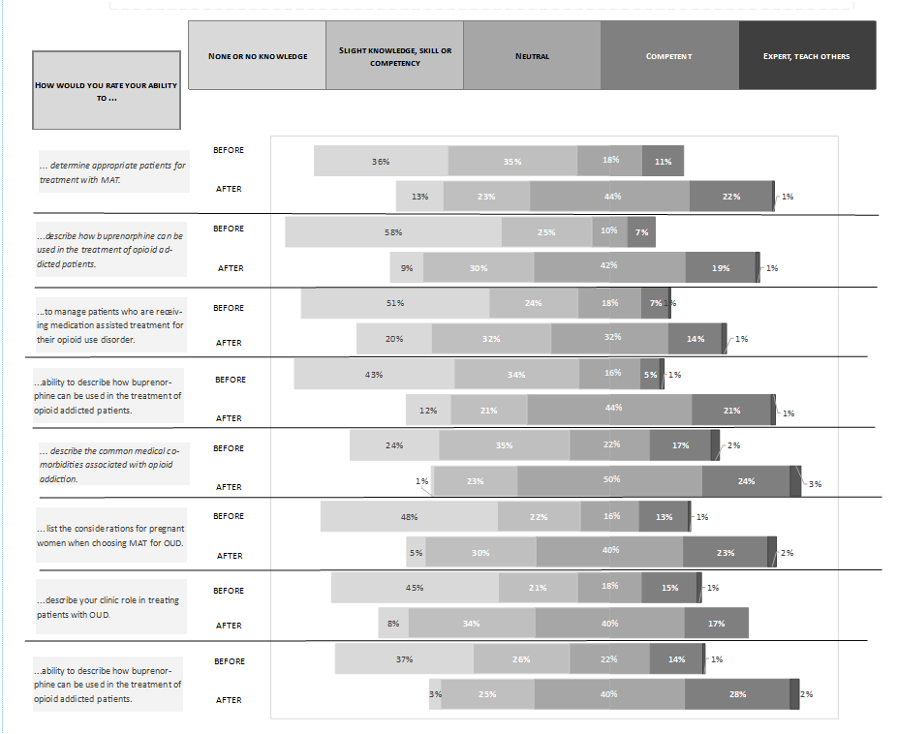
Self-rated ability to deliver MAT before and after training
How would you rate your ability to…
None (0) | Slight (1) | Neutral (3) | Competent (4) | Expert (5)
Determine appropriate patients for treatment with MAT. | Before
 | After
Describe how buprenorphine can be used in the treatment of opioid addicted patients. | Before
 | After
Manage MAT patients who are receiving MAT for their OUD. | Before
 | After
Describe the common behavioral health co-morbidities associated with opioid addiction. | Before
 | After
Describe the common medical co-morbidities associated with opioid addiction. | Before
 | After
List the considerations for pregnant women when choosing MAT for OUD. | Before
 | After
List considerations for youth when choosing MAT for OUD | Before
 | After
Describe your clinic role in treating patients with OUD. | Before
 | After
Adjusted for role; P < .0001 for all

Slide 17
Mean Change Score: Self-rated ability by study arm
*Adjusted for role; P < .0001 for all
Notes:
There were differences between study arms for self-rated ability. This analysis compared mean change scores between the two arms. For respondents in the SOuND practices, the mean change scores ranged from .9 to 1.3. Pretty consistent positive improvement. For ECHO, the changes were much more diverse and ranged from - .76 to .56.
We’re not sure what is contributing to these differences. We speculate that SOuND training, with more built-in facilitation support, might provide additional support and lead to more confidence.

Slide 18
Limitations
Overall response rate 47%
We do not yet have information on full implementation of MAT in the practices.
A cost comparison between SOuND and ECHO training models is beyond the scope of this analysis.
Notes:
1. While the overall reach of IT MATTTRs was excellent with over 440 participants from 42 practices representing 65% of the potential practice participants, the curriculum evaluation was completed by just over 200 (47%). The lower response rate in SOuND Team Training may have impacted the results. However, there was widespread agreement on the value of the IT MATTTRs curriculum regardless of how it was delivered.
While immediate evaluation results are positive, we do not yet have information on full implementation of MAT in the practices. Data include self-reported perceived ability and not practice behaviors. However, this type of survey and self-report are the standard for this type of evaluation. The study team is finalizing data collection from all practices to determine implementation and MAT delivery.
Finally, given the overall positive response to IT MATTTRs, but with some differences in self-rated ability to deliver MAT between SOuND Team Training and ECHO, a cost comparison between these two delivery models will provide additional information about how best to deliver training to rural primary care practices.

Slide 19
Conclusions
Study successfully reached the goal number of practices and substantial reach within participating practices.
Overall response to curriculum is positive, across roles and in SOuND and ECHO participants.
Overall, participant-reported knowledge and ability to deliver MAT improved significantly. However, greater increases were reported by SOuND Team Training respondents.
Team training is an important step in the progression towards MAT provision in primary care settings – beginning to improve knowledge and sense of ability and laying the groundwork for practice behavior change.
Notes:
Overall, the response to the IT MATTTRs team training was positive – overall, across roles, and by study arm.
While provider training is necessary, we don’t believe it’s sufficient to support implementation and delivery of MAT in primary care practices. IT MATTTRs team training helps provide a full understanding the entire practice team.

Slide 20
Thanks to Study Team
Jack Westfall
Kristen Curcija
Christin Sutter
John “Fred” Thomas
Miriam Dickinson
Don Nease
Jodi Holtrop
Yajaira Johnson-Esparza
Mary Fisher
Jen Ancona
Dionisia de la Cerda
Beka Mullen
Dawn Howell
Lori Jarrell
Duane Pearson
Shandra Brown-Levey
Funded by the Agency for Healthcare Research and Quality
Notes:
What started as a research project in part of rural Colorado is now growing and spreading around the state. A big new funding partner is the Colorado Office of Behavioral Health as well as the Colorado Consortium for Prescription Drug Abuse Prevention.

Slide 21
Thank You!
Check out our websites for information about the project:
www.itmatttrscolorado.org
www.haveyoumetmat.com
www.MATintheSLV.org
http://www.practiceinnovationco.org/itmatttrs2/
Linda Zittleman:
linda.zittleman@ucdenver.edu
303-724-9716

Slide 22
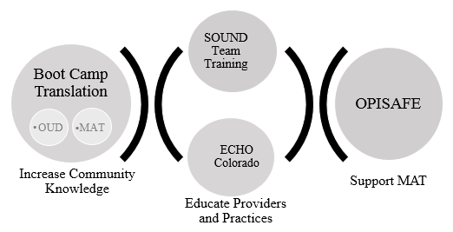
Figure 1. Multi-level approach to implementing Medication Assisted Treatment in rural Colorado

Slide 23
Why is opioid use disorder getting so much attention?
Greater than 4 million Americans report using prescription pain medicine for non-medical reasons.
More Americans die each year of drug overdose than motor vehicle accidents.
80% of the world’s prescribed opioids are prescribed in the United States.
Center for Behavioral Health Statistics and Quality. (2015). Behavioral health trends in the United StatesResults from the 2014 National Survey on Drug Use anHealth (HHS Publication No. SMA 15-4927, NSDUH Series H-50). Retrieved from http://www.samhsa.gov/data/
http://archive.samhsa.gov/data/2k12/NSDUH115/sr115-nonmedical-use-pain-relievers.htm. Accessed February 2, 2016.
http://www.coloradohealthinstitute.org/key-issues/detail/community-health/colorado-county-drug-overdose-death-rate. Accessed February 12, 2016.
Notes:
Thank you for having me here today. I’m the co-Director for the High Plains Research Network, which is based in the Dept of Family Medicine at the University of Colorado. That’s where my office is, but most of the work we do takes places in the 16 counties of eastern Colorado. For years, the state of Medication Assisted Treatment in this region was…well, there wasn’t much to talk about. But the problem of OUD was growing.

Slide 24
Practice Curriculum Training Modules
IT MATTTRs Primary Care Practice Team Training Module Content
Module | Topics Covered | SOuND Session No. | ECHO Session No.
1 | Epidemiology, neurobiology of addiction, buprenorphine effectiveness; MATerials Resource Toolkit. | 1 | 1
2 | Buprenorphine safety, identifying and preparing patients (forms, instructions, motivation), definition of success | 2 | 2, 3, 4
3 | Insurance and billing, Induction, Stabilization, Maintenance, relapse, non-pharmacological treatment | 3 | 5, 6, 7
4 | MAT in special populations, including pregnant women, adolescents, people with co-morbidities | 4 | 7, 8
Notes:
Let me describe the Practice Team Training to give you more context for the Train the Trainer Program.
Back in 2016, when IT MATTTRs started in, no adequate team curriculum existed, so we created one for primary care teams. This training is delivered on-site, in person to full practice teams - front desk, medical assistants, nurses, medical records, care coordinators, and providers.
There was also no curriculum for behavioral health practices. Addiction and SUD treatment had been carved out of BH decades ago and most providers did not have much experience with substance use disorder, and even fewer were familiar with opioid use disorder and medication assisted treatment. So we engaged our talented BH team who were developing an expertise in OUD and MAT through there work in the DFM and with Salud Family Health.
The BH curriculum introduces BHPs to office-based opioid treatment with buprenorphine, including its importance, effectiveness, approach, and training requirements. Even if BHPs are not working in an integrated setting where MAT is provided, it is still important that they have this background since they will be working with patients who are on MAT for OUD.
Practice facilitation – sessions on how to do some of the MAT activities and tasks.
Practices also received a MAT Implementation Check List and MATerials (resource book with care plans, template Consent Forms, template Patient Agreements, patient handouts, definitions, billing info, etc.)

Slide 25
Self-rated ability by study arm
Question | ECHO N | ECHO Mean change score | SOuND N | SOUND Mean change score | Adj. p-value*
Determine appropriate patients for treatment with MAT. | 48 | -0.15 | 127 | 1.02 | <.0001
Describe how buprenorphine can be used in the treatment of opioid addicted patients. | 45 | 0.42 | 127 | 1.31 | <.0001
Manage MAT patients who are receiving MAT for their OUD. | 49 | -0.76 | 122 | 1.13 | <.0001
Describe the common behavioral health co-morbidities associated with opioid. | 46 | 0.56 | 125 | 1.02 | .0095
Describe the common medical co-morbidities associated with opioid addiction. | 50 | 0.04 | 122 | 0.94 | <.0001
List the considerations for pregnant women when choosing MAT for OUD. | 46 | 0.24 | 126 | 1.14 | <.0001
List considerations for youth when choosing MAT for OUD. | 49 | -0.39 | 126 | 1.05 | <.0001
Describe your clinic role in treating patients with OUD. | 46 | 0.39 | 115 | 1.05 | .0001
P < .0001 for all

Slide 26
IT MATTTRs:
Creating the practice environment
conducive to care for OUD using MAT
Team Training (BHPs, MD, PA, NP, front desk, RN, billing, MA, navigators…)
Screen for OUD in primary care practices.
Engage the patient in MAT delivered in primary care practices.
Refer patients to behavioral health in primary care practices.
Monitor patients in MAT in primary care practices.
Care for the practice MAT Team.
Diagnose OUD in primary care practices.
Prescribe buprenorphine by primary care physicians in primary care practices.
Buprenorphine waiver training for providers (MD, DO, PA, NP)
Notes:
Everyone on the team can help. There are roles and tasks for all. And the roles and tasks may not always fit exactly with the typical roles and tasks defined by one’s degree or title. MAT for OUD is about finding the team member passionate about the topic or task, and provide them the training to do that task. So a front desk person may become your best screener. An MA may provide the best action planning. You may have staff that can serve as peer counselors/support. The Team makes MAT work.
Even the front desk and staff who don’t have direct contact with patients are part of the team. For instance, front desk can have a better understanding of what OUD is and therefore, can be more mindful of their interactions with patients with OUD, ensuring that they treat these patients with empathy and respect, as they would any patient. Staff who don’t have direct contact with patients can share information they learn with the community in efforts to dispel misconceptions.
peer counselors/support. The Team makes MAT work.

Slide 27
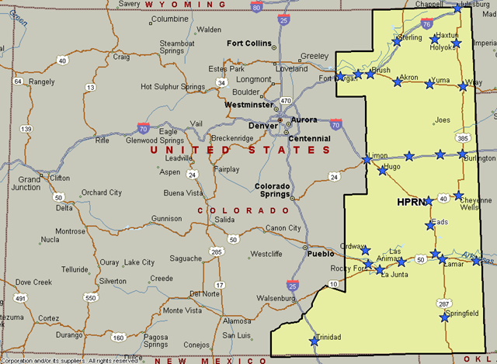
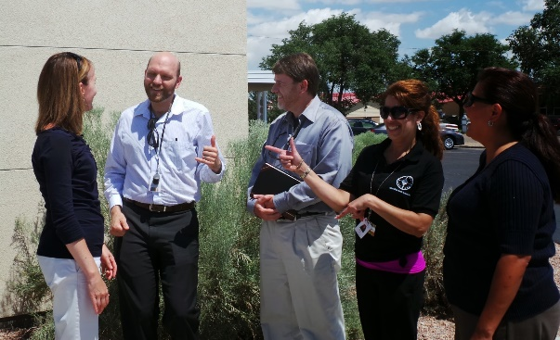
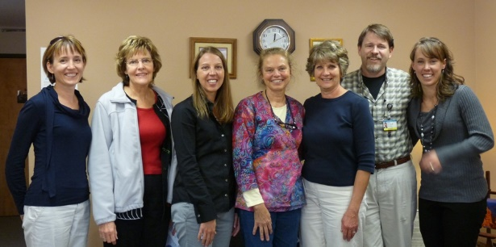
Background
Over the past 5 years, the High Plains Research Network and its Community Advisory Council (C.A.C.) and practices identified OUD as a primary concern in their communities.
Walsh, CO practice providers and staff
Valley-Wide Health Center,
Las Animas, CO
Haxtun Family Health Center
Notes:
Thank you for having me here today. I’m the co-Director for the High Plains Research Network, which is based in the Dept of Family Medicine at the University of Colorado. HPRN consists of 16 rural and frontier counties of eastern Colorado. There are 53 primary care practices and 16 hospitals in the region. Several years ago, we began to hear more and more from practices that they needed help – they didn’t know what to do with their patients that kept coming in for opioid prescriptions – knowing that there was likely a problem with misuse or abuse. They didn’t know what to do.

