Slide 1
Welcome 2017 NAPCRG PBRN Conference

Slide 2
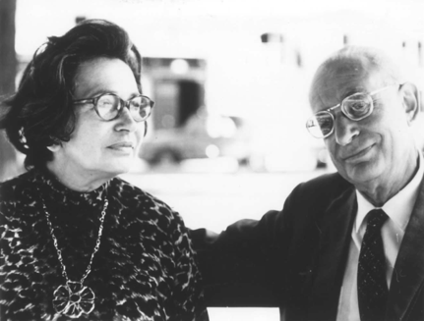

Slide 3
“At the center of medicine there is always a human relationship between a patient and a doctor.”
-Michael Balint
Notes:
On of Balint’s core assumptions is that

Slide 7
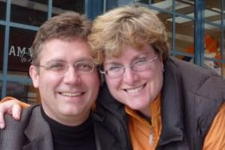

Slide 8
“At the center of PBRN research there is always a human relationship.”
Notes:
On of Balint’s core assumptions is that

