Slide 1
Primary care challenges in
Northern Canada: a natural experiment for system change
Cross Border Integrated
Primary Care Symposium
Washington, DC, March 2-3, 2017
Kue Young, CM, MD, DPhil, FRCPC, FCAHS
Professor and Dean

Slide 2
The context
Disparities in health outcomes
  between Canadian North and rest of country;
  within North, between non-Aboriginal and Aboriginal people
Per capita health expenditures in the North is substantially higher than rest of Canada
Primary care offers potential for redressing health and health care disparities
What are key challenges for primary care?
How can research contribute to health system improvement?

Slide 3
What is meant by “the North”?
In this presentation, North = the 3 territories
“Northern conditions” also prevail in the provincial North, but extracting sub-provincial regional data
very difficult
Share common features
with Alaska

Slide 4
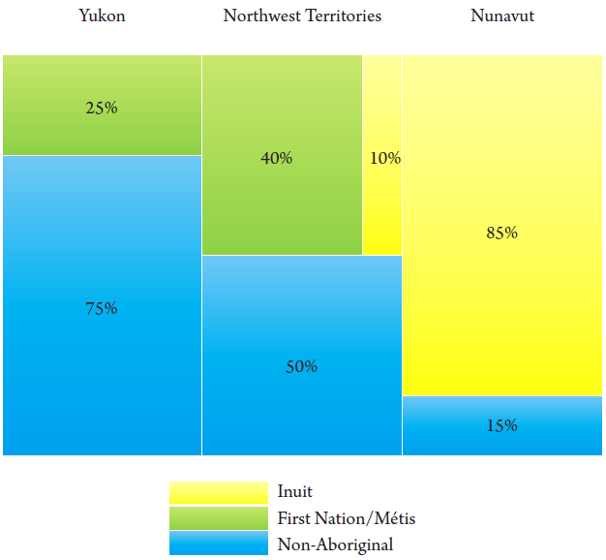

Total population ≈ 110,000
Population density: 0.03 persons/km²
Aboriginal people ≈ 50% of population
Largest cities – Yellowknife and Whitehorse – about 20,000 population each

Slide 5
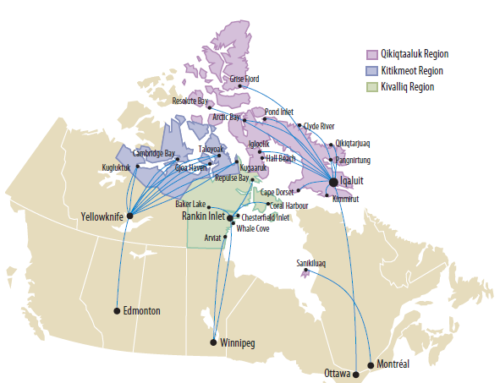
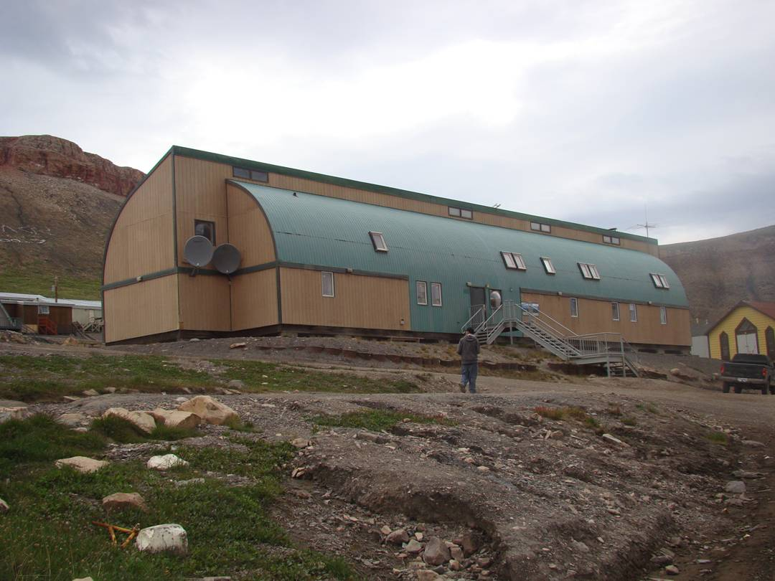
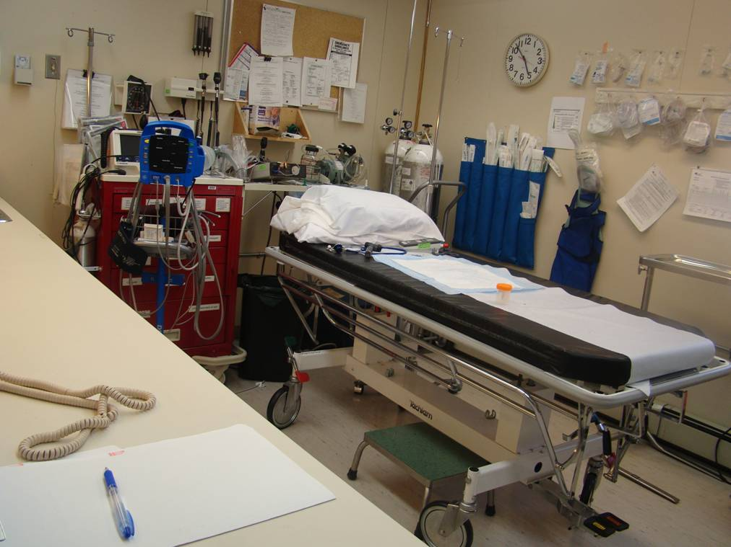
Primary health care [outside of cities] is nurse-based;
Reliance on telecommunications and transportation systems
Health care predominantly government-administered
Many small communities separated by large distances

Slide 6
How wide is the health gap?
* Life expectancy at birth (M)
The Facts:
* Per capita total health expenditures
Countries of the world

Slide 7
How much is spent on health care?
International comparison of
per capita total health expenditures
WHO Global Health Observatory

Slide 8
How well is the health system performing?
Age-standardized hospitalization for ambulatory care sensitive conditions
(mean 2009-2013)
Age-standardized avoidable mortality rate from preventable causes (mean 2007-2011)
CIHI Health Indicators

Slide 9
Primary care challenges . . [some of them]
High turnover of both physicians and nurses – reliance on short-term locums with limited experience in remote health care, unfamiliar with making referrals or providing clinical advice over long distances at both ends of the telephone
Over-reliance on transferring patients out of community, many deemed unnecessary, with high economic and social cost
But when emergency evacuation is needed, logistical and weather issues, long distances and travel time compromise patient outcome
Communication and transportation is the “glue” that binds the system together but a source of much dissatisfaction among staff and patients. Improving it will strengthen primary care and overall health system performance

Slide 10

NWT Health & Social Services developed Med-Response to address this issue:
A centralized air ambulance coordination, triage and dispatch system [both outbound and repatriations]
Aims to ensure that air ambulance flights reach patients as quickly as possible
A single number for primary care
providers in communities to call for
emergency clinical support
Coordinates urgent referrals to
higher levels of care, including
tertiary care centres outside territory
Field tested end of 2014 and
officially launched Feb 2015

Slide 11
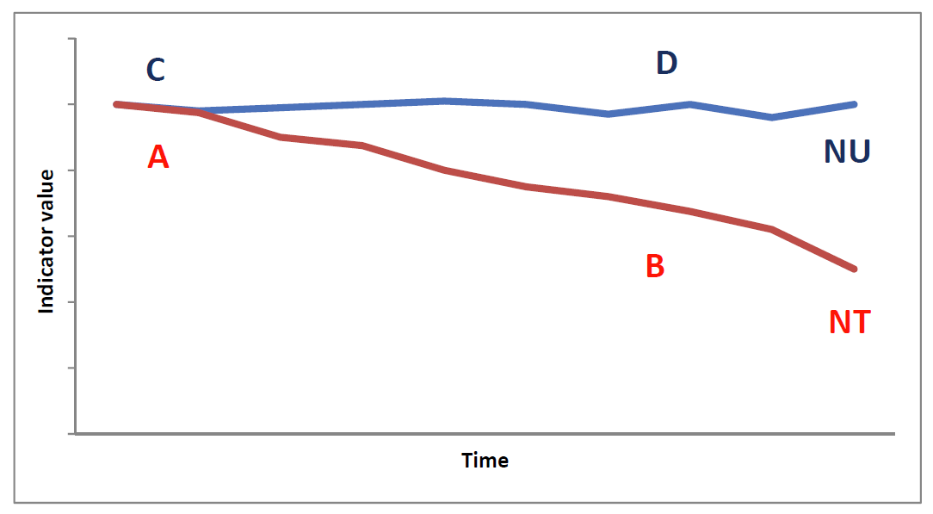
Opportunities for research
Med-Response is a timely innovation that could have potential major impact on the health care system
A natural experiment - generates research evidence that benefits NWT and also provide valuable lessons for other regions, especially potential replication in Nunavut
Clinical outcomes
Cost-effectiveness
Provider satisfaction
Community acceptance

Slide 12
Some preliminary results on
changes in travel pattern and costs
Government expenditures on medical travel continue to rise
Medical travel around 6% of total health department operating budget in NWT
Nunavut, with only 78% of NWT’s population, spent 3 x as much on medical travel, which accounts for 15-20% of health department budget [Note: there are no roads in Nunavut]
“Medical travel” includes medivacs, non-urgent transfers, and patient escorts

Slide 13
Focus on medevacs [air ambulance]
Review of medical travel database FY 2011, 2012, 2013, 2014, 2015 – need 2016 and 2017 as Med-Response launched only early in 2015
Preliminary outcome indicators to be monitored:
  Reduction in number and rate of medevacs
  Reduction in total cost and per trip cost
  Shift from medevac -> scheduled flights
  Reduction in “overflights” – direct from communities to tertiary centres
Identify community-level and system-level factors that determine medevac “hotspots”
Need separate study at recipient hospitals to determine post-transfer clinical outcomes

Slide 14
Questions posed by conference organizers
How was the program developed? √
What methods were used to support implementation and measure impact/success ? √
How was success defined? √
What is the evidence on the role of primary care in addressing health equity? X – not directly addressed
Can learnings be applied in different settings?
should be applicable to scattered small populations separated by long distances - but only resource rich health systems can afford expensive air travel

Slide 15
What contextual factors need to be taken into consideration for broader scale up/system reform? -
Not so much as scale up but replication in another jurisdiction; even if Med-Response turns out to be “successful” according to our indicators, transplanting it to Nunavut requires understanding of community-level factors (geography, burden of disease, social cohesion, etc) and system-level factors (workforce – training, turnover; governance)

