Slide 1
Caroline S. Blaum, MD, MS
March 2 ⁻ 3, 2017
Funded by the John A. Hartford Foundation and the Patient Centered Outcomes Research Institute (PCORI) Eugene Washington Engagement Award (#2870)

Slide 2
Affiliations and Disclosures
No disclosures
New York University Langone Medical Center
Diane and Arthur Belfer Professor of Geriatrics
Director, Division of Geriatric Medicine and Palliative Care
Caroline.Blaum@nyumc.org

Slide 3
Goals of this Presentation
Introduce Patient Priorities Aligned Care
Development
Making it happen

Slide 4
Multiple Chronic Conditions (MCC)
Individuals with ≥ 2 concurrent chronic conditions that collectively
adversely affect health status, function, or quality of life and…
require complex healthcare management, decision-making, or coordination
NQF multimorbidity definition

Slide 5
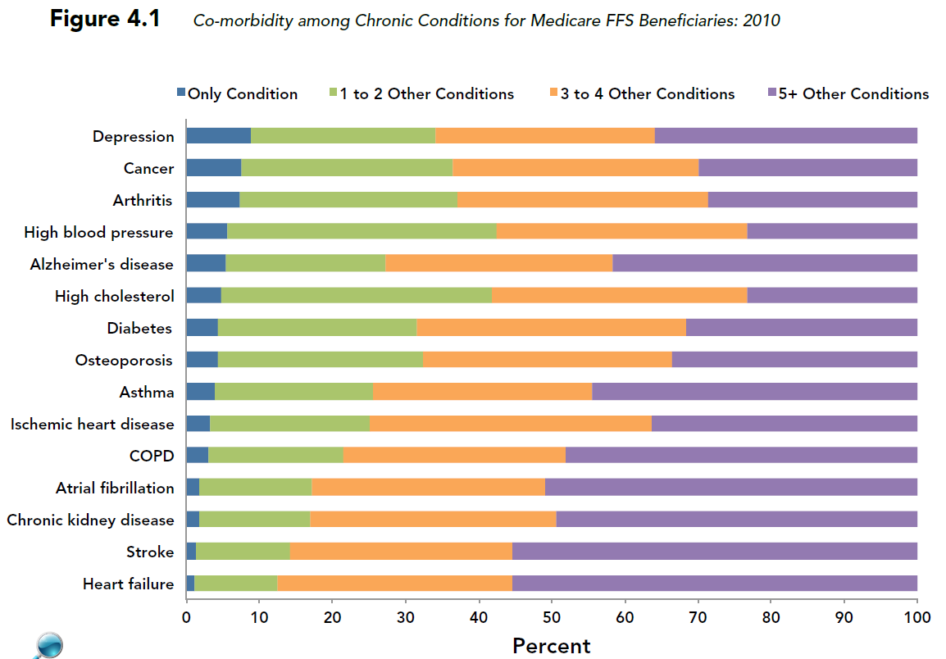
Slide Courtesy of R. Goodman, CDC
Notes:
Source: CMS 2012 Chartbook

Slide 6
What is the Problem?
Older adults with Multiple Chronic Conditions (MCC) get a lot of care that is:
Potentially harmful and of unclear benefit
Burdensome
Expensive
Fragmented across clinicians, settings, and conditions
May not be targeted at what matters to patients

Slide 7
Introducing Mr. T, an 83-year-old man with fatigue, decreased appetite, weakness
Previous heart attack Diabetes Hypertension Heart failure (EF 28%) Osteoporosis Depression | He thinks… his medications are causing a lot of his symptoms too much of his time involved in his health care

Slide 8
Disease-based care for Mr. T
Cardiologist: concerned about heart failure & blood pressure; ↑ β-blocker & statin, Consider implantable cardioverter defibrillator (ICD)
Endocrinologist: concerned about HgbA1C & fractures; start insulin, bisphosphonate
Psychiatrist: concerned about depression; ↓ or stop β-blocker, add another antidepressant
Primary Care: Concerned about BP & Hgb A1C metrics; navigate conflicting recommendations
Result for Mr. T: ~20 visits/month +blood draws; 12 medications →fatigue, weakness,↓ appetite; conflicting recommendations from his clinicians

Slide 9
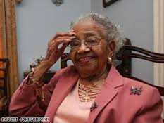
Solution is a move from…
Patient priority directed decision- making & care
Disease-based decision-making & care

Slide 10
Carealign:
Patient Priorities Care for persons with multiple chronic conditions
John A. Hartford Foundation (JAHF)
Patient Centered Outcomes Research Institute (PCORI)

Slide 11
Carealign Team
Care Align Team
Mary Tinetti
Caroline Blaum
Jessica Esterson
Denise Acampora
Rosie Ferris
Eliza Kiwak

Slide 12
The Carealign Planning Project
Launched: Dallas, April 2014 with 75 attendees
Convened: Over 18 month planning phase, ~150 patients, caregivers, 1° & specialty clinicians (MD, APRN), health system leaders, payers, health information technology, systems design, policy makers
Assembled: 35 of these individuals into advisory groups that met regularly over 15 months

Slide 13
Carealign planning project
Asked them:
To identify issues that needed to be addressed to improve care and outcomes of persons with multiple conditions
To design a feasible, sustainable approach that aligns care around what matters most to older adults with multiple conditions

Slide 14
Thank You
Over 150 people contributed to the development of aligned, patient goals-directed care for people with multiple chronic conditions. These included patients, caregivers, providers, policy makers, researchers, health system leaders, and funders.
We especially thank our Steering Committee:
Fred Masoudi
Michael Parchman
Eileen Sullivan-Marx
Gary Oftedahl
Libby Hoy
Phil Posner

Slide 15
What is Patient Priorities Care? Three Core Components
Patient’s health outcome goals & care preferences elicited & shared
Clinicians translate these goals into care options
All care aligned with patient’s health outcome goals within the context of care preferences

Slide 16
Example of health outcome goals
Outcomes patients want from their health care given their conditions, health trajectory, & life …
Specific, measurable, actionable, reliable, timebound (SMART) goals
Examples: Able to walk at > 2 block or 1 flight daily without stopping for SOB

Slide 17
What are care preferences?
Domains (examples) of care preferences**
Health care utilization (e.g. # visits, hospitalizations; clinicians; diagnostics)
Medication management (e.g., complexity; adverse effects; monitoring)
Self-management tasks (e.g., diet, exercise, check weights, bp, glucose)
Procedures (time, discomfort, anxiety, complications; time to recover)
** patient activity/workload; activities and consequences willing & able to tolerate to achieve outcomes; AKA care burden, treatment burden if unacceptable

Slide 18
Translating disease specific care into care based on patient priorities and preferences
Major trials are disease specific and evaluate disease specific outcomes
People with MCC are not usually in trials
Trials have minimal information on adverse events
Need new and different evidence:
Treatment effects on common goals (function, symptoms, survival) for persons with MCC
Need to consider trade-offs, uncertainty, trajectory and complexity

Slide 19
Patient health priorities aligned care most helpful for persons:
Appropriate for everyone
With multiple conditions and multiple clinicians
Getting conflicting recommendations
Feeling burdened by care
Uncertain benefit of guideline based care (see figure)

Slide 20
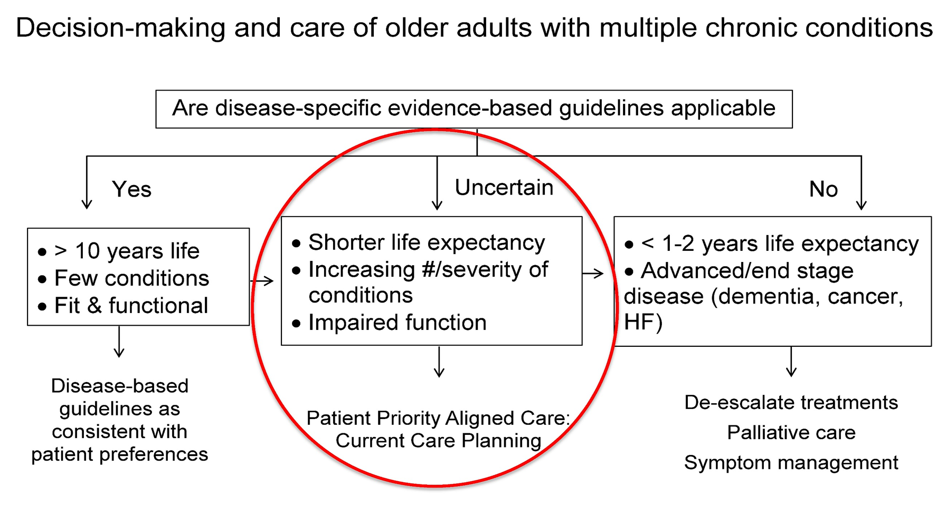

Slide 21
A year with Mr. T. and patient priority care
Before patient priority care
With patient priority care
9 visits/month; fewer clinicians
8 medications, less tired, weak
Check glucose weekly
Specialists offer only tests & procedures consistent with his priorities (no ICD)
Walks 2 blocks to his friend’s house; babysits 3 y.o. grandson 4 hours/ week
~ 20 visits /month
12 medications →tired, weak
Check glucose daily, monthly blood tests
Specialists want more tests & procedures (ICD)
Can’t do what wants

Slide 22
Making Patient Priority Care Happen
Test approach (aligned, priorities-based care) in the real world for feasibility and effect size (JAHF, Moore Foundation)
Develop technical assistance
Pilot in clinical situations
Create demand and support for patient goals (priorities) directed care among health systems, clinicians, patients, caregivers - messaging and communication (RWJ)
Develop a research agenda and network to prepare PPC for a large comparative effectiveness trial (PCORI)

Slide 23
Special Thanks to the Patient Priority Care Coordinated Effort Funders
Patient-Centered Outcomes Research Institute (PCORI) Eugene Washington PCORI Engagement Award
The John A. Hartford Foundation
Robert Wood Johnson Foundation
Gordon and Betty Moore Foundation

Slide 24
ProHealth Primary Care and Bristol Cardiologists: Patient Health Priorities Care
September, 2016

Slide 25
Pilot in Primary Care
Identify appropriate patients with MMC and invite them to participate
Develop training materials and prepare facilitators, patients, and providers
Develop clinic workflow in primary care and specialty clinic
Implement patient priorities care
Evaluate process, clinical and utilization outcomes

Slide 26
Practice Change Framework
Supportive leadership
Clinical champion(s)
Decision support/preparation
Team care
Workflow support/HIT
Collaborative learning
Feedback and continuous improvement (PDSA)

Slide 28
Getting Ready for Patient Priority Care PCORI Engagement Award

Slide 29
Patient Priority Care Research Agenda and Community: Specific Aims
Design a research agenda in patient centered outcomes research (PCOR) and comparative effectiveness research (CER)
focuses specifically on translating disease specific care into patient priorities care.
Begin the alignment of primary and specialty care around patients health outcomes goals and preferences with primary care and cardiology; engage surgery as the next specialty
Develop a nationwide research network that includes patients, caregivers, clinicians, researchers and healthcare systems to implement and evaluate Patient Priority Care.

Slide 30
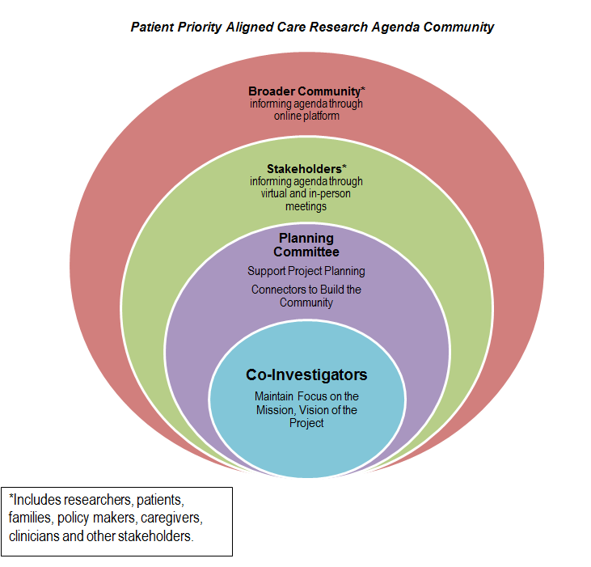
Patient Priority Aligned Care Research Agenda Community

Slide 31
Research Themes from the Consensus Conference
What outcomes do we want from PPC and how do we measure them?
How do we communicate tradeoffs and uncertainly for Patients and Providers?
Who is the best person to help patients and caregivers construct priorities and preferences?
How can we incentivize providers to deliver Patient Priorities Aligned Care?
What HIT/EHR tools can best assist with communication of patient priorities and preferences among different providers and also with patients and caregivers?

Slide 32
Patient Priorities Care Publications
Tinetti ME, Esterson J, Ferris R, Posner P, Blaum CS. Patient Priority-Directed Decision Making and Care for Older Adults with Multiple Chronic Conditions. Clin Geriatr Med. 2016; 32(2):261-75
Tinetti ME, Naik AD, Dodson JA. Moving From Disease-Centered to Patient Goals–Directed Care for Patients With Multiple Chronic Conditions: Patient Value-Based Care. JAMA Cardiol. 2016;1(1):9-10.
Ferris R, Blaum C, Kiwak E, Austin J, Esterson J, Harkless G, Oftedahl G, Parchman M, Van Ness PH, Tinetti ME. Perspectives of Patients, Clinicians, and Health System Leaders on Changes Needed to Improve the Health Care and Outcomes of Older Adults With Multiple Chronic Conditions. Journal of Aging and Health. 2017 Feb 1:0898264317691166.
Development of a clinical process for eliciting older adults’ health outcome goals and care preferences (In prep)

