Slide 1

Advancing the Science of Transformation in Integrated Primary Care:
Informing Options for Scaling-up Innovation
A Cross-Border Symposium
Washington, DC
March 2-3, 2017

Slide 2

















Thank to our partners and sponsors

Slide 3
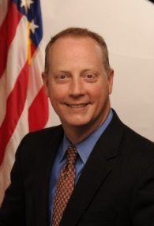
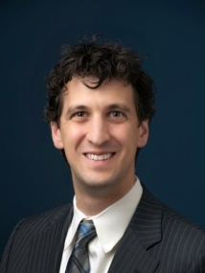

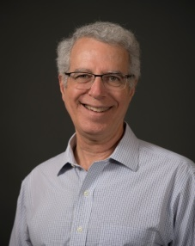
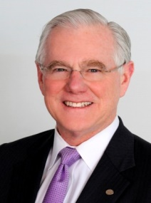

An RGC/ABFM Embassy Series Event:
Alternative Payment Models & Primary Care Delivery in the United States and Canada
Patrick H. Conway, MD, MSc
Joshua Tepper, MD, MPH, MBA
Andrew Bazemore, MD, MPH
Session Chair
Rick Glazier, MD, MPH
Michael McGinnis, MD, MPP
#CrossBorderPC2017

Slide 4
Advancing the Science of Transformation in Integrated Primary Care:
Informing Options for Scaling-up Innovation
Alternative Payment Models
March 2, 2017
Rick Glazier, MD, MPH, CCFP, FCFP
Senior Scientist, Institute for Clinical Evaluative Sciences
Scientist, Centre for Research on Inner City Health, St. Michael’s Hospital
Staff Family Physician, St. Michael’s Hospital
Professor, Family and Community Medicine, University of Toronto
Notes:
Display slides 1, 2, 3, 5, 7, 9, 11, 12, 13, 15, 19, 24

Slide 5

Canadian Health Care, Explained: 14 Systems
hospitals
global budget
}
long-term care
number of beds
doctors
FFS
Paid from separate budgets
Primary care physicians
few accountabilities
weak measurement
few networks
little governance
not many teams
mostly FFS
groups and solo
→ few connections, perilous transitions
→ little support for care coordination
Payment

Slide 6

Why Change is Needed
“Burning Platform is a business lexicon that emphasizes immediate and radical change due to dire circumstances.”
http://www.problem-solving-techniques.com/Burning-Platform.html
Triple aim

Slide 7
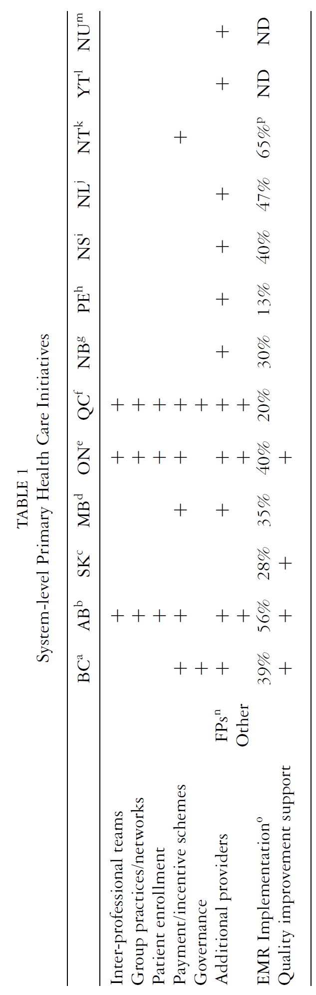
Primary Care Transformation – Canada
Hutchison B, Levesque JF, Strumpf E, Coyle N. Primary health care in Canada: systems in motion. Milbank Q. 2011;89(2):256-88. doi: 10.1111/j.1468-0009.2011.00628.x.

Slide 8
Primary Care Transformation – Canada
Hutchison B, Levesque JF, Strumpf E, Coyle N. Primary health care in Canada: systems in motion. Milbank Q. 2011;89(2):256-88. doi: 10.1111/j.1468-0009.2011.00628.x.
Reforms

Slide 9
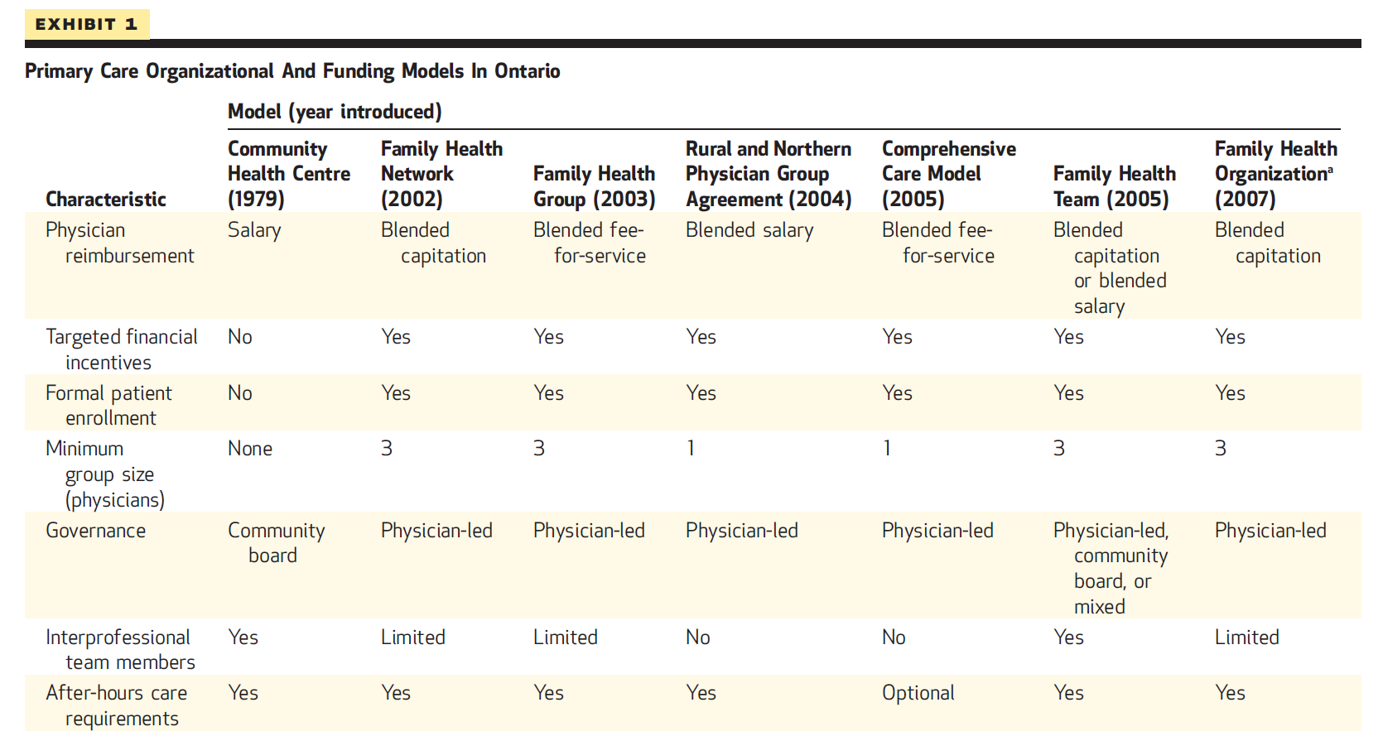
Ontario’s Large-Scale Experiment
Hutchison B, Glazier RH. Health Affairs 2013:32:695-703

Slide 10
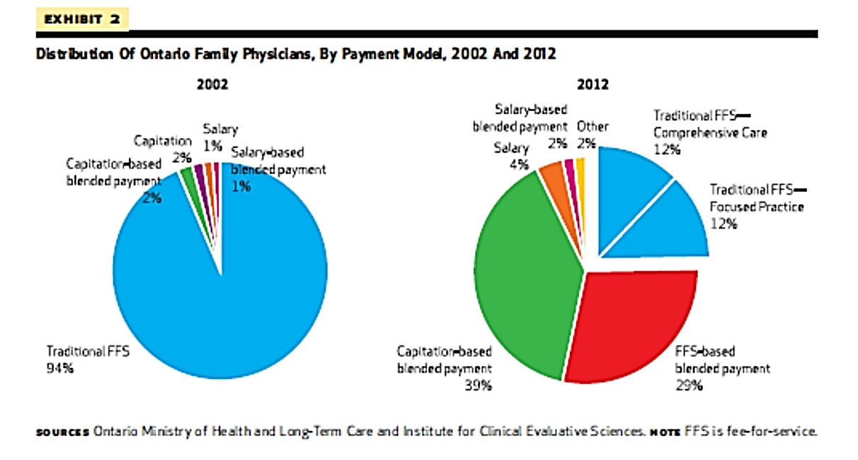
Transformation in Physician Payment
Hutchison B, Glazier R. Health Affairs 2013;32:1-9

Slide 11
Payments
Successes

Slide 12



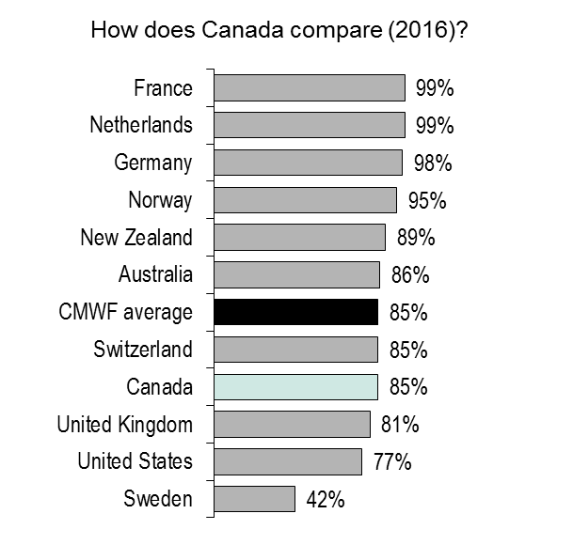
Most Canadians have a regular doctor or place where they receive care
Is there one doctor you usually go to for your medical care?
85% of Canadians
have a usual doctor
93% of Canadians
have a usual doctor or place
they go to for medical care
Above average
Same as average
Below average
2016 Commonwealth Fund Survey
Notes:
Click to add notes

Slide 13




Canadians report better experiences with their regular doctors than 11-country average
When you need care or treatment, how often does your regular doctor or the medical staff you see always | Canada | CMWF average
Know important information about your medical history
Spend enough time with you
Involve you as much as you want in decisions about your care and treatment
Explain things in a way that is easy to understand
63%
57%
57%
55%
63%
56%
70%
63%
Above average
Same as average
Below average
2016 Commonwealth Fund Survey

Slide 14
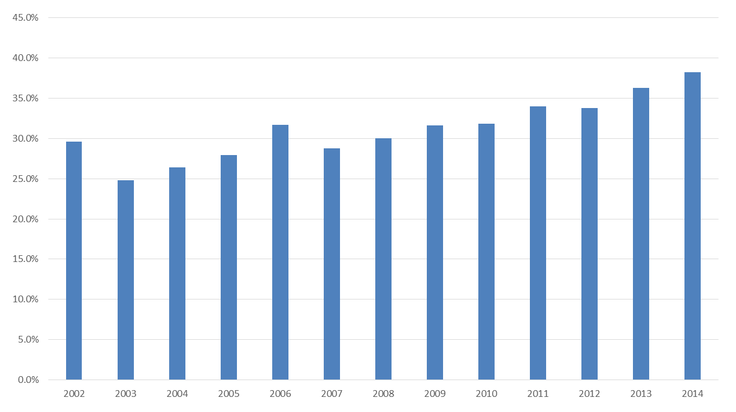
Successes of the Transformation
Medical student choice for family medicine
Canadian Resident Matching Service
Challenges

Slide 15
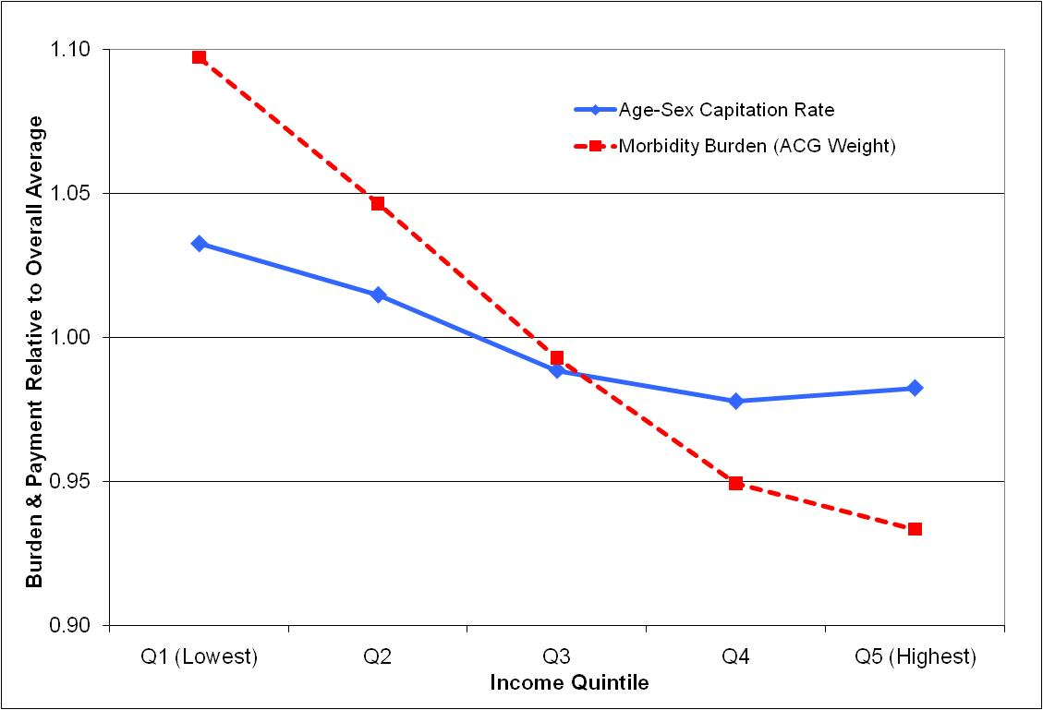
Capitation Payments
    Sibley LM, Glazier RH. Health Policy. 2012;104(2):186-92.

Slide 16
Those Left Behind
Kiran T, et al Ann Fam Med 2016;14:517-525.
BC, Quebec

Slide 17
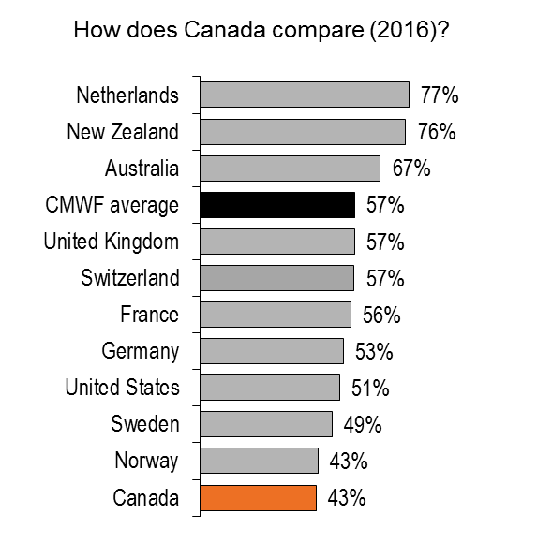
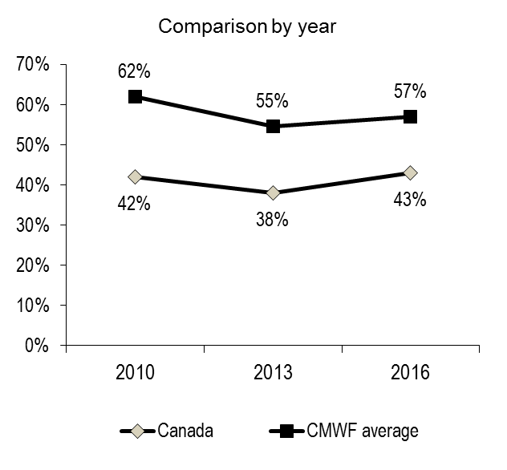
Same- or next-day appointments are difficult to get in Canada
Last time you were sick or needed medical attention, how quickly could you
get a same- or next-day appointment to see a doctor or a nurse?
Above average
Same as average
Below average
2016 Commonwealth Fund Survey
After hours
Notes:
Note
There is a slight methodological difference in the 2016 result, as it excludes respondents who did not seek a medical appointment. This information was not available in earlier years.

Slide 18

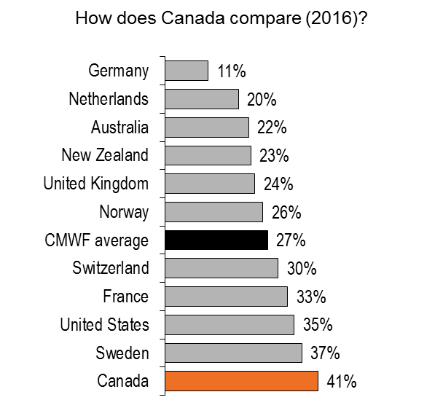
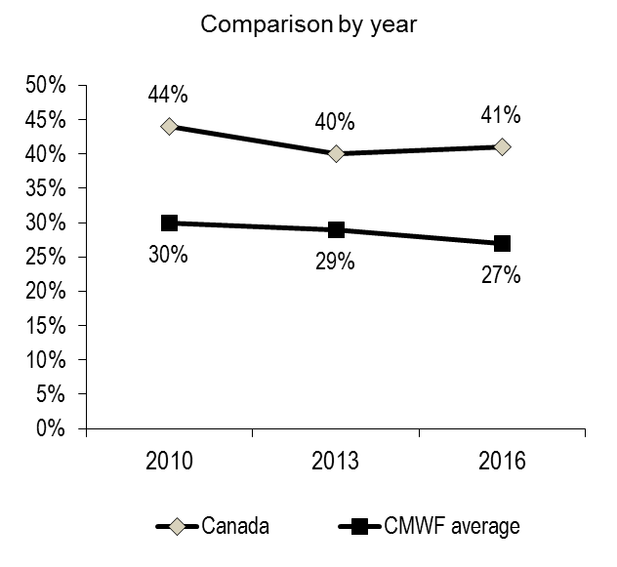
Canadians are high users of emergency departments
Adults who used an emergency department in the past 2 years
Above average
Same as average
Below average
2016 Commonwealth Fund Survey
Scaling up

Slide 19

Parting Words
“Primary Care In Canada: So Much Innovation, So Little Change”
Brian Hutchison, Julia Abelson, and John Lavis
Health Affairs 2001
“More than anything else though, what Canada needs to fix its systemic health-care woes is to create a semblance of a system.”
André Picard, Globe and Mail 2017

Slide 20
Reaction
Dr. Michael McGinnis

